Slide 1

Establishing Keystone’s “fingerprint” through targeted
Nuclear Magnetic Resonance (NMR)

Slide 2
Overview and Rational
Nuclear Magnetic Resonance (NMR) spectroscopy represents a cutting-edge analytical technique that can offer unparalleled insight into the molecular composition and consistency of biotics products pre and post processing.
In this study, we utilized both untargeted NMR and targeted NMR to meticulously evaluate and demonstrate how our flagship postbiotic product, Keystone, can withstand the high temperature processing requirements seen in gummy production.
Through sophisticated data analysis techniques, including Principal Component Analysis (PCA) and Hierarchical Clustering Analysis (HCA), we are able to quantitatively compare and contrast the molecular profiles of Keystone before and after high heat processing.
By establishing Keystone’s “fingerprint” through targeted NMR, we are able to demonstrate Keystone’s presence post processing in a variety finished goods such as gummies.
These analyses not only affirm our commitment to innovation and excellence but also highlight the strides we've made in working hand in hand with our partners to unlock new application opportunities. This study also underscores the pivotal role of NMR in our continuous effort to surpass industry standards and deliver intentional and functional products of unmatched quality.

Slide 3
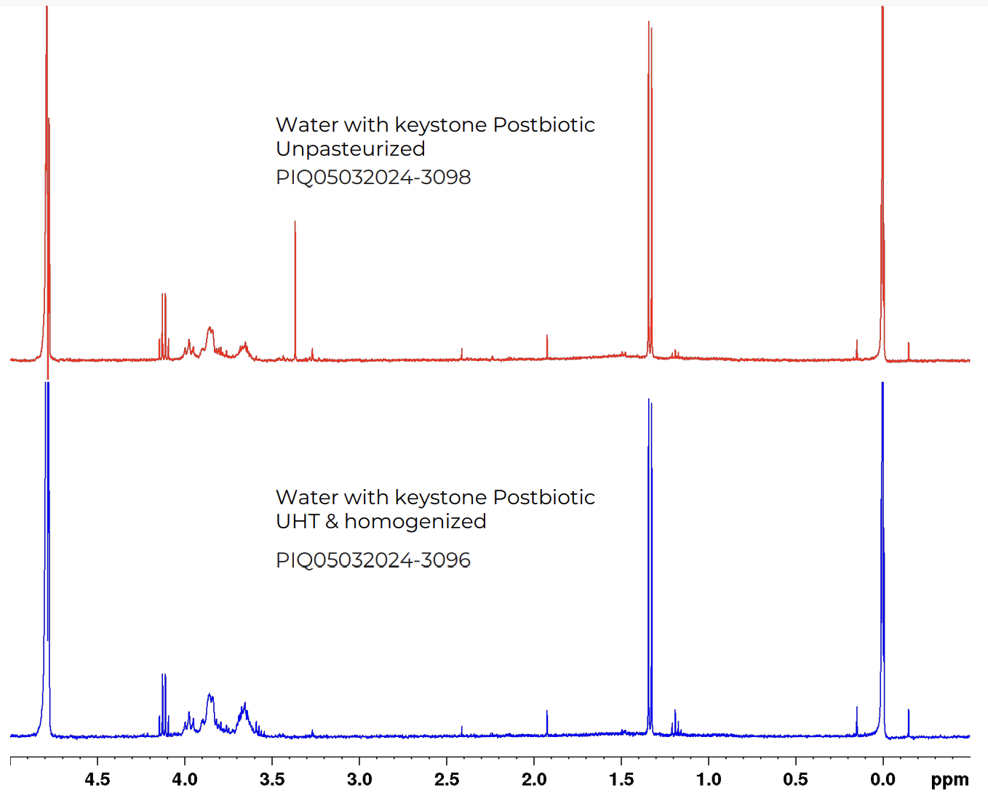
Keystone pre & post UHT processing in water
Untargeted NMR Spectrums
Talking points:
High similarity across samples
Each peak is a unique metabolite. Height of a peak correlates with quantity.

Slide 4
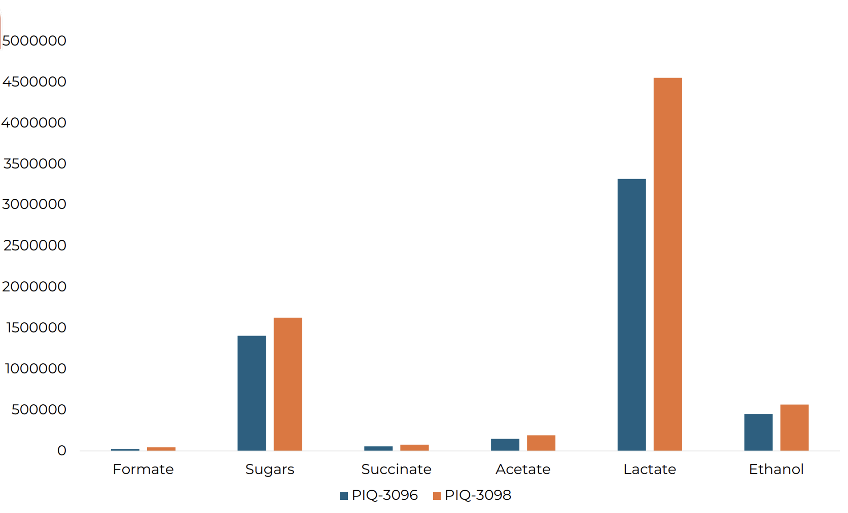


Keystone pre & post UHT processing
Targeted NMR –Keystone’s fingerprint.
Talking points:
Keystone’s fingerprint markers withstand UHT and Homogenization
Unpasteurized
Homogenized & Pasteurized

Slide 5
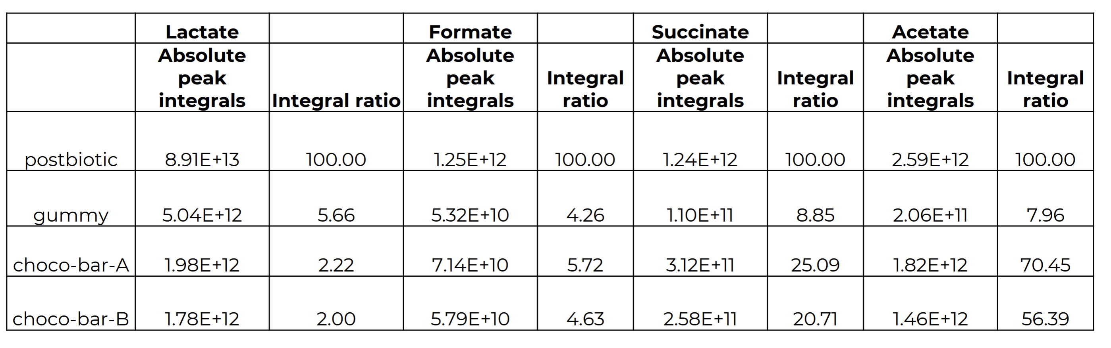
Validating Keystone’s presence in finished goods
Targeted NMR – Keystone’s fingerprint.
Talking points:
Keystone’s key markers present in gummies & Chocolate bars
(Concentration of fingerprint markers close to inclusion rate of 5% for gummies)

Slide 6
Authentication via Polymerase Chain Reaction (PCR)
Polymerase Chain Reaction (PCR) is a highly sensitive and specific technique that can be used to identify and quantify microbial strains in complex food matrices.
In this study, strain-specific primers were used to track the integrity and presence of Keystone Postbiotic™ in various processing conditions, and a PCR-based fingerprinting method was developed to confirm its presence in final goods.
PCR utilized primers targeting unique genetic markers of Lactobacillus rhamnosus and Lactobacillus plantarum present in Keystone Postbiotic™. DNA was extracted from finished product samples, followed by PCR to detect these strains.
Finished products were examined using gel electrophoresis to confirm successful amplification and were subsequently submitted for Sanger sequencing to validate the strain identities.
Through PCR, we established a robust and sensitive method that reliably detects and confirms the presence of Keystone Postbiotic™ in finished products. This approach also ensures the integrity of Keystone Postbiotic™ is maintained across various formulations and processing conditions, providing a consistent and sensitive verification tool for quality control

