Slide 1

Improving health through microbiome innovation
FOR CLIENT NAME HERE
DATE

Slide 2


“Improving health through microbiome innovation”
Function-first science that opens nature’s toolbox to bring inspired microbiome solutions to our partners.
“I feel the effect”

Slide 3







Platforms build upon foundation of science
Supporting specific needs states of the target population
GUT-BRAIN HEALTH
SPORTS RECOVERY
HEALTHLY AGING
stress
mood
sleep
gut permeability
soreness
energy/stamina
joint health
Inflammation
muscle maintenance
WOMENS HEALTH
HEALTHY METABOLISM
COMPANION ANIMAL
menopausal support
stress/mood
hormone support
healthy weight
blood glucose
satiety
anxiety
aggression
sleep
VERB’S VISION
Create a metabolite leaderboard targeting key health conditions
Technologies are modular. Standalone, stacked with other Verb technologies, or integrated with customer ingredients
North Star: Efficacy. Consumer need to "feel the effect"
PAGE 4

Slide 4

Keystone Postbiotic®
for foundational gut microbiome health

Slide 5

Why we are excited …
Strains and grains work together to revitalize one's existing beneficial keystone gut microflora
Postbiotic for precision microbiome health
No major shift in diversity, endogenous “good” microbes go up and the “bad” go down, able to modulate Akkermansia
No GI distress/side effects
Consistent MOA from in vitro data to pilot to clinical trials results
MOA defined: Microbiome to butyrate to stress biomarkers to inflammatory to “feel the effect”
Notes:
Precision Microbiome modulation
Good bacteria up/bad bacteria down -> not broad increase in both good and bad
Decrease in gas/bloating
Low dose
Trending changes in fecal SCFA concentrations
Acetate (p=0.08)
Butyrate (p=0.28)

Slide 6





Keystone Postbiotic®
MULTI BENEFIT
LOW DAILY DOSE
SUPPLY CHAIN
Manufactured in USA
Scaled to meet demand
Non-GMO Project Verified
Allergen-free
Kosher
Self-affirmed GRAS
Supports microbiome balance
Supports emotional wellbeing & mood
Supports GI health and immune performance
Gas & Bloat relief
Suggested dose:
300 mg daily
=
Notes:
Refer to Purity IQ NMR and PCR data to show traceable metric and reproduceablity of Keystone Postbiotic

Slide 7

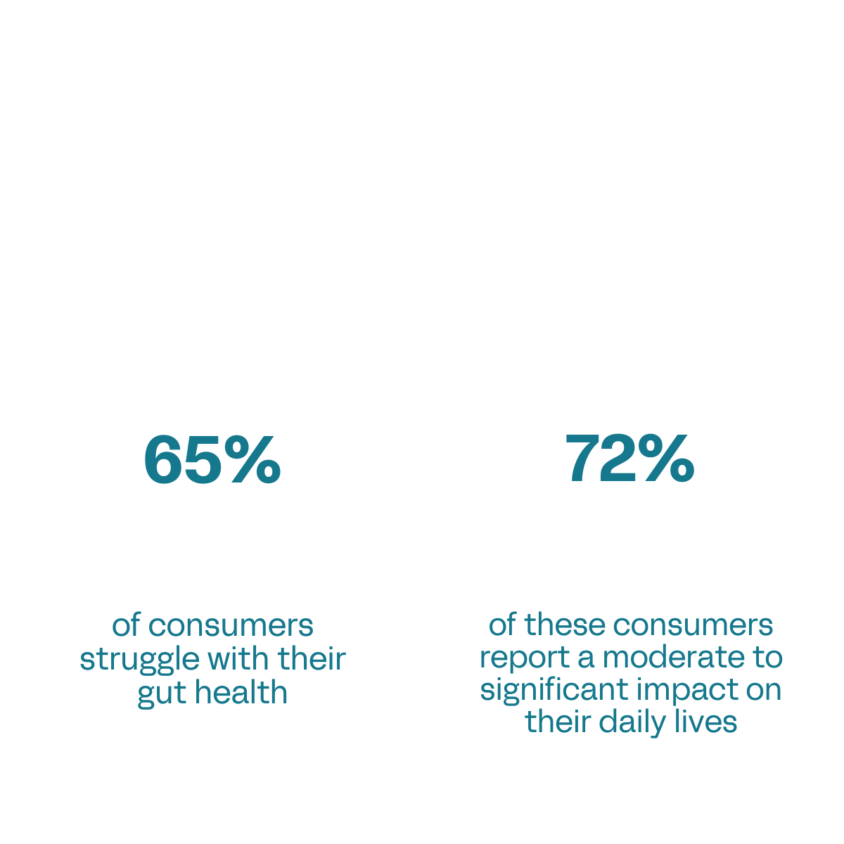
Gut health concerns are a daily struggle for many consumers
Source: Verb Biotics 2024 Consumer Health Survey

Slide 8
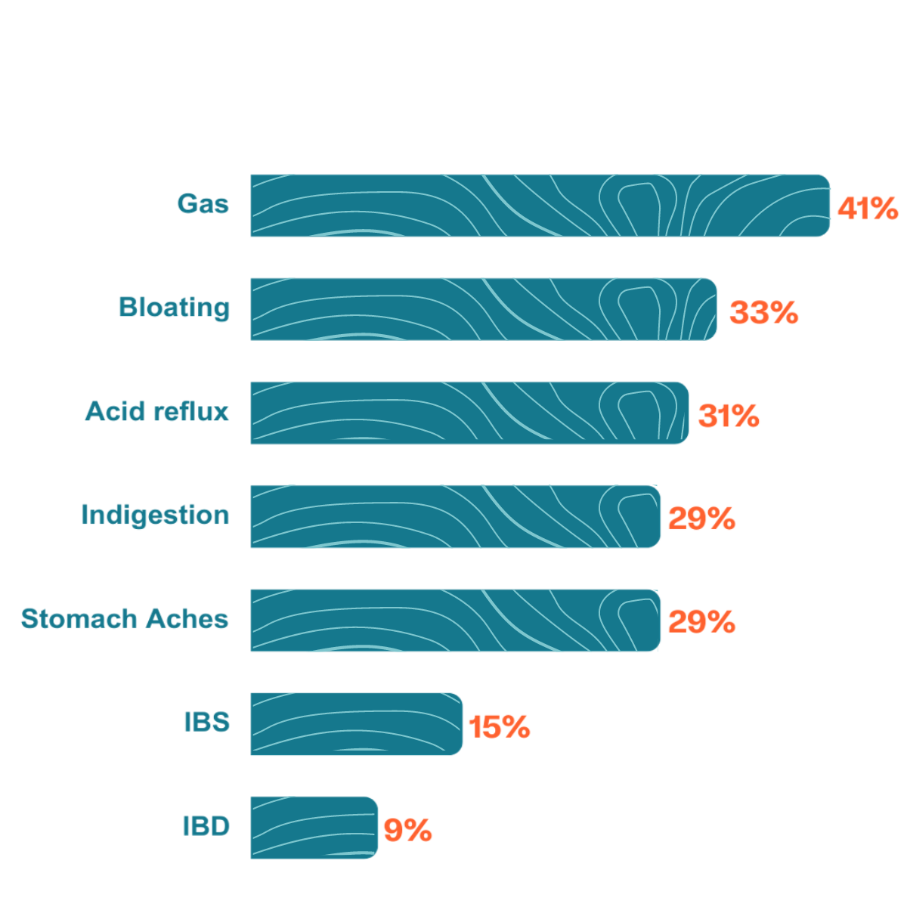
Percent of consumers who experience the following symptoms
Source: Verb Biotics 2024 Consumer Health Survey

Slide 9






Function first, intentional design
STRAIN & SUBSTRATE SELECTION
HEALTH
INDICATION
MECHANISMS
OF ACTION
Regulatory
Clinicals
Scale
GI Distress
3 synergistic MOAs
Lactobacillus probiotic strains fermented on oats
Shelf-stable
postbiotic for food, beverage & supplement brands
Notes:
keep

Slide 10
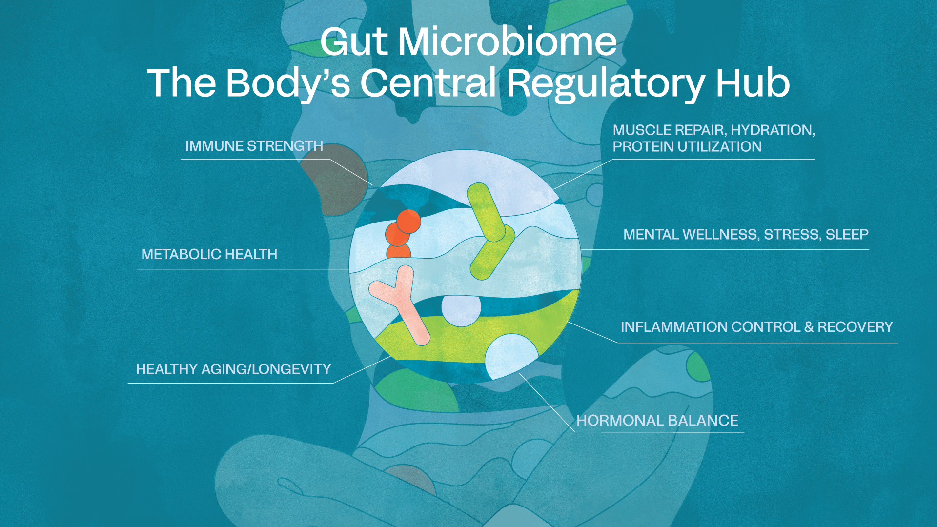

Slide 11

Keystone microbes have a big role in our health...
Central role and outsized influence in maintaining the stability, integrity (tight junctions), and function of the gut environment
Suppress the overgrowth of pathogens
Deliver metabolites (acetate, butyrate and propionate)
Often anaerobic -> difficult to isolate/manufacture/formulate

Slide 12
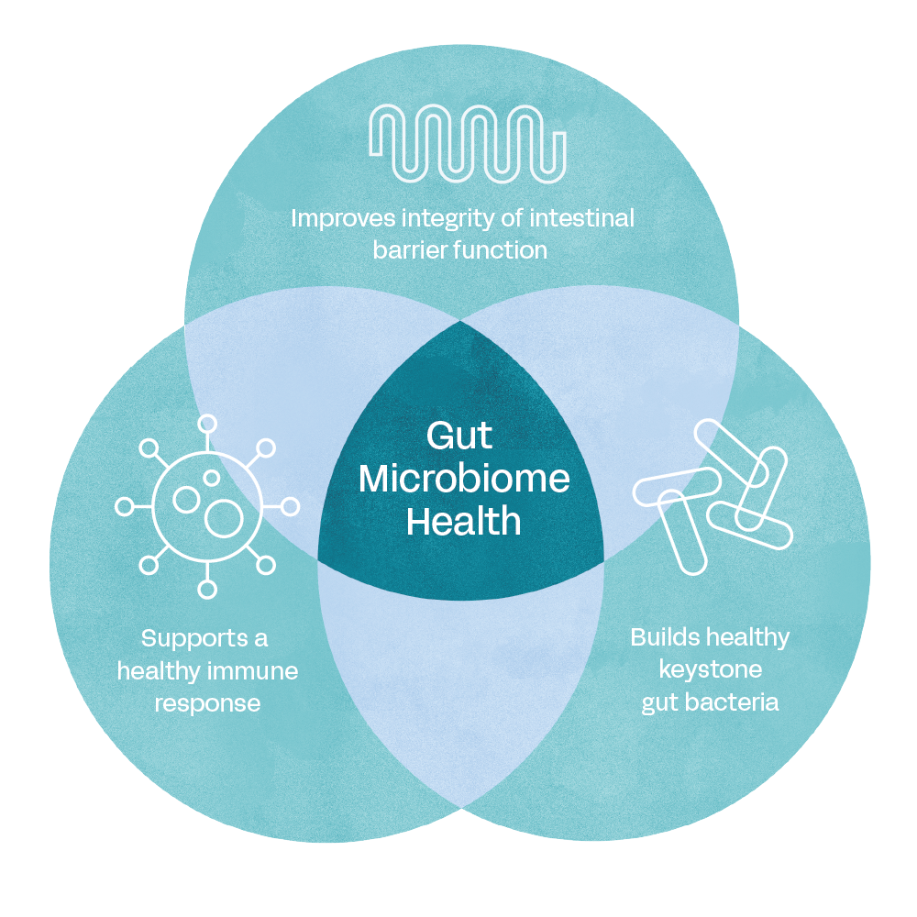
Three synergistic mechanisms of action
Notes:
Gas and bloating is the end result, these are the MOA’s that we want the product to do.

Slide 13

Why oats for the substrate?
Oats have a unique composition of beta-glucans, polyphenols, and other phytochemicals
  Beta-glucans > function as a prebiotic to boost gut health
  Polyphenols (Avenanthramides) > act as signaling molecules to modulate inflammation
Oat compounds induce gene expression in the bacteria to help regulate gut barrier function, modulate inflammation and cross feed members of the microbiome.
Notes:
Oats stimulate certain genes during the fermentation of Keystone

Slide 14


A NEW APPROACH
A new type
of postbiotic utilizing fermentation
MICROBES
Improve immune health
& gut barrier integrity
OATS
Improve immune health &
aids keystone bacteria linked
to a healthy gut.
FERMENTATION
Stimulates biotransformation of botanicals & production of metabolites
DELIVERS FUNCTION-SPECIFIC METABOLITES
Notes:
Fermented foods are products made through microbial action and the enzymatic conversion of food components.
Replace with Brooke’s version

Slide 15
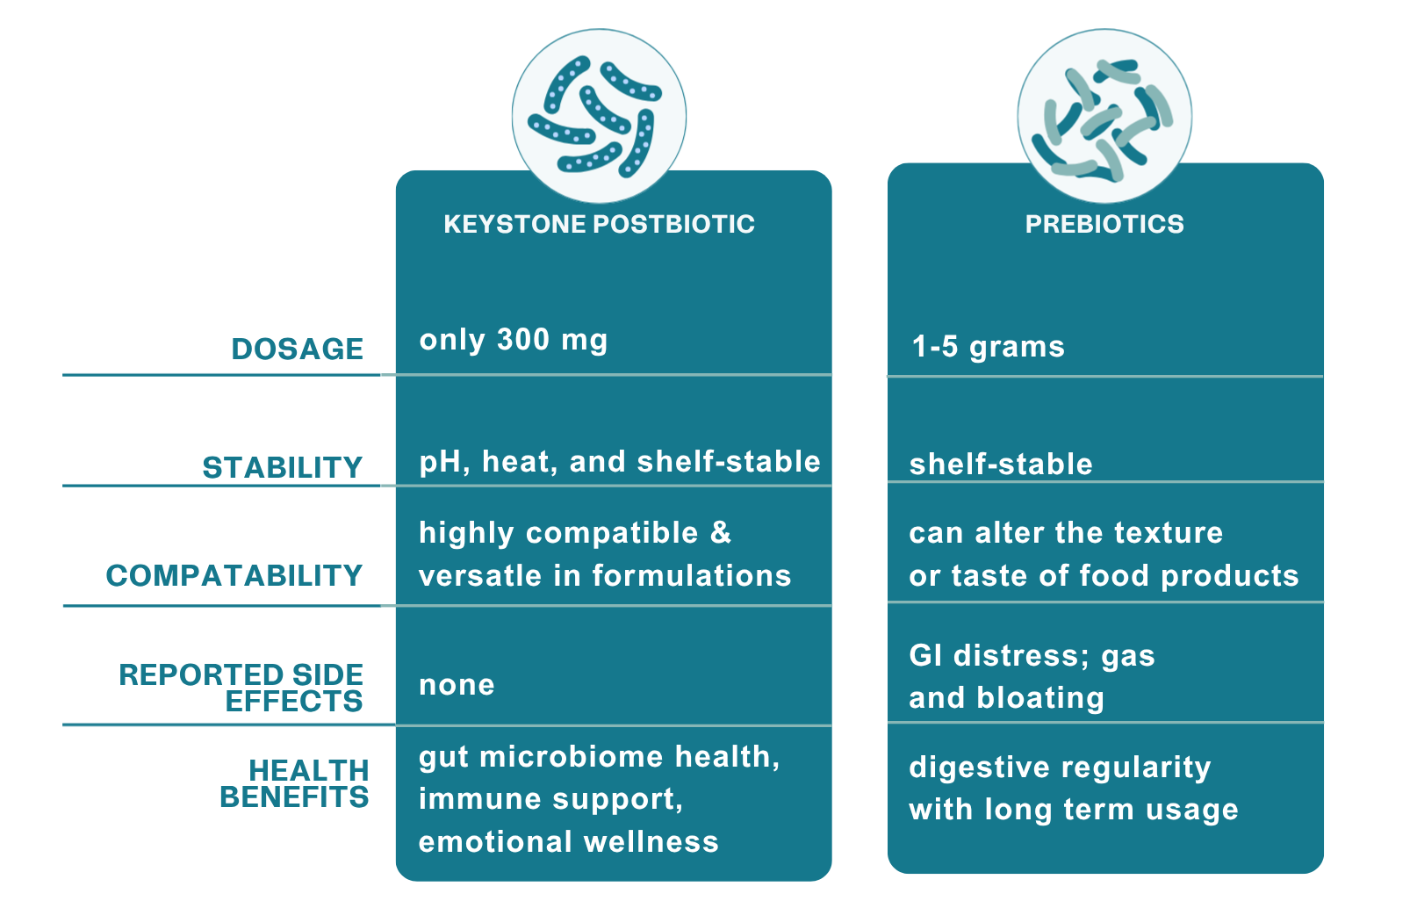
Postbiotics:
Intentionally inactivated microorganisms and/or their components that provide health benefits to the host
Only 300 mg
1-5 grams
pH, heat, and shelf-stable
Highly compatible & versatile in formulations
Can alter the texture or taste of food products
GI distress, like gas and bloating
None!
Low; prebiotics are widely available
Gas & bloating relief, barrier integrity, immune support
Digestive regularity with long term usage
PAGE 15

Slide 16

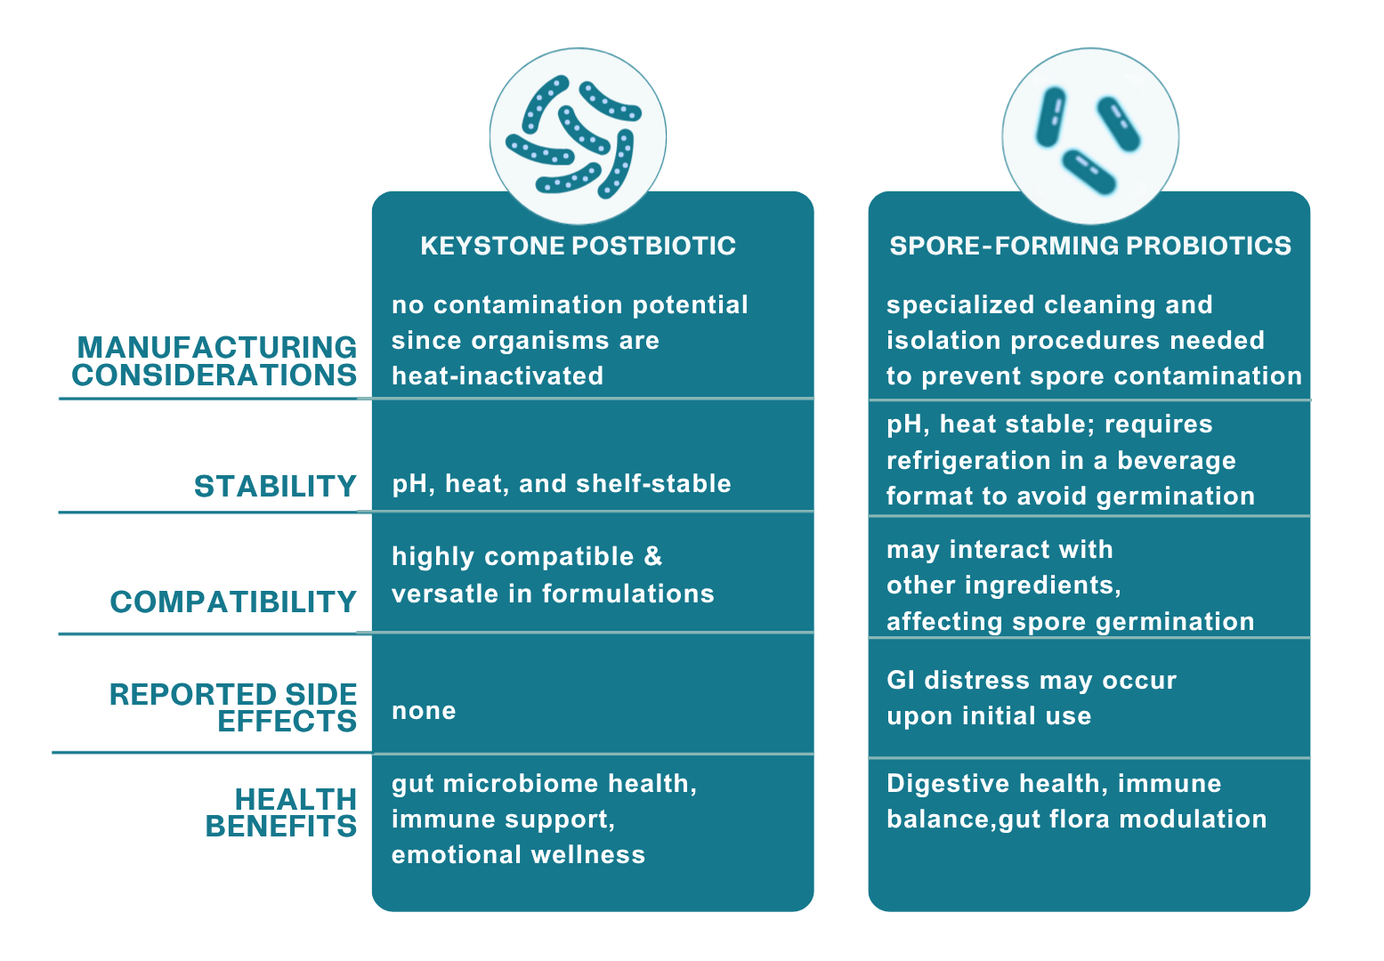
PAGE 16

Slide 17
In vitro Data
Keystone Postbiotic

Slide 18
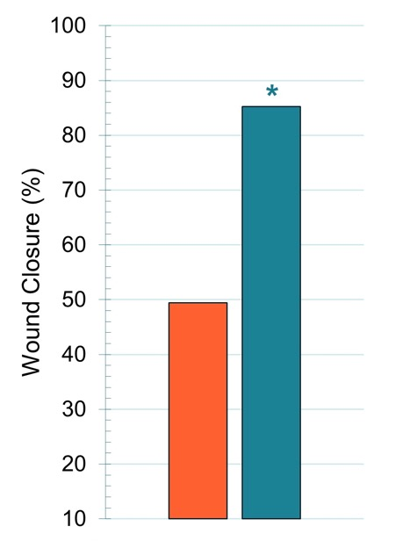
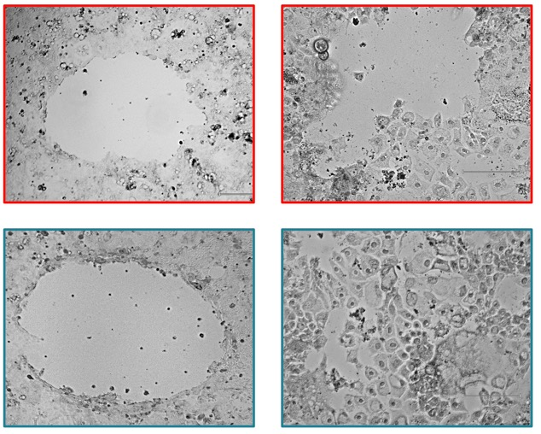
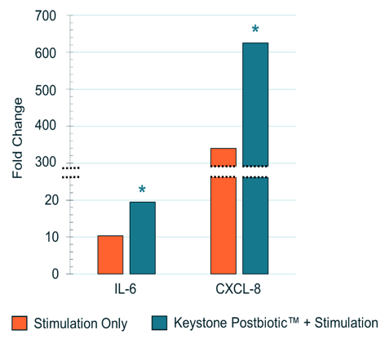
Supports foundational intestinal barrier function
0 h
24 h
Control
Keystone
Keystone Postbiotic increased chemokine production
Control
Keystone Postbiotic®
Notes:
These two strains have been shown to regulate the immune system. Took intestinal epithelial cells and added Keystone. We saw an increase in two chemotaxic cytokines or chemokines, IL-6 and CXCL-8. Initially it sounds like these markers are inflammatory, but we know from the literature and work done on these bacterial strains that we will see an increase in these cytokines. They aren’t involved in inflammation at all, but rather they are involved in maintaining a healthy intestinal epithelium. We see an increase in these signal molecules, so the next step was to look at wound healing assays.

Slide 19

Intestinal Epithelium
TEER 24h
*
*
Supports foundational intestinal barrier function
No Stimulation
Stimulation Only
Keystone + Stimulation

Slide 20

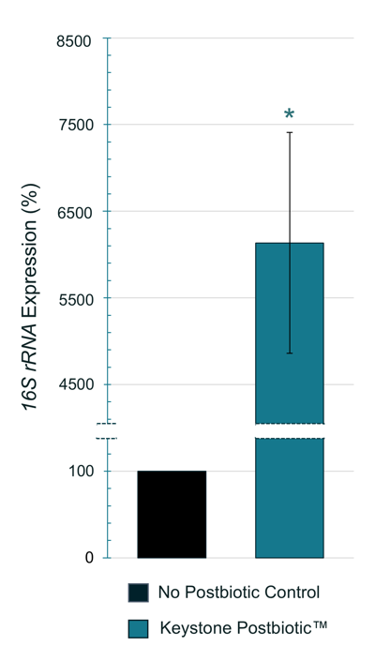

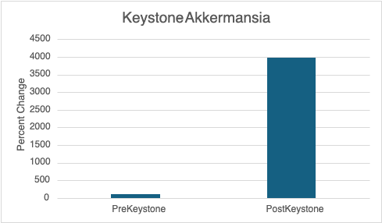
Supports keystone gut bacteria
Initial data supports human clinical #2
[
In the human pilot study, Keystone significantly
increased endogenous Akkermansia levels.
[
Supplementation with Keystone Postbiotic increased the endogenous Bifidobacterium population of human fecal flora 54 times
PAGE 20
Based on a gene-based analysis targeting a conserved DNA sequence unique to Bifidobacterium.
Notes:
To better understand how Keystone Postbiotic™ can affect the proliferation of Bifidobacterium in the human intestine, we developed a human fecal-based media seeded with human stool (n=3 donors) to quantify the Bifidobacterium population after 48 hour anaerobic incubation. Measurements of Bifidobacterium were done by quantitative polymerase chain reaction (qPCR) to determine the amount of Bifidobacterium DNA present before and after stimulation with Keystone Postbiotic™. The original Bifidobacterium population was stimulated 54-fold by Keystone Postbiotic™. The inclusion of grapeseed extract with Keystone Postbiotic™ was more supportive toward the fecal Bifidobacterium population which had a 369-fold increase. In vitro studies demonstrated that Keystone Postbiotic™ promotes the proliferation of Bifidobacterium spp., creating the foundation of numerous health-improving effects.

Slide 21
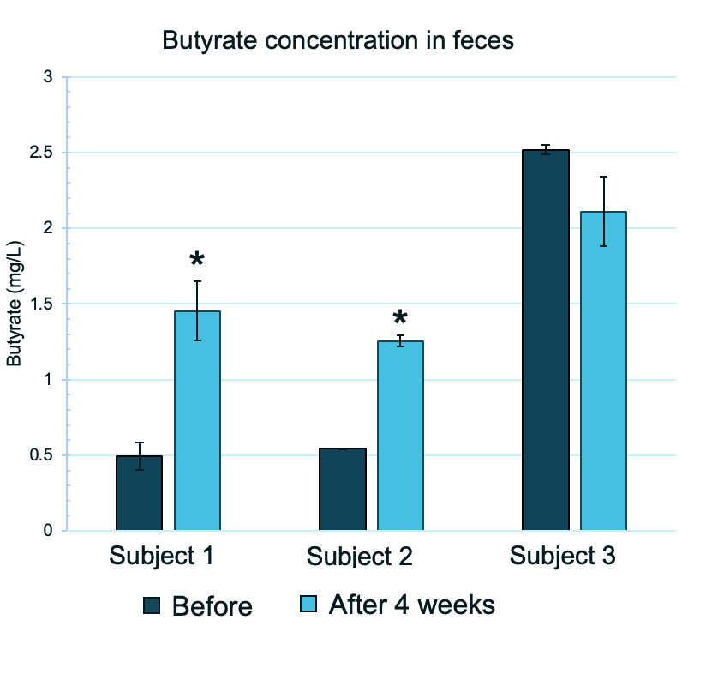
Increases butyrate levels
[
Keystone increased fecal butyrate in subjects on a Western Diet
PAGE 21
Notes:
To better understand how Keystone Postbiotic™ can affect the proliferation of Bifidobacterium in the human intestine, we developed a human fecal-based media seeded with human stool (n=3 donors) to quantify the Bifidobacterium population after 48 hour anaerobic incubation. Measurements of Bifidobacterium were done by quantitative polymerase chain reaction (qPCR) to determine the amount of Bifidobacterium DNA present before and after stimulation with Keystone Postbiotic™. The original Bifidobacterium population was stimulated 54-fold by Keystone Postbiotic™. The inclusion of grapeseed extract with Keystone Postbiotic™ was more supportive toward the fecal Bifidobacterium population which had a 369-fold increase. In vitro studies demonstrated that Keystone Postbiotic™ promotes the proliferation of Bifidobacterium spp., creating the foundation of numerous health-improving effects.

Slide 22
Human Clinical Data
Keystone Postbiotic

Slide 23
Keystone Postbiotic® human pilot study design
DESIGN
DURATION
SUBJECTS
ARMS
SITE
Randomized, double-blind
4 weeks
Healthy
Male & Female
Age 18-65
300 mg Postbiotic (n = 10)
USA
Endpoints:
  Fecal SCFAs | Changes in microbiome | GI Symptoms Rating Scale (GSRS) | Quality of Life Questionnaire (SF-36) | Physical Activity Questionnaire

Slide 24
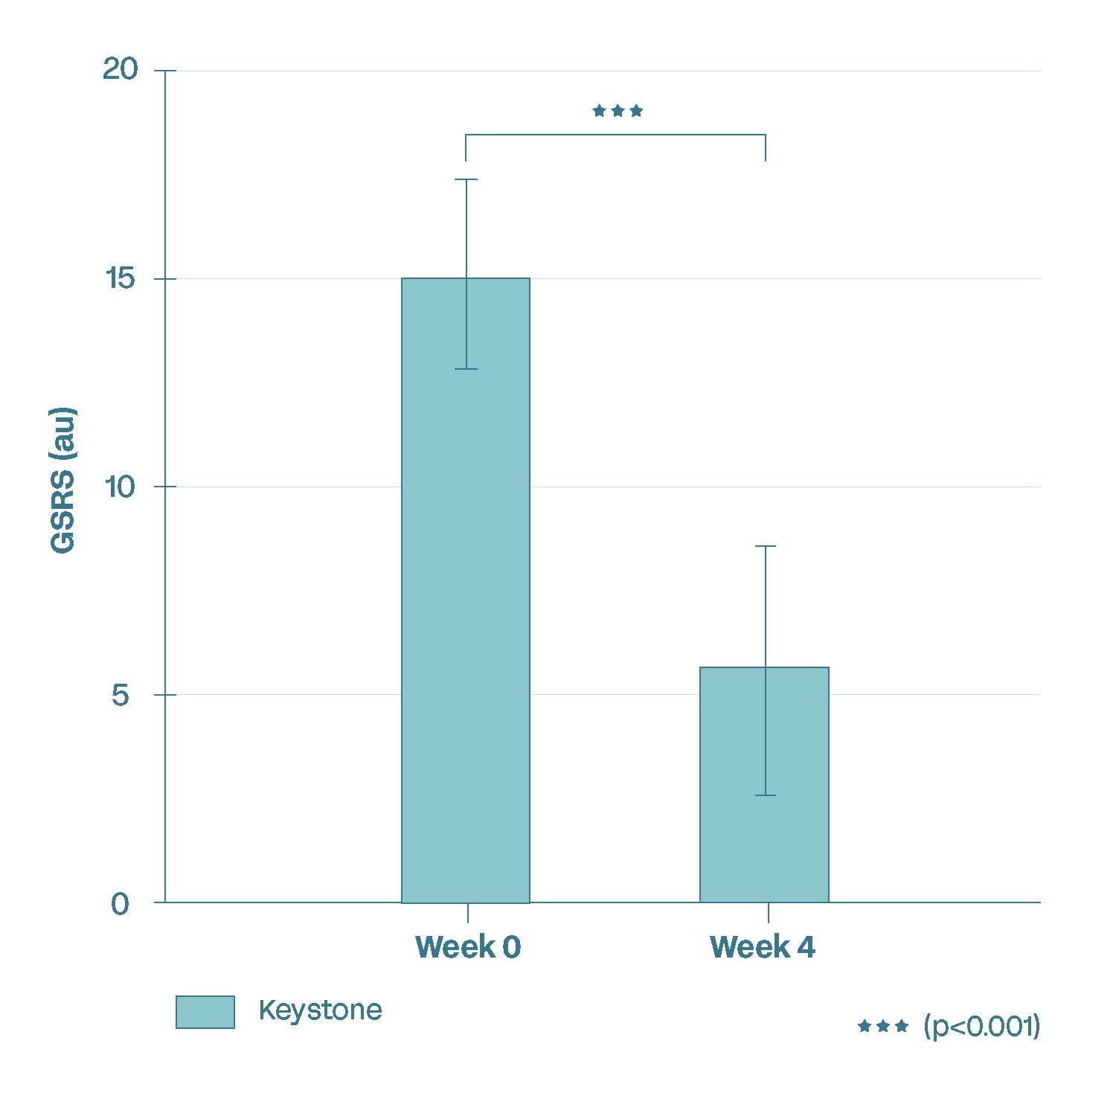
Keystone Postbiotic Decreases GSRS
(Gastrointestinal Symptom Rating Scale)
Clinical Results: GSRS
GSRS values significantly decreased after 4 weeks
Notes:
The GSRS is an instrument based on reviews of gastrointestinal symptoms and clinical experience, to evaluate common symptoms of gastrointestinal disorders including:
Abdominal pain
Reflux syndrome
Diarrhea
Indigestion
Constipation
62.7% decrease
65.9% decrease

Slide 25

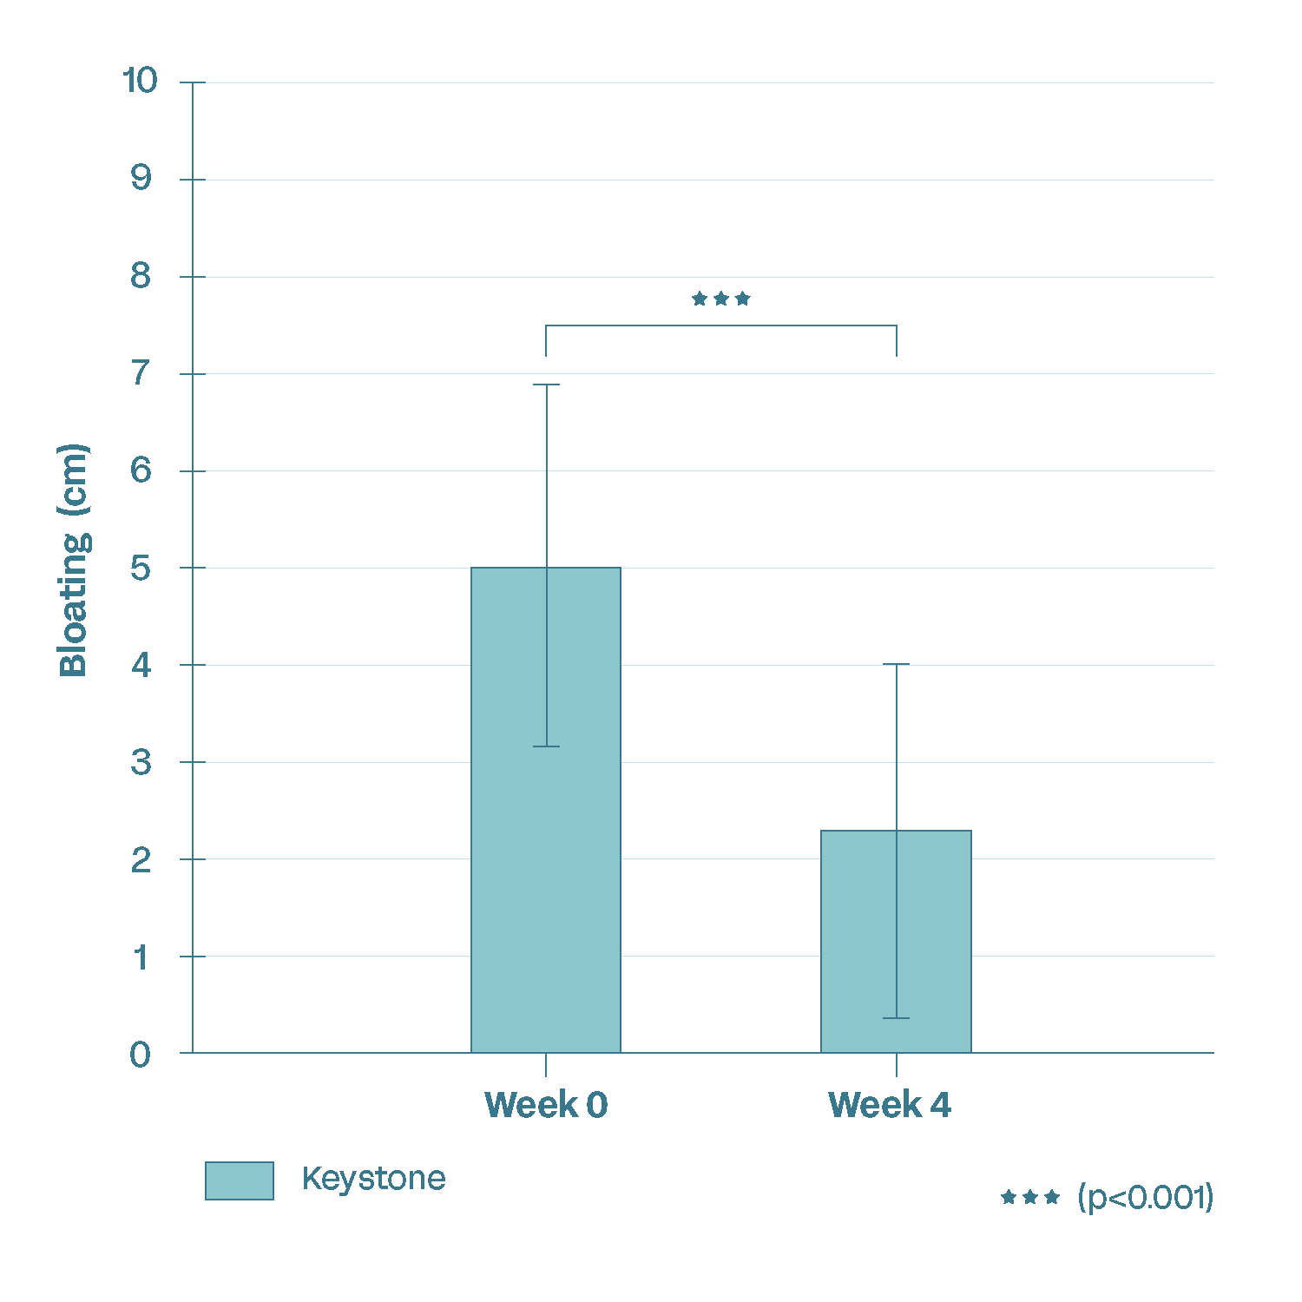
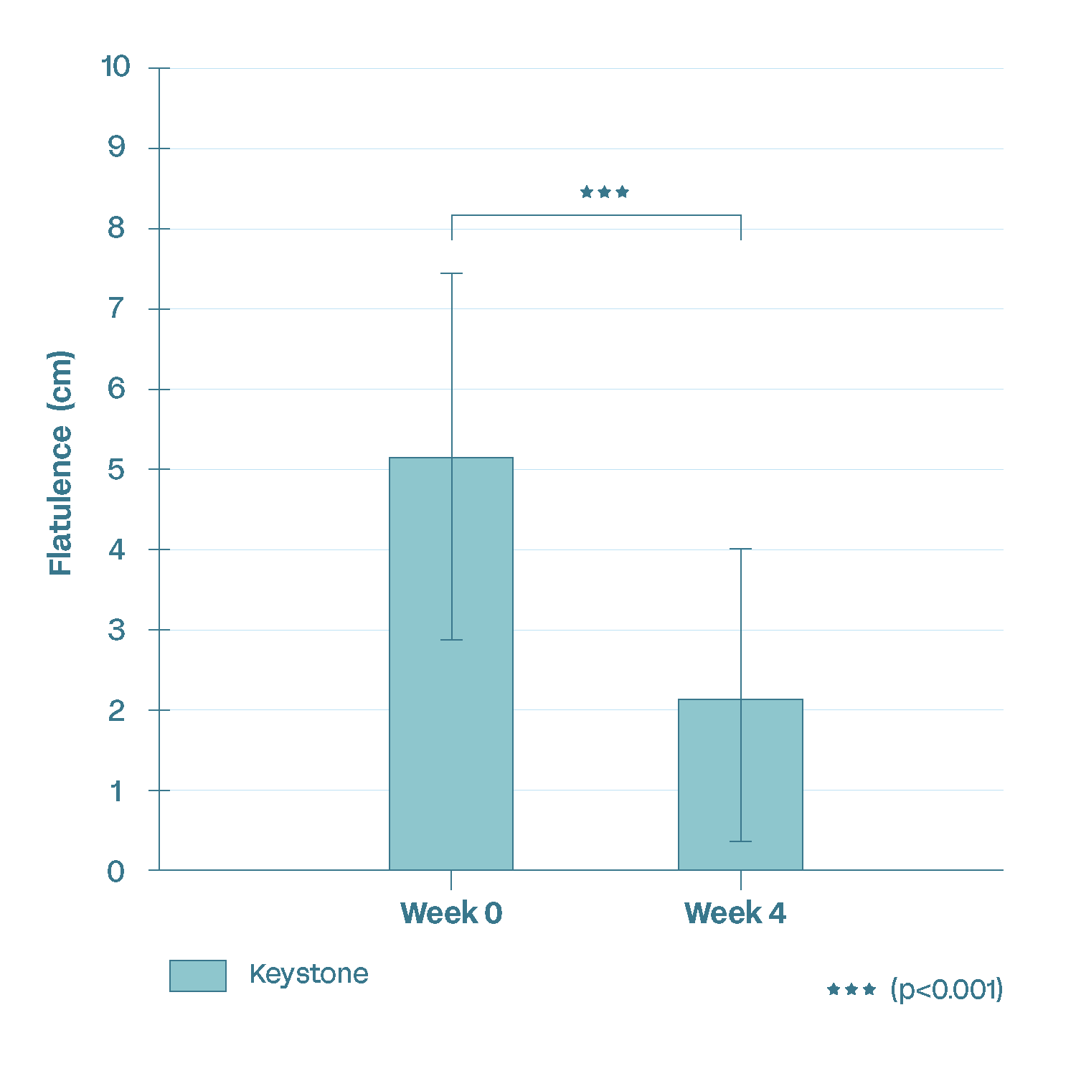
Keystone Postbiotic decreases bloating and flatulence
Clinical Results: Flatulence
Clinical Results: Bloating

Slide 26
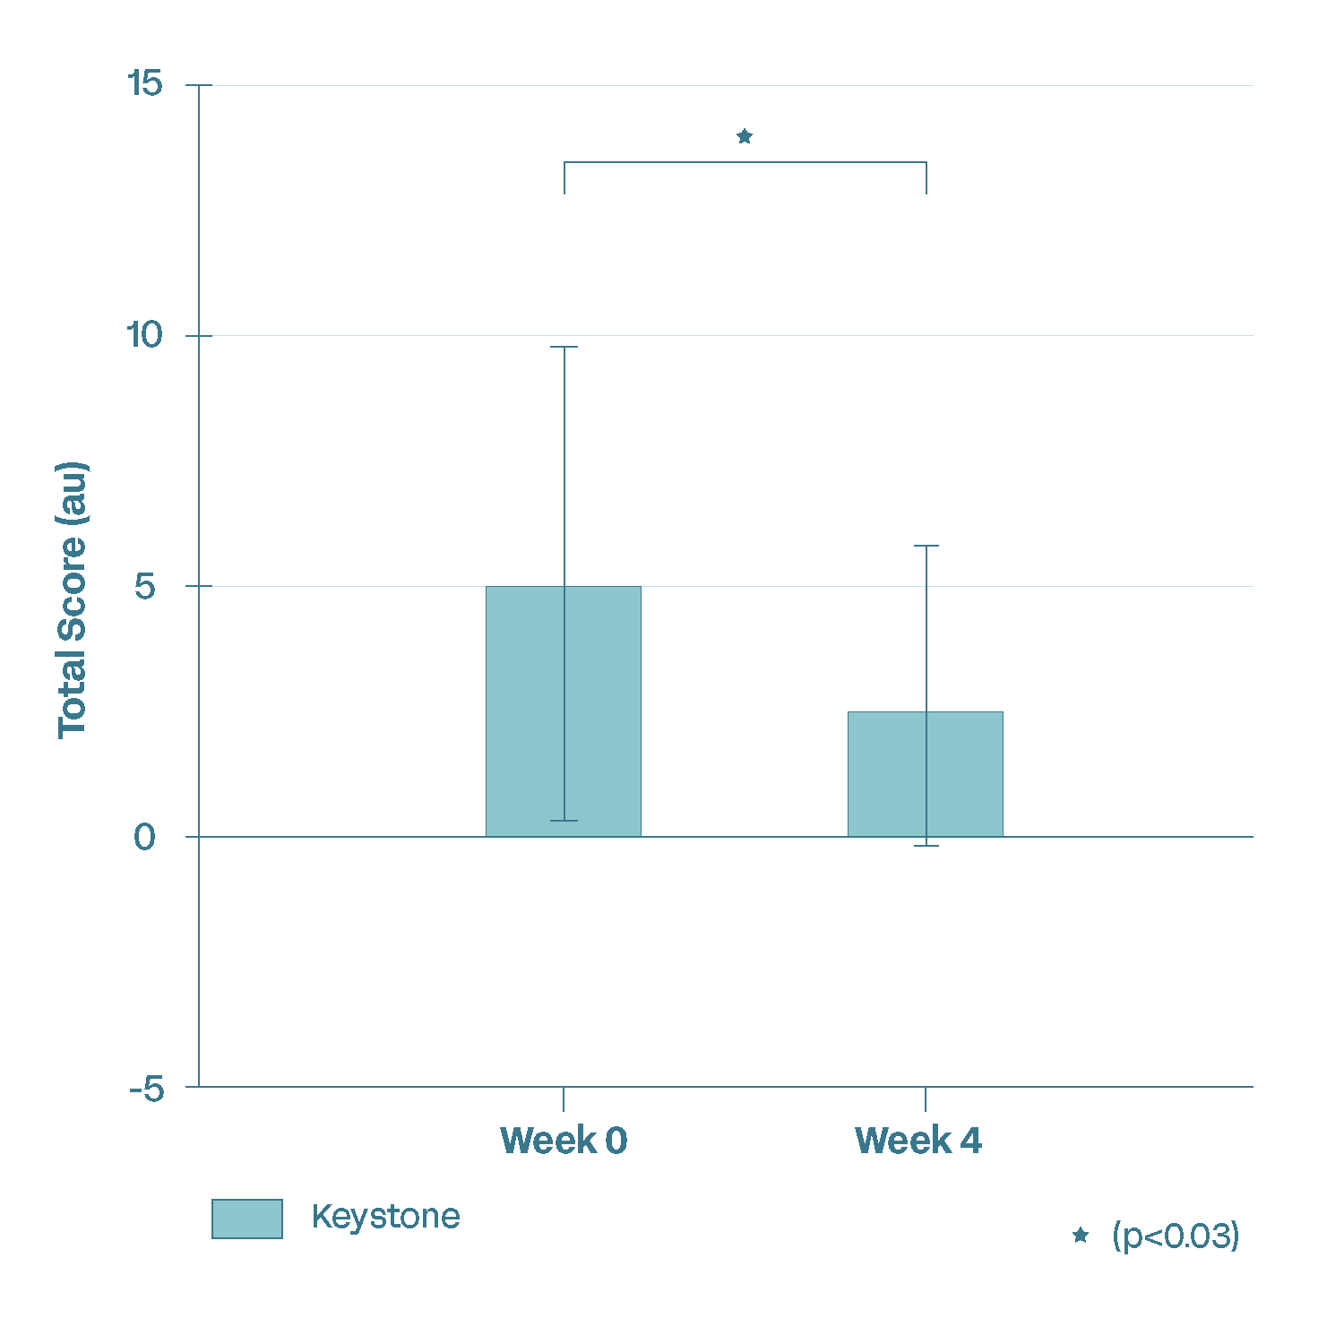
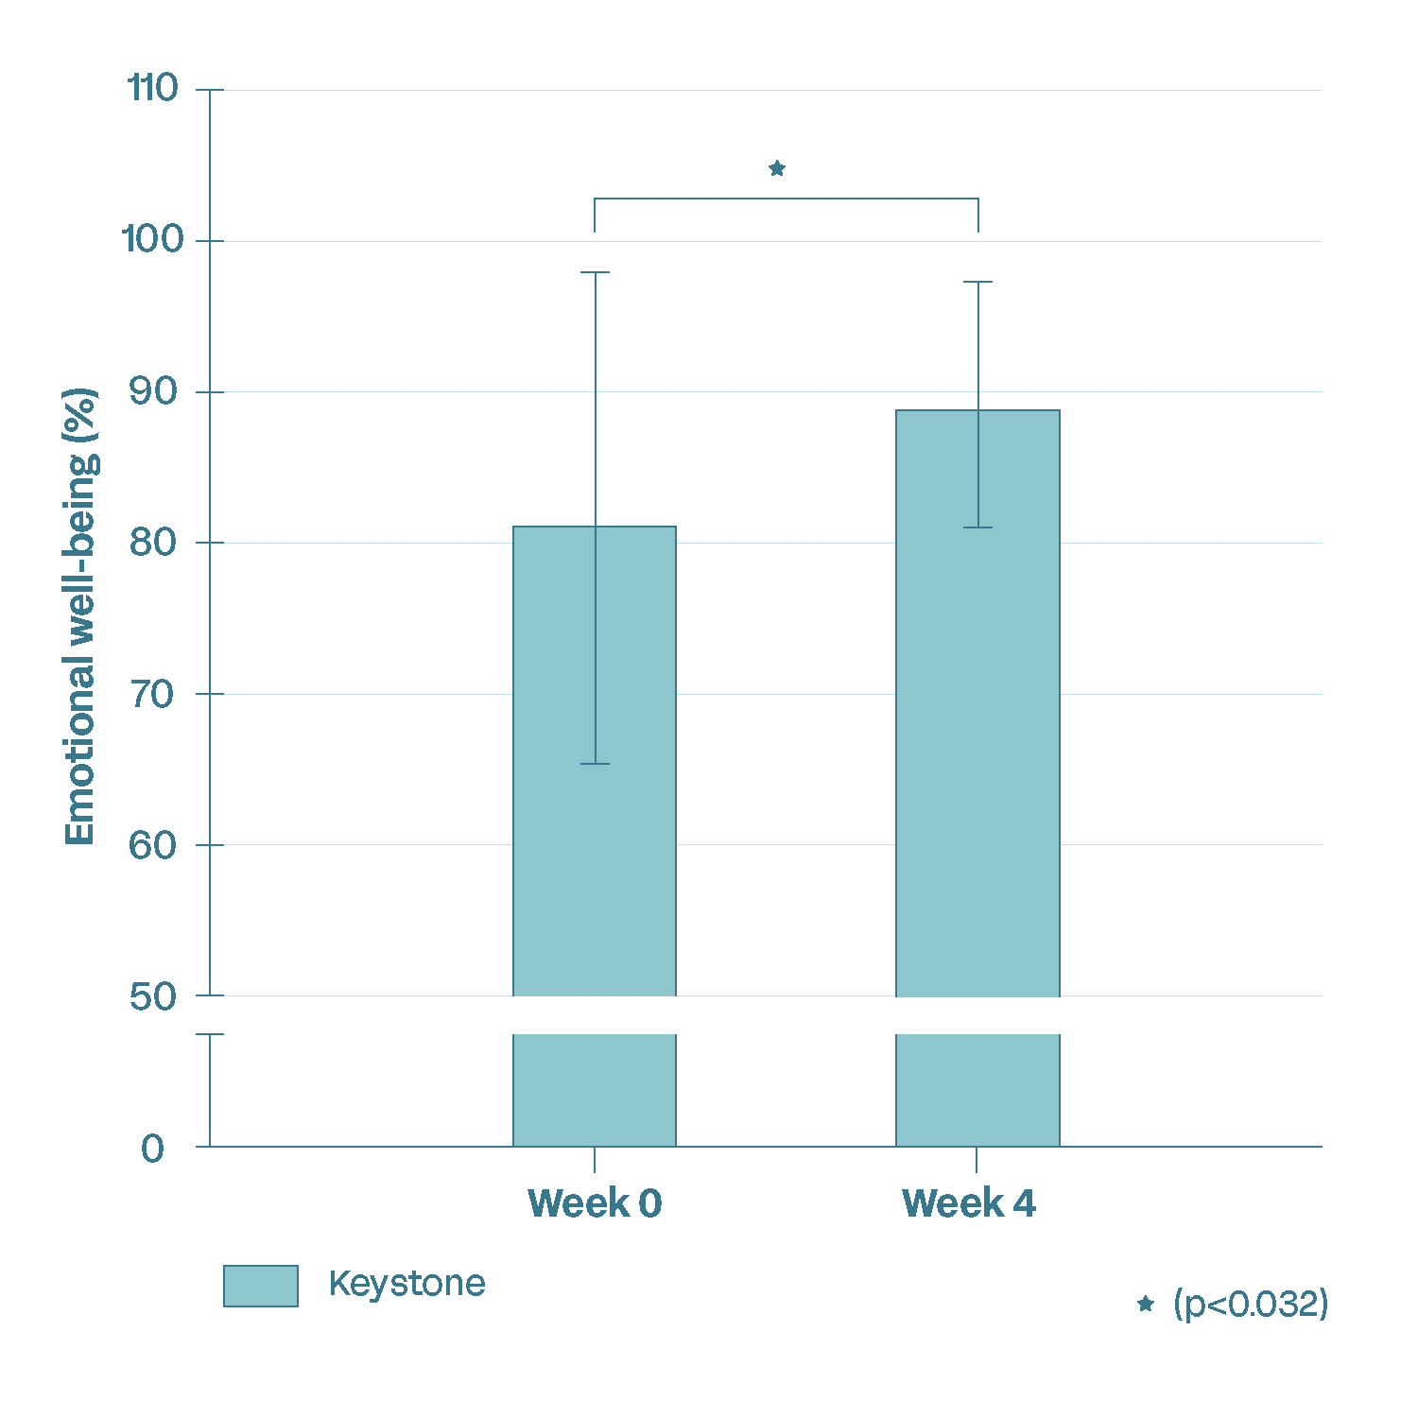
Emotional Wellbeing
Clinical Results: Mood/Stress
Clinical Results: Emotional well-being
Participants reported a significant reduction in anxiety symptoms (GAD-7 questionnaire) after 4 weeks of Keystone supplementation.
Participants reported a significant improvement in emotional well-being (SF-36 questionnaire) after 4 weeks of Keystone supplementation.
Notes:
The SF-36 questionnaire is a 36-item Short Form Health Survey to measure overall health and quality of life. The SF-36 measures emotional well-being through its Mental Health domain which includes questions related to happiness, calmness and peacefulness, depression and sadness, and nervousness.
8.8% increase

Slide 27
Keystone Postbiotic Human Study #2
DESIGN
DURATION
SUBJECTS
ARMS
SITE
Double-blind
Randomized
Placebo-controlled
4 weeks
Healthy
Male & Female
Age 18-65
300 mg Postbiotic
(n = 40)
Placebo (n = 40)
USA
Endpoints:
SCFAs | Inflammatory & Immune markers | Intestinal permeability
  Fecal microbiome diversity | Cortisol levels | GI health | GLP-1 | QoL
Notes:
Break down the endpoints to be more digestible – have everything in the notes

Slide 28

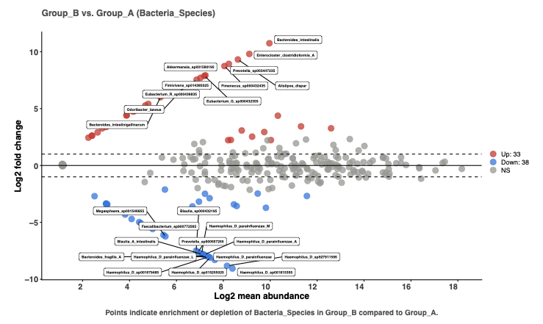

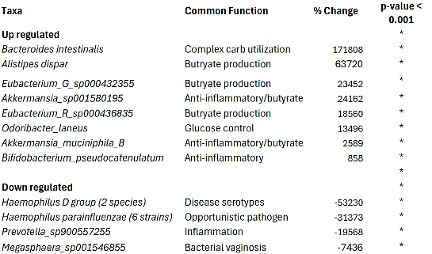
Keystone Clinical Data: Targeted microbiome modulation with Keystone
Increases endogenous Akkermansia and other beneficial bacteria already living in your gut, no colonization by foreign probiotic strains
DESIGN
DURATION
SUBJECTS
SITE
Takeaway: Significant rise in 33 beneficial species and drop in 38 potentially harmful species vs placebo
Notes:
Keystone promoted the growth of endogenous beneficial bacteria within the gut microbiome.
Clinical findings demonstrate not only an increase in health-promoting microbial species but also a corresponding decrease in non-beneficial species highlighting its role in restoring microbial balance and strengthening gut microbiome resilience.

Slide 29
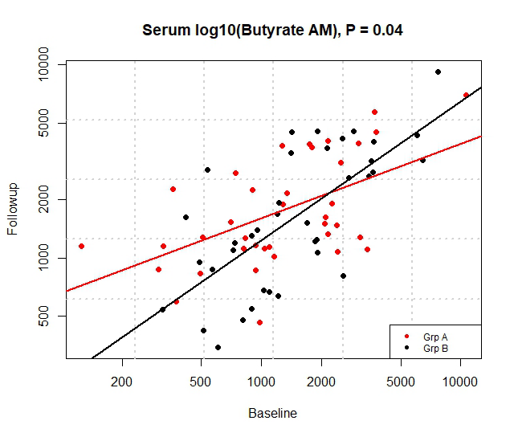
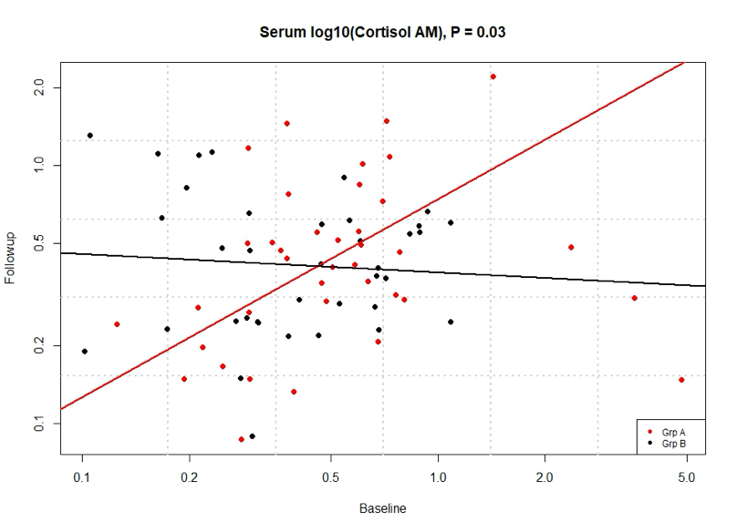
Keystone Clinical Data: Biomarkers Measured
Serum Butyrate p=0.053
Salivary Morning Cortisol p=0.03
KEY:
Red = Placebo
Black = Keystone
Takeaway: Participants on Keystone had more butyrate in blood and significantly lower rates of the stress hormone cortisol production after 4 weeks

Slide 30
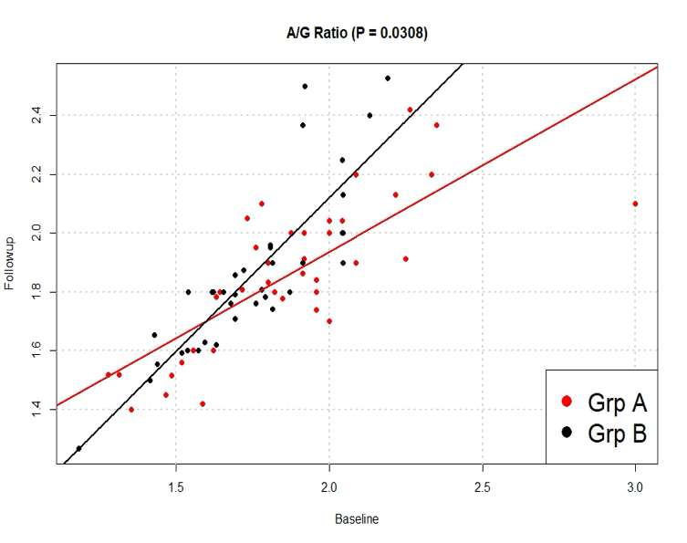
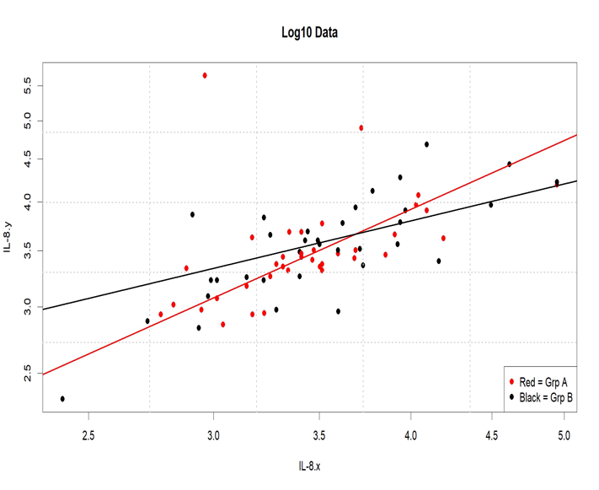
Keystone Clinical Data: Biomarkers
IL-8 Rate p=0.040
Albumin/Globulin Ratio p=0.0308
KEY:
Red = Placebo
Black = Keystone
IL-8 increases at a significantly lower rate than placebo when on Keystone, while
A/G ratio demonstrates a significantly faster rate of increase when on Keystone (liver health).

Slide 31

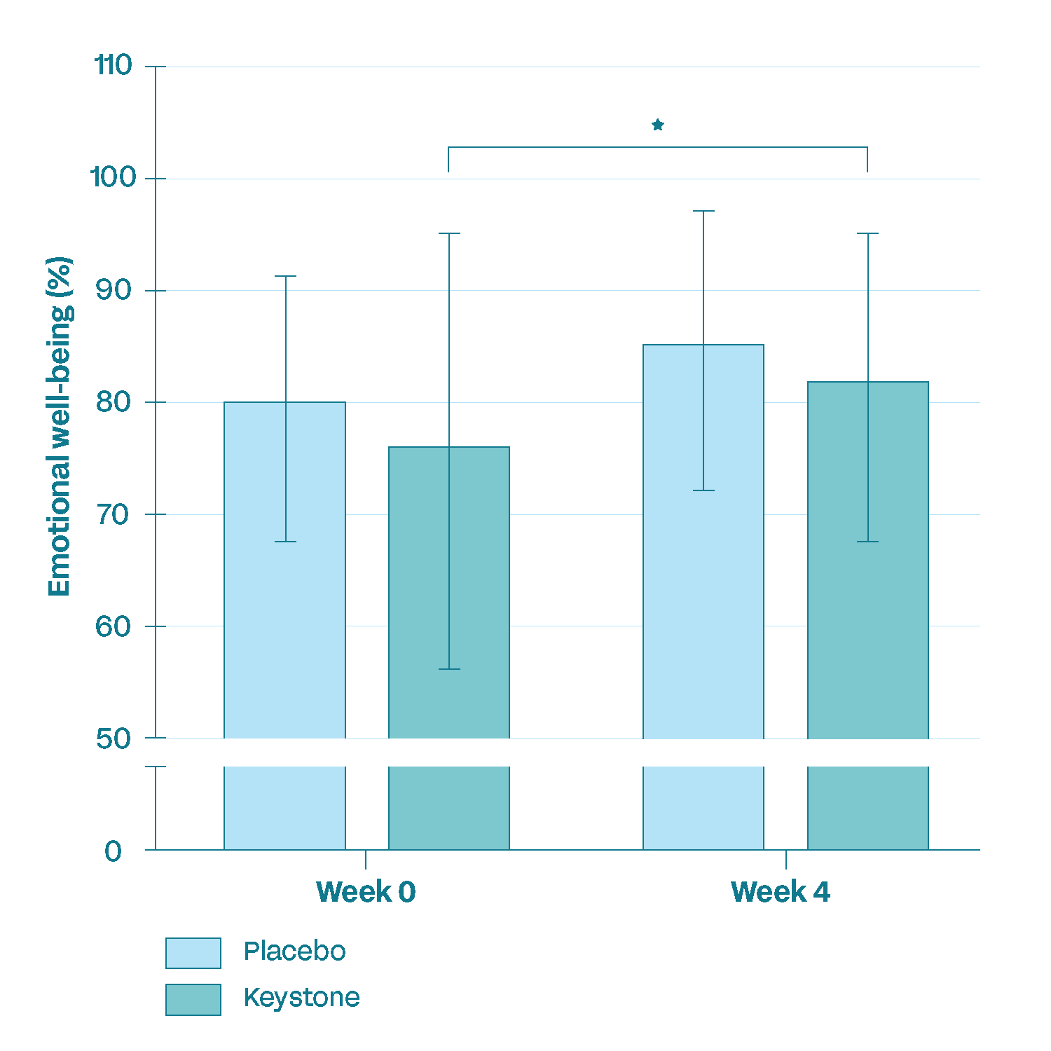
Keystone Clinical Data: Emotional Health
DASS21 Low Mood Change over 4 weeks
 | Decreased | No Change | Increased
Placebo | 34% | 47% | 18%
Keystone | 68% | 24% | 8%
*p=0.011
DASS21 Stress Change over 4 weeks
 | Decreased | No Change | Increased
Placebo | 55% | 21% | 24%
Keystone | 71% | 8% | 21%
p < 0.05
Takeaway: Participants on Keystone demonstrated a significant decrease in feeling depressed, statistically improved emotional well-being and a higher percentage of them reported a decrease in stress after 4 weeks.
Notes:
The Depression, Anxiety and Stress Scale - 21 Items (DASS-21) - is a set of three self-report scales designed to measure the emotional states of depression, anxiety and stress. Each of the three scales contain 7 questions (ranked from 0 to 4)
The SF-36 includes a component for evaluating emotional well-being and another for role limitations due to emotional problems, which are assessed through questions about feelings such as "full of pep," "nervousness," "down in the dumps," "calm and peaceful," "downhearted and blue," and "happy". It also includes a general question on how emotional health impacts daily activities like social interactions.

Slide 32


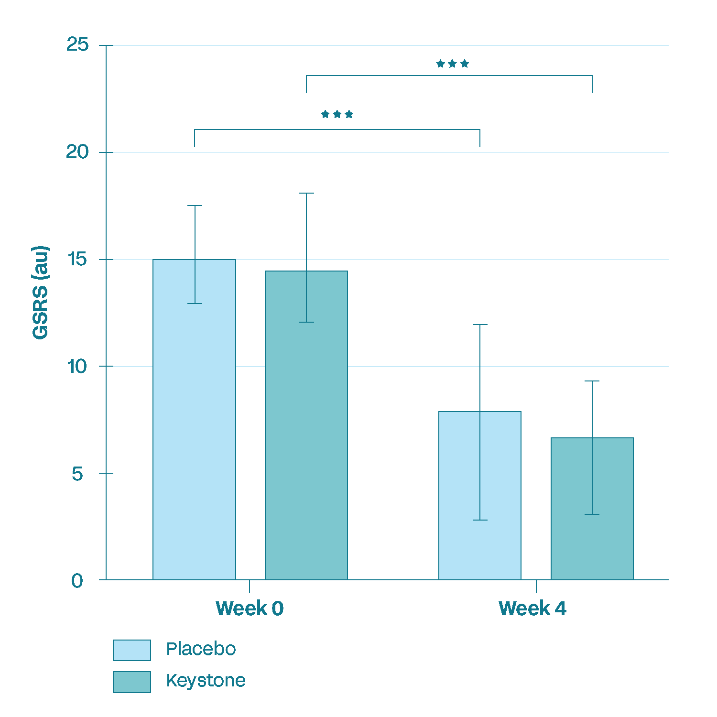
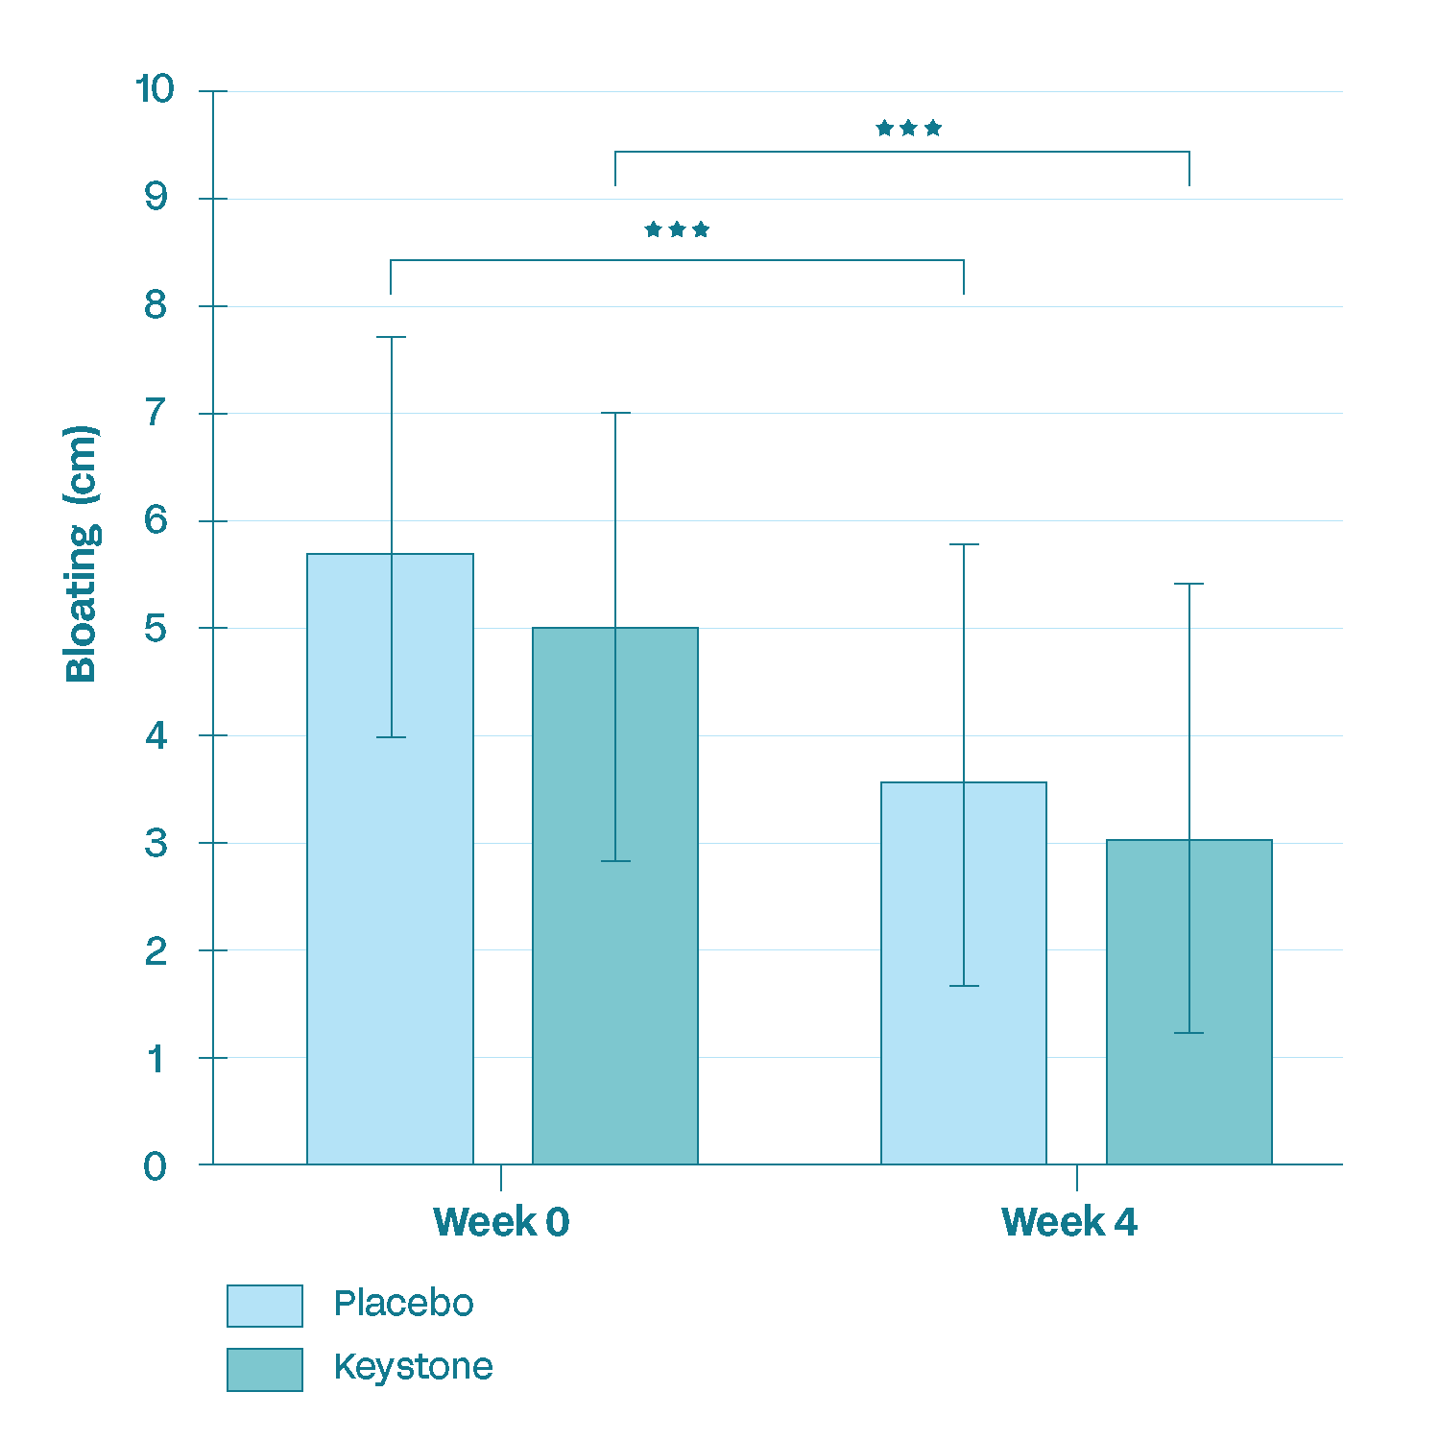
Improved GI health and bloating
These data confirms what we observed in the pilot study; Decrease in GI symptoms
and bloating from baseline p ≤ 0.001

Slide 33
Clinical Summary
Precision Microbiome Modulation
  Increase in butyrate producers, immune modulating,
  and metabolic health strains
  Decrease in non-beneficial strains
Subjects felt better over 4 weeks
  Increased mood/stress/energy
  Reduced gas and bloating
Body of evidence supports improvements in:
  Microbiome composition
  Intestinal barrier function
  Emotional wellbeing: reduces periodic stress
Notes:
Precision Microbiome modulation
Good bacteria up/bad bacteria down -> not broad increase in both good and bad
Decrease in gas/bloating
Low dose
Trending changes in fecal SCFA concentrations
Acetate (p=0.08)
Butyrate (p=0.28)

Slide 34

Keystone Postbiotic®
Foundational Gut Microbiome Health: Promotes the growth of native keystone bacteria to support a healthy gut microbiome, balanced immune response, and emotional wellbeing.
Synergistic Formulation: Combines clinically relevant Lactobacillus probiotic strains with fermented oats to revitalize one's existing beneficial gut microflora.
Shelf-Stable and Ready-to-Use: No refrigeration needed; stable across a wide range of product formats.
Precision over Prebiotics: Unlike prebiotics that merely feed bacteria, Keystone delivers ready-to-act postbiotic metabolites that interact with one's existing gut microbes.
Clean-Label and Non-GMO: Powered by whole-food oats and microbial fermentation — as well as certified non-GMO — it’s designed for health-conscious consumers.
“Keystone Postbiotic combines probiotic strains and fermented oats to deliver
shelf-stable, ready-to-act postbiotics for daily gut support, no refrigeration needed."
PAGE 34

Slide 35
Keystone Postbiotic Claims
Structure/Function Claims
Gut Health
  Promotes microbiome health
  Supports production of beneficial keystone bacteria
  Supports an increase in health-promoting microbial species
Immune & Barrier Function
  Strengthens immune performance
Mental Wellbeing
  Supports emotional wellbeing/mood
PAGE 35

Slide 36
Keystone Postbiotic Benefit Areas
Microbiome Modulation
  ≥ 800% increase in 33 beneficial endogenous bacterial species
  ≥ 7000% reduction in 38 potentially harmful bacterial species
  Up regulates endogenous Akkermansia up to 24000%
  Up regulates butyrate producing bacteria by 63000%
Whole-Body Benefits
  ≥ 50% improvement in gas and bloating
  68% of participants improved their emotional wellbeing
  Lowers IL-8 production, suggesting improved immune regulation
  Increases butyrate production, supporting anti-inflammatory pathways
  Reduces cortisol by week 4
  Improves albumin/globulin ratio, reflecting immune balance,
  resilience and healthy live function
  No GI distress observed in clinical testing
PAGE 36

Slide 37






Keystone Postbiotic applications
GREEN JUICE
SODAS
ENERGY DRINKS
FUNCTIONAL FOOD
NON-DAIRY
PROTEIN DRINKS/POWDERS
SPORTS
NUTRITION
CHOCOLATE

Slide 39
Appendix

Slide 40

^{Services}
Development & Marketing

Slide 41
Development Services
We collaborate with your R&D and PD teams to develop differentiated, outcome-driven formulation concepts
FORMULATION COMPATIBILITY
NEW PRODUCT CONCEPTS
Compatibility Assessment
MOA development
Ingredient assessments
Near term stability
Potential process development
Product Ideation
Health outcome
MOA
Clinical Biomarkers
Claims
Structure/function claims + lifestyle claims
Page 41

Slide 42
Marketing Services
We collaborate with your marketing team to identify gaps & product fit for a successful launch
CONSUMER MESSAGING
NEW PRODUCT CONCEPTS
Ingredient Storytelling Kit
Science-backed narratives
Messaging/positioning
Visuals
Educational content
Consumer and Category Insights
Retailer data | category opportunity | food/beverage
Amazon data | benchmarks for velocity
Price point data
Formulations
New product concepts + combinations
Claims
Structure/function claims + lifestyle claims
Labels
Design + nutrition facts panel (NFP)
Page 42

Slide 43


Marketing Services Team
Meet the team with B2C dietary supplement and food experience
Celestia Howe
Sr. Director of Marketing
Brooke Burditt
Marketing Manager
Celestia brings deep expertise in brand strategy and consumer marketing, with a proven track record of building awareness and driving growth for innovative health, wellness, and tech companies. Celestia founded Cofo Provisions, a marine collagen brand sold at Whole Foods, Erewhon, and Amazon.
Brooke is a data-driven, creative marketer with a diverse CPG background, from baby food to chocolate to better-for-you snacking. At Verb Biotics, she draws on this cross-industry experience to turn complex science into clear, compelling marketing that resonates with consumers and fuels brand growth.
Page 43

