Slide 1

Improving health through microbiome innovation
FOR CLIENT NAME HERE
DATE

Slide 2


“Improving health through microbiome innovation”
Function-first science that opens nature’s toolbox to bring inspired microbiome solutions to our partners.
“I feel the effect”

Slide 3







Platforms build upon foundation of science
Supporting specific needs states of the target population
GUT-BRAIN HEALTH
SPORTS RECOVERY
HEALTHLY AGING
stress
mood
sleep
gut permeability
soreness
energy/stamina
joint health
Inflammation
muscle maintenance
WOMENS HEALTH
HEALTHY METABOLISM
COMPANION ANIMAL
menopausal support
stress/mood
hormone support
healthy weight
blood glucose
satiety
anxiety
aggression
sleep
VERB’S VISION
Create a metabolite leaderboard targeting key health conditions
Technologies are modular. Standalone, stacked with other Verb technologies, or integrated with customer ingredients
North Star: Efficacy. Consumer need to "feel the effect"
PAGE 4

Slide 4

LP815®
For dual action stress and sleep support

Slide 5
Why we are excited …
LP815 acts as a GABA factory in the gut, signaling microbial production that increases GABA production
Sustained and stable GABA release for long-lasting, dual action stress, sleep, and mood support
Proven to increase GABA levels by day 7 and keep them sustained through week 6
Quality of life solution compared to acute, short-term release stress & sleep supplements
No GI distress/side effects/no next-day drowsiness
Notes:
Precision Microbiome modulation
Good bacteria up/bad bacteria down -> not broad increase in both good and bad
Decrease in gas/bloating
Low dose
Trending changes in fecal SCFA concentrations
Acetate (p=0.08)
Butyrate (p=0.28)

Slide 6


LP815®
MULTI BENEFIT
Helps reduce feelings of irritability
Promotes a calm mood
Supports a healthy stress management
Supports deep restorative sleep
Helps relieve night sweats
LOW DAILY DOSE
L. plantarum 815 (LP815TM) 50mg*
*5 Billion CFU
SUPPLY CHAIN
Manufactured in USA
Scaled to meet demand
Non-GMO Project Verified
Allergen-free
Kosher
Self-affirmed GRAS

Slide 7
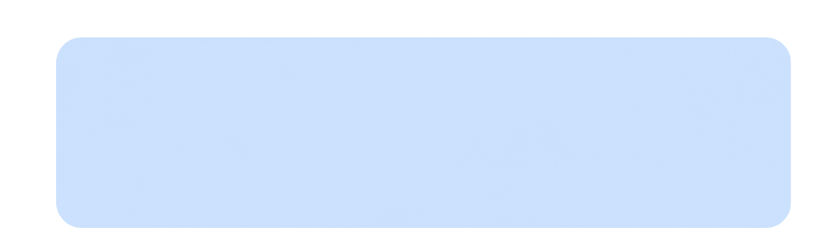
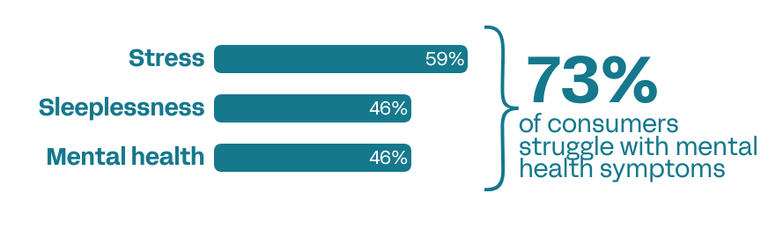
Mental well-being is a significant struggle for your consumers.
We’re here to help.
Source: Verb Biotics 2024 Consumer Health Survey

Slide 8
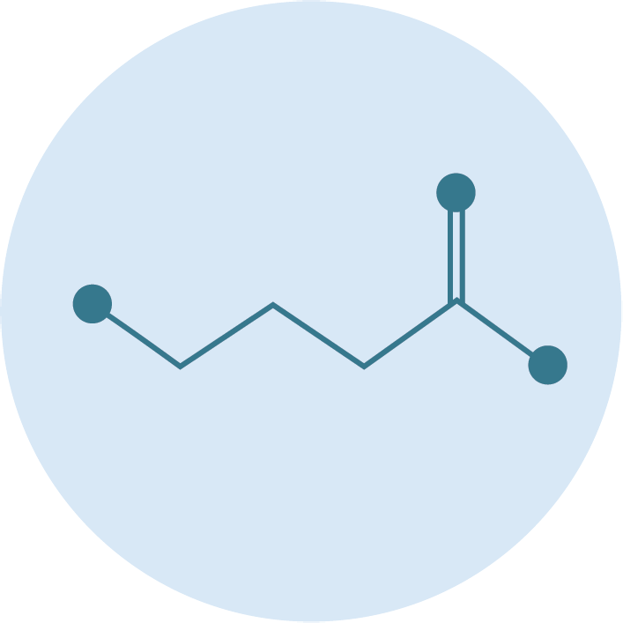
Why GABA?
A major inhibitory neurotransmitter: Gamma-Aminobutyric Acid (GABA) is a metabolite with a fundamental role in signaling the nervous system.
Main mechanism = slow the stimulation of certain nerve signals in the brain.
Provides a calming effect by preventing neurons from firing and regulating how quickly they react.
Notes:
Camille
KEEP

Slide 9



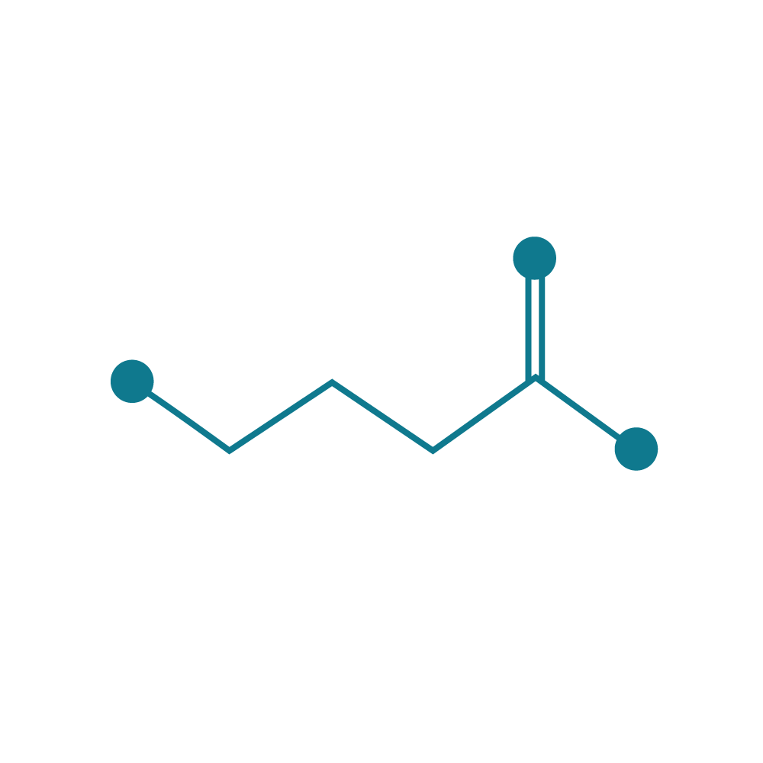
Function first, intentional design
STRAIN IDENTIFICATION/
OPTIMIZATION
HEALTH
INDICATION
MECHANISMS
OF ACTION
Regulatory
Clinicals
Scale
LP815
Stress/Mood/Sleep
Enables sustained GABA production
Lactiplantibacillus plantarum, LP815™, a proprietary strain of lactic acid bacteria
Add in mood,
stress, and relaxation dietary supplements
Non-GMO, Kosher, Allergen-Free, Self-affirmed GRAS
PAGE 9

Slide 10

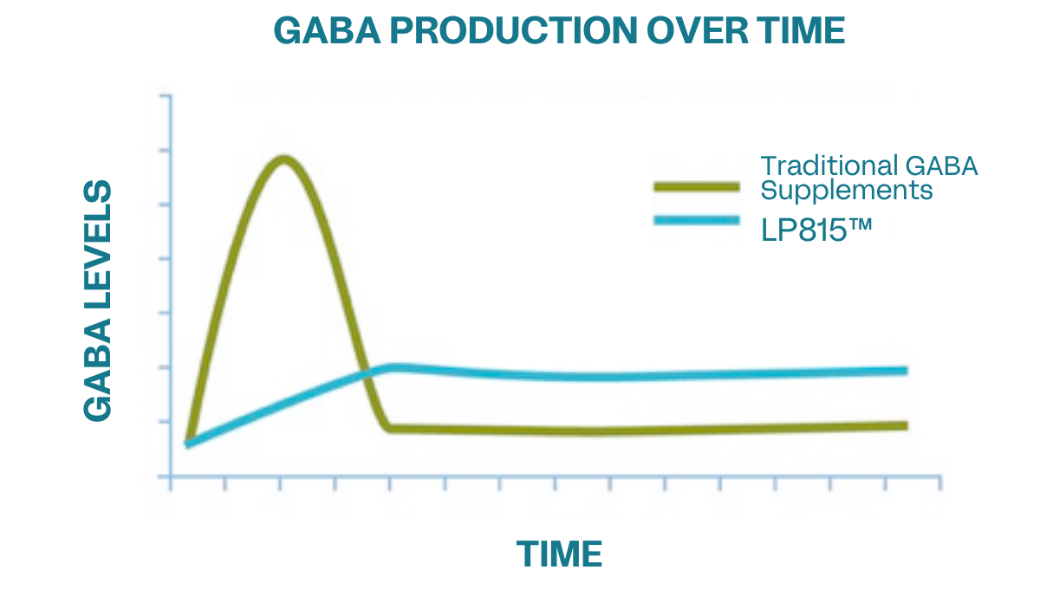
The LP815 Difference
A novel probiotic with sustained and consistent GABA production within the GI tract.
  Unlike traditional GABA supplements, LP815 consistent release provides calming and stress modulation for consumers.
Adapted from: Li J, et. al. Front Pharmacol. 2015 Nov 10;6:260. doi: 10.3389/fphar.2015.00260.
Notes:
Diane - The advantage of taking a probiotic that produces GABA versus just taking a GABA supplement is that GABA produced by bacteria will provide a consistent, prolonged release of GABA over time as long as you're taking the probiotic. This is very different then what happens when you take a GABA supplement which delivers a bolus of of GABA at once. In this case, GABA levels increase and within 4-5 hours according to the data go back down to baseline levels. While GABA production from a probiotic would be more consistent, and we believe provide a sustained release product compared to the other options that are on the market.
Remove the text, LP815™ difference

Slide 11
Unprecedented large-scale screen
Comparative GABA Production
3
We searched over 250 million isolates to identify LP815
Screen done leveraging latest biotech tools and under gut-like conditions
LP815 is a sustained and consistent producer of clinically relevant GABA
GABA Normalized per Pos. Con.
2
1
Benchmark
Lactiplantibacillus plantarum
LP815®
Notes:
We really wanted to understand what the landscape was overall, so we identified the top strains that produce GABA that were commercially available, and we benchmarked against those. From there we leveraged our relationship with Ginkgo Bioworks to be able to force some strains to produce more GABA through directed evolution. Through this effort, we screened over 250 million different isolates to to identify those that produce the most. When you look at this graph, what are you are looking at is a small subset of those isolates.
Note: strains not all L.Plantarum
L. plantarum 815 produces three times the amount of GABA compared to benchmark. This high production stems in part from its ability to uncouple the production of GABA from pH which is the main driver of what allows different strains within the gut to produce GABA. It can produce GABA at more of a neutral pH which you'll find in the gut as opposed to highly acidic pH, so at physiological concentrations of pH it produced higher amounts of GABA.

Slide 12
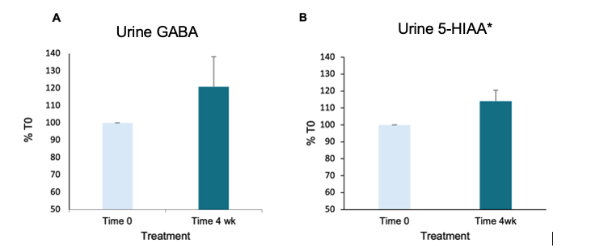
Pilot data: LP815 increases GABA & Serotonin in humans
75% of participants demonstrated an increase in GABA levels in urine, averaging 20% above baseline
90% of participants demonstrated an increase in urinary 5-HIAA, which is a metabolite of serotonin
n=8 (5 F, 3 M)
*5-hydroxyindoleacetic acid (5-HIAA), a metabolite of serotonin
Notes:
Diane - Eight healthy adults (5F, 3M) provided a urine sample at the beginning of the study (T0) and after 4 weeks of supplementation. Urine collection was performed according to the manufacturer’s instructions and measured at the manufacturer’s laboratory facility using the Neurotransmitter Basic Panel (Life Extension/National Diagnostics, Inc.). Participants that had GABA levels in the high range (<4.7mmol/g creatinine) at baseline were excluded from the study. The participants then took Lp815TM GABA Probiotic (1x10⁹ cfu/day) for 4 weeks. Participants went about their normal activities and diets during the study period; however, they did refrain from beginning any new treatments, using antibiotics, or taking probiotic products. After 4 weeks of supplementation, a second urine collection was performed according to the manufacturer’s instructions and measured at the manufacturer’s laboratory facility.
LP815TM was well tolerated by the participants. After 4 weeks of treatment with Lp815TM, 75% of participants demonstrated an increase in GABA levels in urine, averaging 20% above baseline (Figure 1A). Concomitant with GABA, 90% of participants demonstrated an increase in urinary 5-hydroxyindoleacetic acid (5-HIAA) which is a metabolite.
Urinary GABA levels were increased in a cohort of healthy adults taking 1x10⁹ CFU/day of Lp815TM, suggesting Lp815TM can increase GABA in the human body. Concomitant with the increase in urinary GABA, a corresponding increase in urinary 5-HIAA* was observed as well. LP815 is well tolerated.

Slide 13
GABA Probiotic, LP815
Gut-Based GABA Production: LP815 acts as a “GABA factory” in the gut, interacting with existing gut microbes to naturally produce the calming neurotransmitter where it can be absorbed and utilized.
Sustained GABA Delivery: Unlike traditional GABA supplements that deliver a quick, short-lived bolus and require frequent redosing, LP815 enables a sustained and consistent release aligned with the body’s physiological rhythms.
Long-Lasting Support for Stress & Sleep: Clinical findings show GABA levels significantly increase within one week, with users reporting improvements in stress response and sleep quality by week four—delivering lasting support through continued use.
Optimized for Human Physiology: LP815 is one of the few strains proven to produce GABA within the body’s natural pH range, ensuring more consistent, biologically relevant effects.
"GABA Probiotic, LP815 delivers long-lasting stress and sleep support by
turning your gut into a natural GABA factory, no redosing, just real results you can feel."

Slide 14
LP815® for better sleep
Microbiome-Based Sleep Support: LP815® is a clinically backed probiotic that stimulates natural GABA production in the gut, supporting the body’s transition into restorative sleep.
Sustained Results: Clinical findings show GABA levels rise within one week, with users reporting improved sleep and reduced stress by week four, without the risk of dependency.
Dual Action: Stress + Sleep: By targeting the gut-brain axis, LP815® provides stress relief and sleep support in one root cause solution.
Biologically Aligned, Not Forced: Unlike melatonin or sleep drugs that override the brain’s natural rhythms, LP815® may help restore circadian balance by working in sync with your internal clock.
Deep Sleep, Naturally: Encourages deeper, higher-quality sleep by calming the nervous system through GABA modulation, not by inducing drowsiness or causing next day adverse effects.
"LP815® offers non-drowsy, microbiome-based sleep and stress support
that works with your biology - not against it - for longer, deeper sleep"
PAGE 14

Slide 15
First Human DB-RPC Clinical Trial:
LP815 Stress/Mood Study
DESIGN
DURATION
SUBJECTS
ARMS
SITE
Double-blind
Randomized
Placebo-controlled
Decentralized
6 weeks
Adults, self-reported with Mild to Moderate anxiety (GAD-7 screening of 5-14)
USA
1B CFU LP815 (n = 34)
5B CFU LP815 (n = 34)
Placebo (n = 34)
ENDPOINTS:
Anxiety GAD-7 questionnaire | HRV | Sleep Metrics (latency, sleep stages)
Grant, A.D., et. al. (2025). Lactiplantibacillus plantarum Lp815 decreases anxiety in people with mild to moderate anxiety: a direct-to-consumer, randomised, double-blind, placebo-controlled study. Beneficial Microbes https://doi.org/10.1163/18762891-bja00073
Notes:
Camille
. Endpoints, don’t delineate primary and secondary, remove safety

Slide 16

Stress/Mood
Study Population
Study population: adults, self-reported with 'Mild to Moderate' anxiety (GAD-7 screening of 5-14)
83 individuals completed the trial
  63% female
  37% male
GAD-7 Questionnaire Categories:
  0–4: minimal anxiety
  5–9: mild anxiety
  10–14: moderate anxiety
  15–21: severe anxiety
Notes:
Camille – change name to study population
Adults, self-reported with Mild to Moderate anxiety (GAD-7 screening of 5-14)

Slide 17
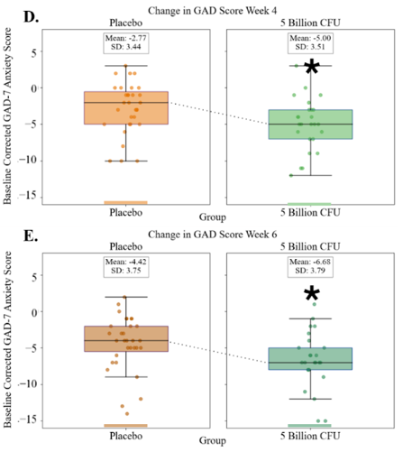
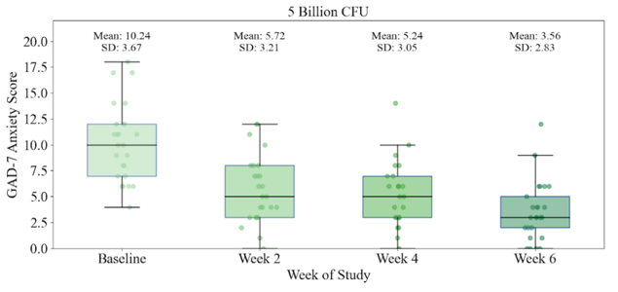
Stress reduction upon taking LP815 may begin as early as 2 weeks, and reaches significance at 4 weeks.
68% of the 5 billion CFU cohort GAD score improved at week 6 vs. 26% of the placebo cohort (p<0.05).
P = 0.02, Week 6
GAD-7 Score is reduced at 5 Billion CFU by weeks 4 and 6 compared to placebo.
Notes:
Camille-
IRRITABILITY – of the GAD-7, all of the questions showed an improvement, but the one question that stood out was the question around “Becoming easily annoyed or irritable”. That is where we saw a large statistically significant impact. We saw a full point improvement at the 5B dose and a ¾ point improvement at the 1B dose.

Slide 18
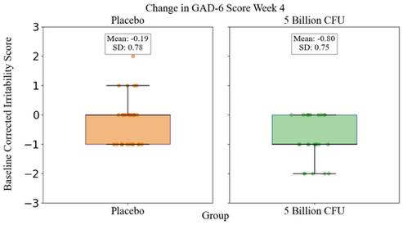
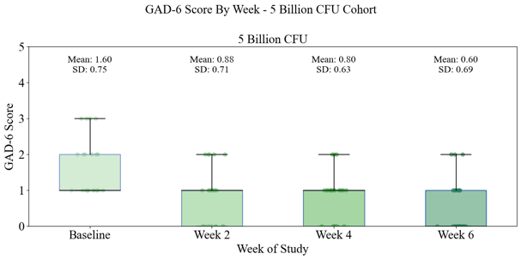
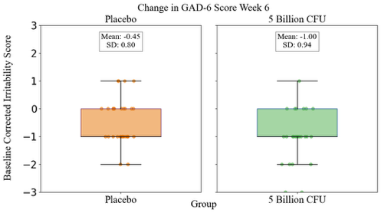
LP815 significantly reduced irritability and annoyance in the GAD-7 screening (p=0.04 at week 4 and p=0.1 at week 6).
*
Notes:
IRRITABILITY – of the GAD-7, all of the questions showed an improvement, but the one question that stood out was the question around “Becoming easily annoyed or irritable”. That is where we saw a large statistically significant impact. We saw a full point improvement at the 5B dose and a ¾ point improvement at the 1B dose.
For Irritability, within the 5B group, all time points are statistically different from baseline (p<0.02).
For 5B group versus placebo:
p=0.04 for week 4
p=0.12 for week 6

Slide 19
Second Human DB-RPC Clinical Trial:
LP815 Sleep Study
DESIGN
DURATION
SUBJECTS
ARMS
SITE
Double-blind
Randomized
Placebo-controlled
Decentralized
6 weeks
Adults, self-reported with moderate to severe sleep disturbance
(ISI score ≥ 15)
5B CFU LP815 (n = 75)
Placebo (n = 75)
USA
ENDPOINTS:
Sleep disturbance symptoms – Insomnia Severity Index (ISI) | Anxiety | GI symptoms | Sleep quality | Daytime alertness | Mood | Night sweats | Quality of life | Sleep duration | Sleep latency | Sleep efficiency | HR | HRV
Notes:
The ISI is comprised of seven items assessing the perceived severity of difficulties initiating sleep, staying asleep, and early morning awakenings, satisfaction with current sleep pattern, interference with daily functioning, noticeability of impairment attributed to the sleep problem, and degree of distress or concern caused by the sleep problem. Total score from 0-28.
Anxiety - Generalized Anxiety Disorder-7 (GAD-7)
GI symptoms - Gastrointestinal Symptom Rating Scale (GSRS)
Sleep quality - daily 10-point visual analogue rating scale (VAS)
Daytime alertness - daily 10-point VAS scale
Mood - daily 10-point VAS scale.
Severity of night sweats - daily 10-point VAS scale.
quality of life score - daily 10-point VAS scale.
Evaluation of GABA levels in the urine at days 0, 2, 4, 7, 14, 28, and 42.

Slide 20

Sleep Study Population
138 individuals completed the trial
51.1% female (n=71)
48.9% male (n=68)
Mean age = 44.1 ± 12.8 yrs
Trial took place over the ‘24 holiday season
Traditionally inconsistent sleep patterns, diets, and routines
Notes:
Camille – change name to study population
Adults, self-reported with Mild to Moderate anxiety (GAD-7 screening of 5-14)

Slide 21
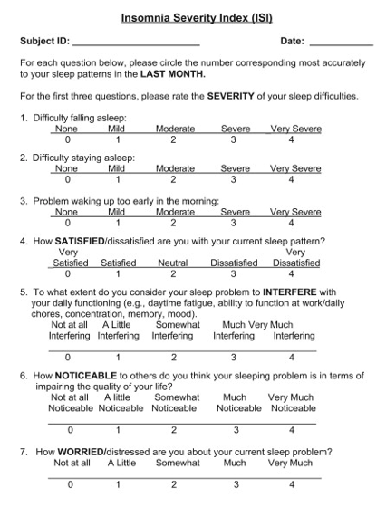
What is the
Insomnia Severity Index?
Screening tool to evaluate severity of sleep issues
ISI Questionnaire Categories:
  0–7: No insomnia
  8–14: Minimal insomnia
  15–21: Moderate insomnia
  22–28: Severe insomnia
Notes:
If you get the question: “Is this a diseased population?” or “Can we translate these data to a healthy population?”
The IRB did not consider our enrollment to be “disease” and no one was diagnosed with a sleep disease.
ISI is a screening tool, not a diagnosis. It's used as a triage tool, and also of course as one of the gold standard in sleep research to assess the efficacy of interventions
As such criteria from formal clinical diagnostic tools (such as DSM‑5 or ICSD‑3) were not met/verified such as frequency (needs to be more than 3x/week) and how long it has been perduring (more than 3 months)
General pop cohort that besides their concerns about sleep quality was in "general good health"
Also, the protocol explicitly excluded untreated sleep apnea, narcolepsy, major depression, etc

Slide 22
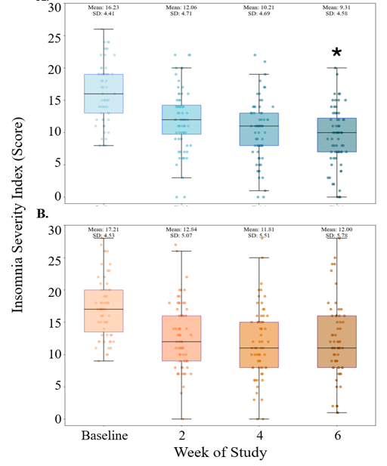
LP815 delivers clinically meaningful sleep relief in 6 weeks
LP815
Statistically significant reductions exceed the 4‑point Minimal Clinically Important Difference (MCID).
LP815 provides a significant improvement that participants can feel.
Outcome at Week 6 | 5 B CFU | Placebo | P value
Mean ISI score | 9.31 ± 4.58 | 12.00 ± 5.78 | 0.01
Reached ≥4‑point MCID | 77 % | 58 % | 0.02
ISI sub‑questions | 5 out of 7↓, p ≤ 0.05 | - | -
Placebo
*p=0.01
Notes:
Additionally, those with severe baseline insomnia exhibited a statistically significant drop by week 4 (p=0.04), (-11.1 ± 5.7 vs -6.9 ± 4.8).
What is a clinically meaningful reduction in ISI? Consensus among the CRO and other sleep experts was a 4-point reduction. Ultimately, the result was that it is meaningful if the participant feels it is meaningful. In the end, there is no definition of clinically meaningful and the argument becomes a blackhole.

Slide 23
ISI sub-questions show improvements across most metrics
ISI Questions | p-values | Key findings
1. Difficulty Falling Asleep | 0.01 | ▲ Improved sleep onset latency
2. Difficulty Staying Asleep | 0.04 | ▲ Improved sleep maintenance
3. Problem Waking Up Too Early | 0.03 | ▲ Improved sleep maintenance
4. Satisfaction With Current Sleep Pattern | 0.05 | ▲ Greater satisfaction with sleep
5. Extent of Interference With Daily Function | 0.42¹ | — No added daytime drowsiness
6. How Noticeable is the Sleep Problem in Terms of Impairing Quality of Life? | 0.11¹ | ▼ Trend towards less visible impairment
7. Worry or Distress About the Current Sleep Problem | 0.05 | ▼ Reduced sleep-related emotional burden
¹ NS=nonsignificant ; Nominal p-values

Slide 24
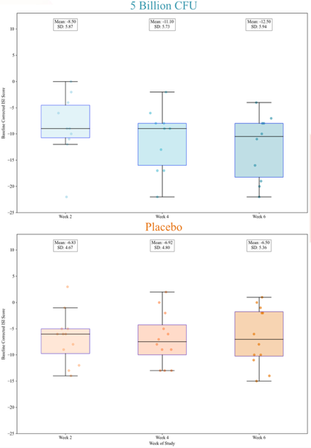
ISI Reduction for Severe Baseline Insomnia
LP815 Delivers Larger Benefits as Baseline Sleep Quality Worsens
LP815
Week 6: the severe-insomnia group cut ISI by 12.5 ± 5.9, triple the MCID, dropping two categories to mild insomnia and doubling the full-cohort response.
ISI reduction at Week 6 | 5 B CFU | Placebo | P value
At least minimal starting insomnia (n=127) | -6.97± 5.48 | -5.26 ± 4.71 | 0.01
At least moderate starting insomnia (n=96) | -8.67 ± 5.09 | -5.67 ± 4.86 | 0.01
Severe starting insomnia (n=21) | -12.50 ± 5.94 | -6.5 ± 5.36 | 0.01
Placebo
Notes:
Additionally, those with severe baseline insomnia exhibited a statistically significant drop by week 4 (p=0.04), (-11.1 ± 5.7 vs -6.9 ± 4.8).
What is a clinically meaningful reduction in ISI? Consensus among the CRO and other sleep experts was a 4-point reduction. Ultimately, the result was that it is meaningful if the participant feels it is meaningful. In the end, there is no definition of clinically meaningful, and the argument becomes a blackhole.
At time 0:
No insomnia n=11
Minimal n=31 (127-96)
Moderate n=75
Severe n=21

Slide 25
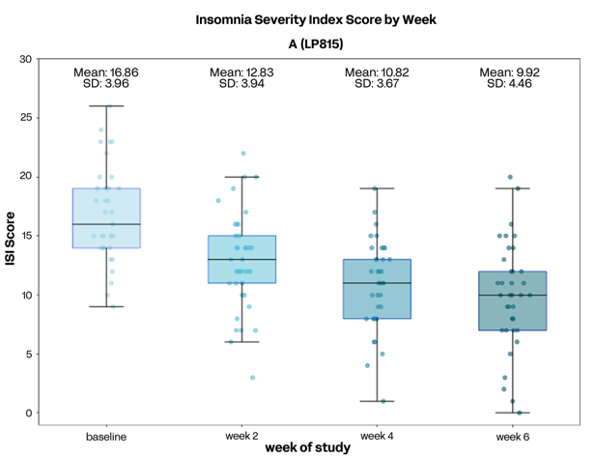
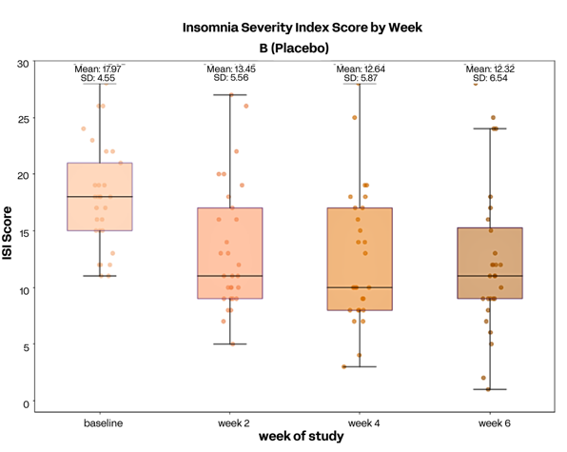
LP815 Improves Women’s Sleep
Women outperform men and placebo in 6-week ISI reduction
Sources
Ask ChatGPT
n=37 5B CFU, n=29 Placebo​; Filtered for scores of at least 8 (Mild Insomnia); * p = 0.003 vs placebo at Week 6
Mixed-effects model, Sex × Treatment: ΔISI −1.7, p = 0.006

Slide 26
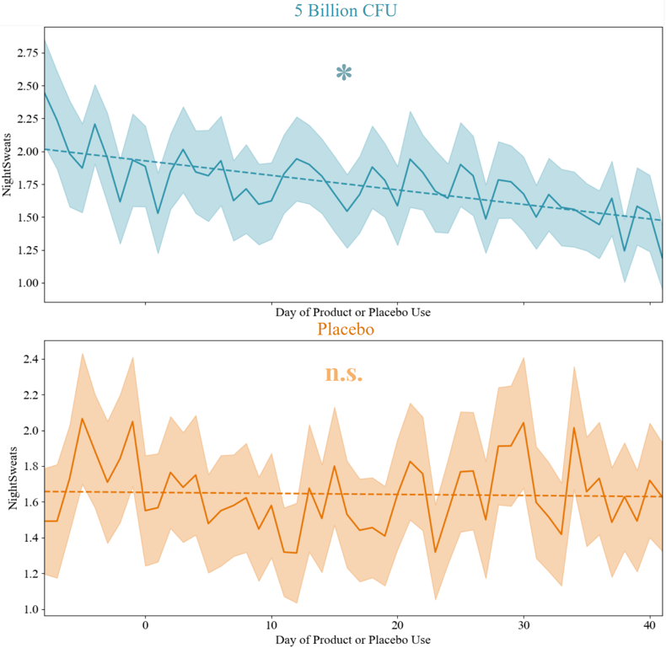
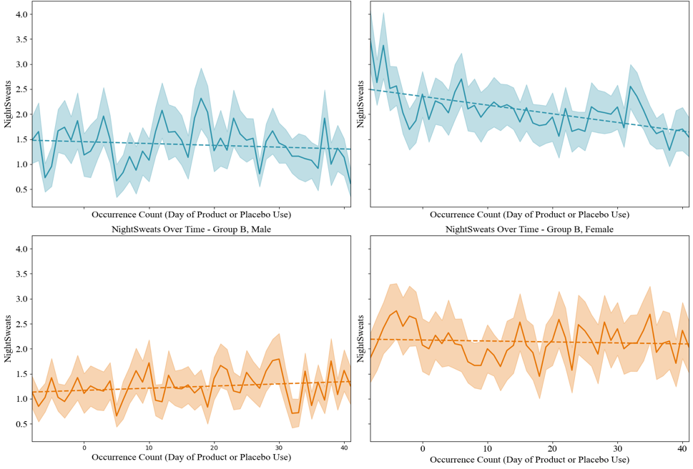
LP815 Decreases Night Sweat Severity
MALE
FEMALE
5 Billion CFU
*
*
Day of Product or Placebo Use
n.s.
n.s.
Placebo
Women have a higher baseline for night sweats and a steeper slope of improvement.
*p<0.05 across study period

Slide 27
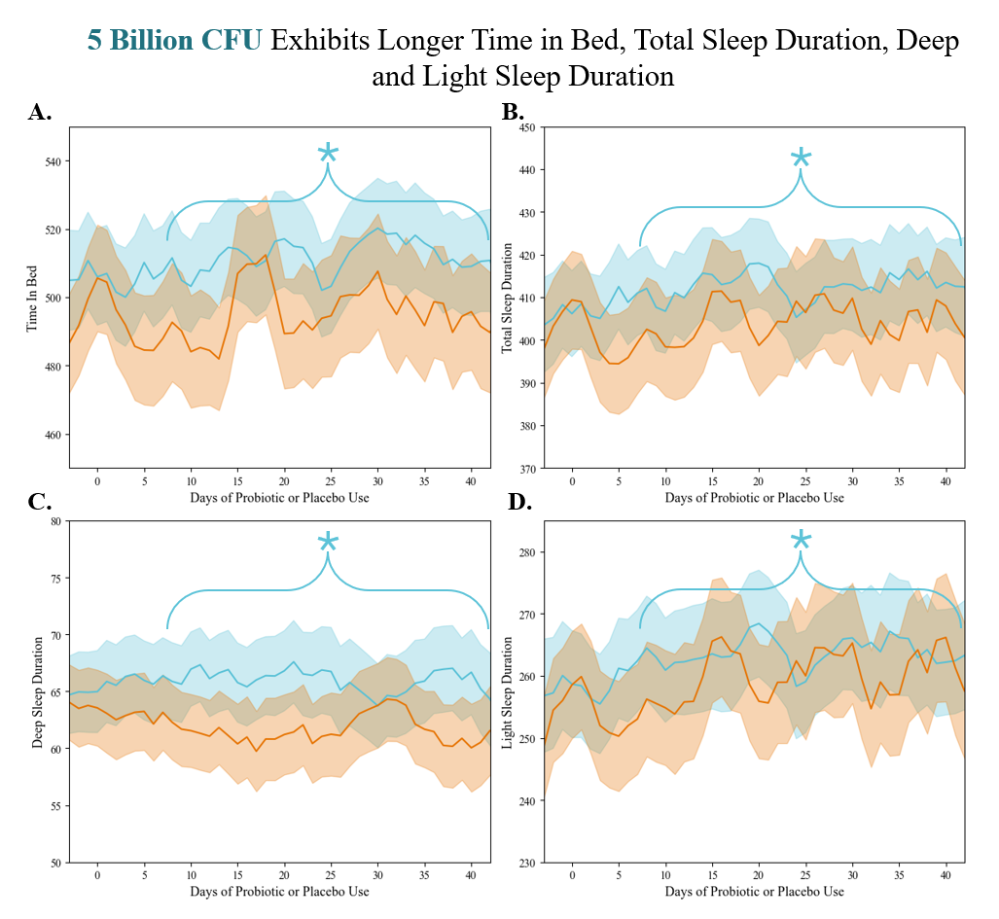
Placebo
LP815
Wearable data also show objective sleep gains:
Longer Time in Bed
Total Sleep Duration
Deep Sleep Duration
...without next-day drowsiness!
* indicates significant difference between groups over the bracketed time window.
*p<0.05 across study period

Slide 28
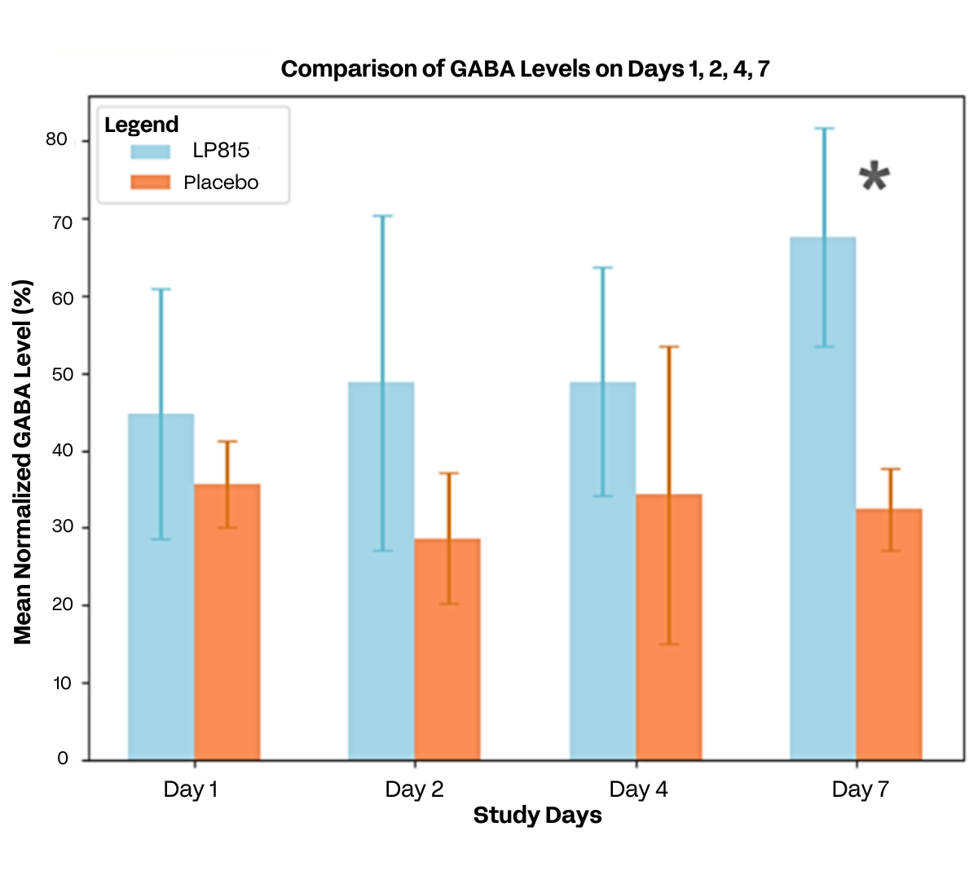
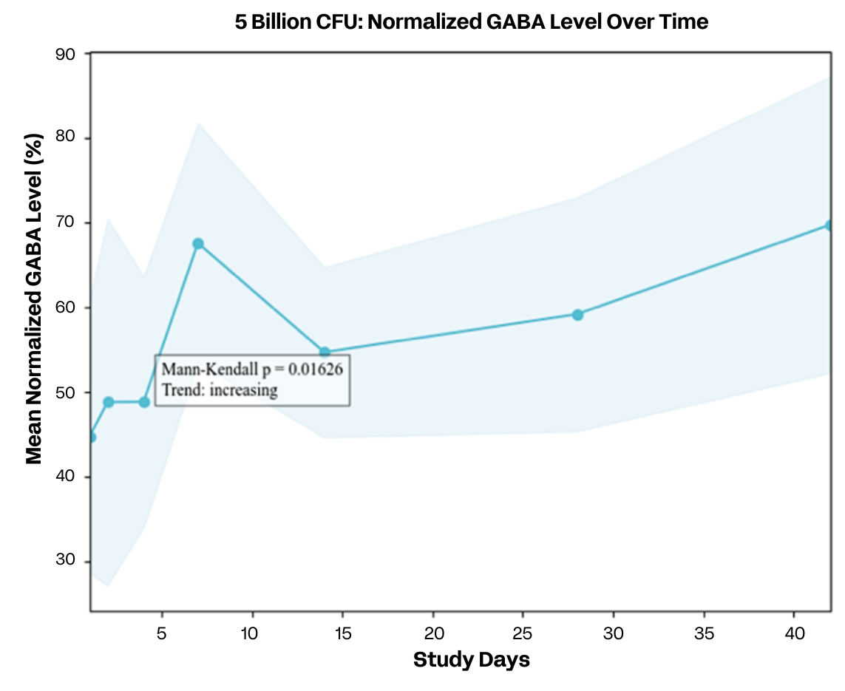
Mechanistic Evidence: LP815 Elevates Urinary GABA
*
*p=0.04
LP815: n=9
Placebo: n=8
Notes:
Placebo had only two participants per time point after day 14, so only 5 Billion CFU data is shown

Slide 29
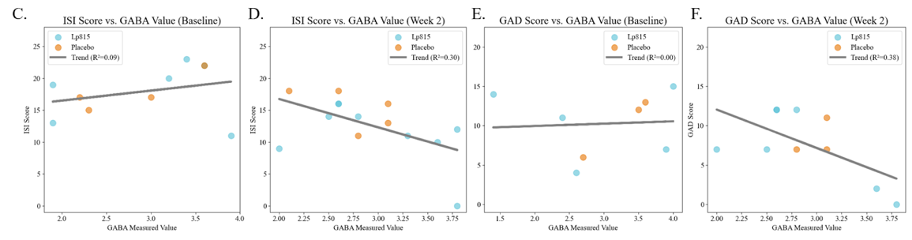
Mechanistic evidence: LP815-driven rise in urinary GABA correlates with lower insomnia and anxiety
Baseline: Urinary GABA shows no link to ISI or GAD-7 (r² ≈ 0)
Week 2: Higher GABA following LP815 supplementation predicts lower ISI and GAD-7 (r² = 0.30, 0.38)
Placebo participation falls to two after Day 14, so Week 2 is the strongest cross-group comparison
Notes:
Mechanistic understanding of LP815

Slide 30
GABA LP815 Claims & Benefits
Structure/Function Claims
  Helps reduce feelings of irritability
  Promotes a calm mood
  Supports healthy stress management
  Supports deep restorative sleep
  Helps relieve night sweats
  Improved total sleep duration and deep sleep duration
Benefits
  68% of participants reduced stress by week 4
  77% of participants improved sleep by week 6
  Stress improved by 151%
  Benefits felt as early as week 2
  No GI distress observed in clinical testing
PAGE 30

Slide 31
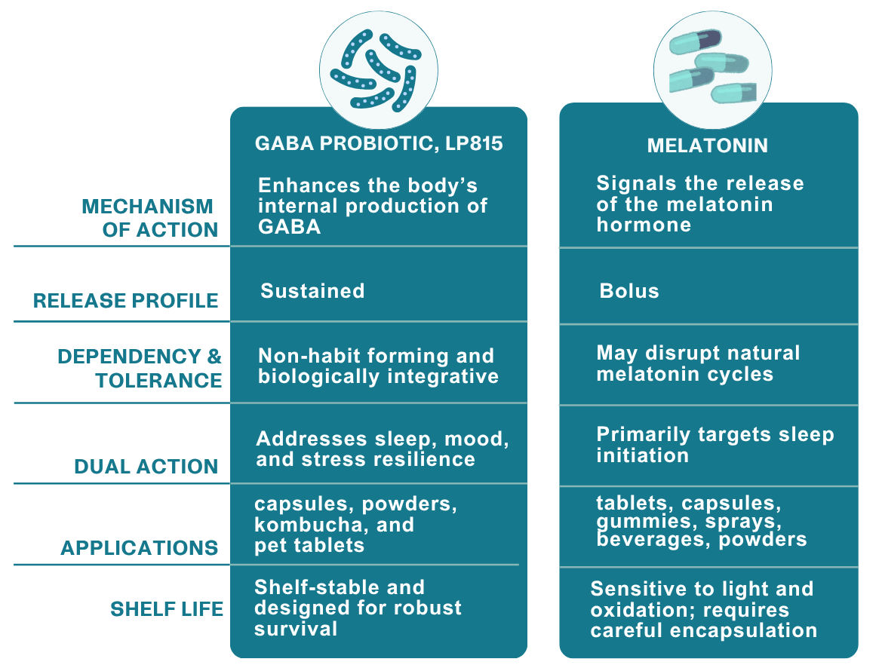
No contamination potential because the organisms are heat-inactivated
Specialized cleaning and isolation procedures needed
to prevent spore contamination
pH, heat-stable; requires refrigeration in a beverage format to avoid germination
No overage required!
10% recommended
May interact with other ingredients, affecting spore germination
Highly compatible &
versatile in formulations
GI distress may occur upon initial use
None!
Gas & bloating relief, barrier integrity, immune support
Digestive health, immune balance, gut flora modulation
PAGE 31

Slide 32

LP815® Compatibility
LP815 has been tested to be stable and compatible with the following sleep supplements in powder format when combined and stored at room temperature for 1 week.
L-Theanine – 200mg
Magnesium L-Threonate – 144mg
Ashwagandha – 600mg
Melatonin – 10mg
*Sleep supplements were tested in capsule concentration amounts
PAGE 32

Slide 33
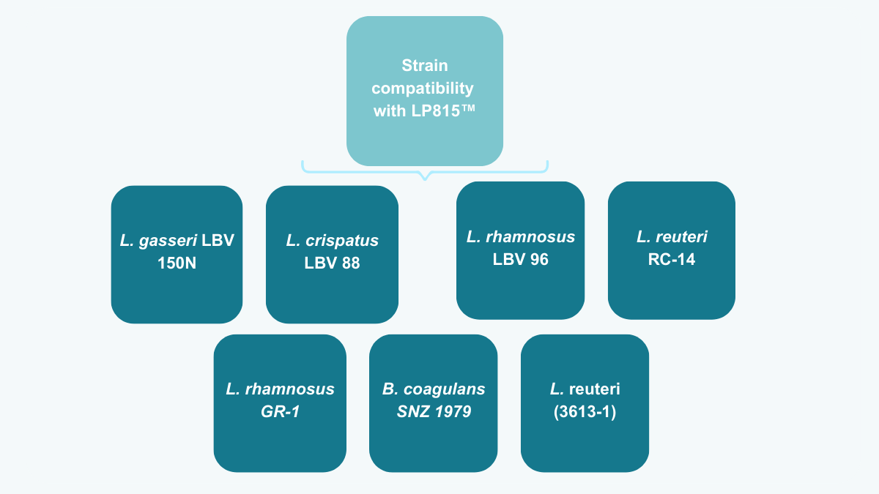
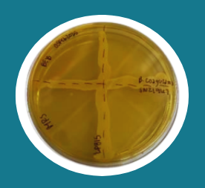
16S rRNA sequencing positively identified each strain
Cross streaking of LP815 against each of the commercially available probiotic strain did not result in a growth inhibition of either the commercially available probiotics or of LP815.
LP815® is viable and compatible with commercially available vaginal health strains.
SNZ 1969

Slide 34









LP815™ Applications
CAPSULES
TABLETS
POWDERS
ICE CREAM
Ask us about this unique format!
YOGURT | KEFIR
KOMBUCHA
non-pasteurized
CHOCOLATE
FREEZE-DRIED FRUIT BITES
Melt & Jet x Verb Biotics

Slide 35
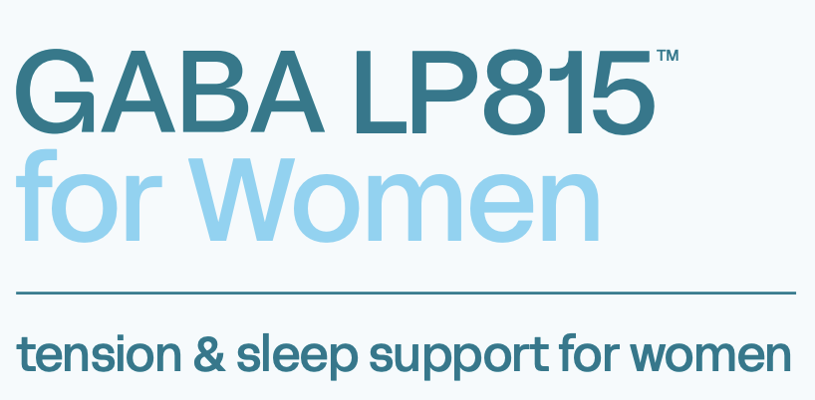

Slide 36
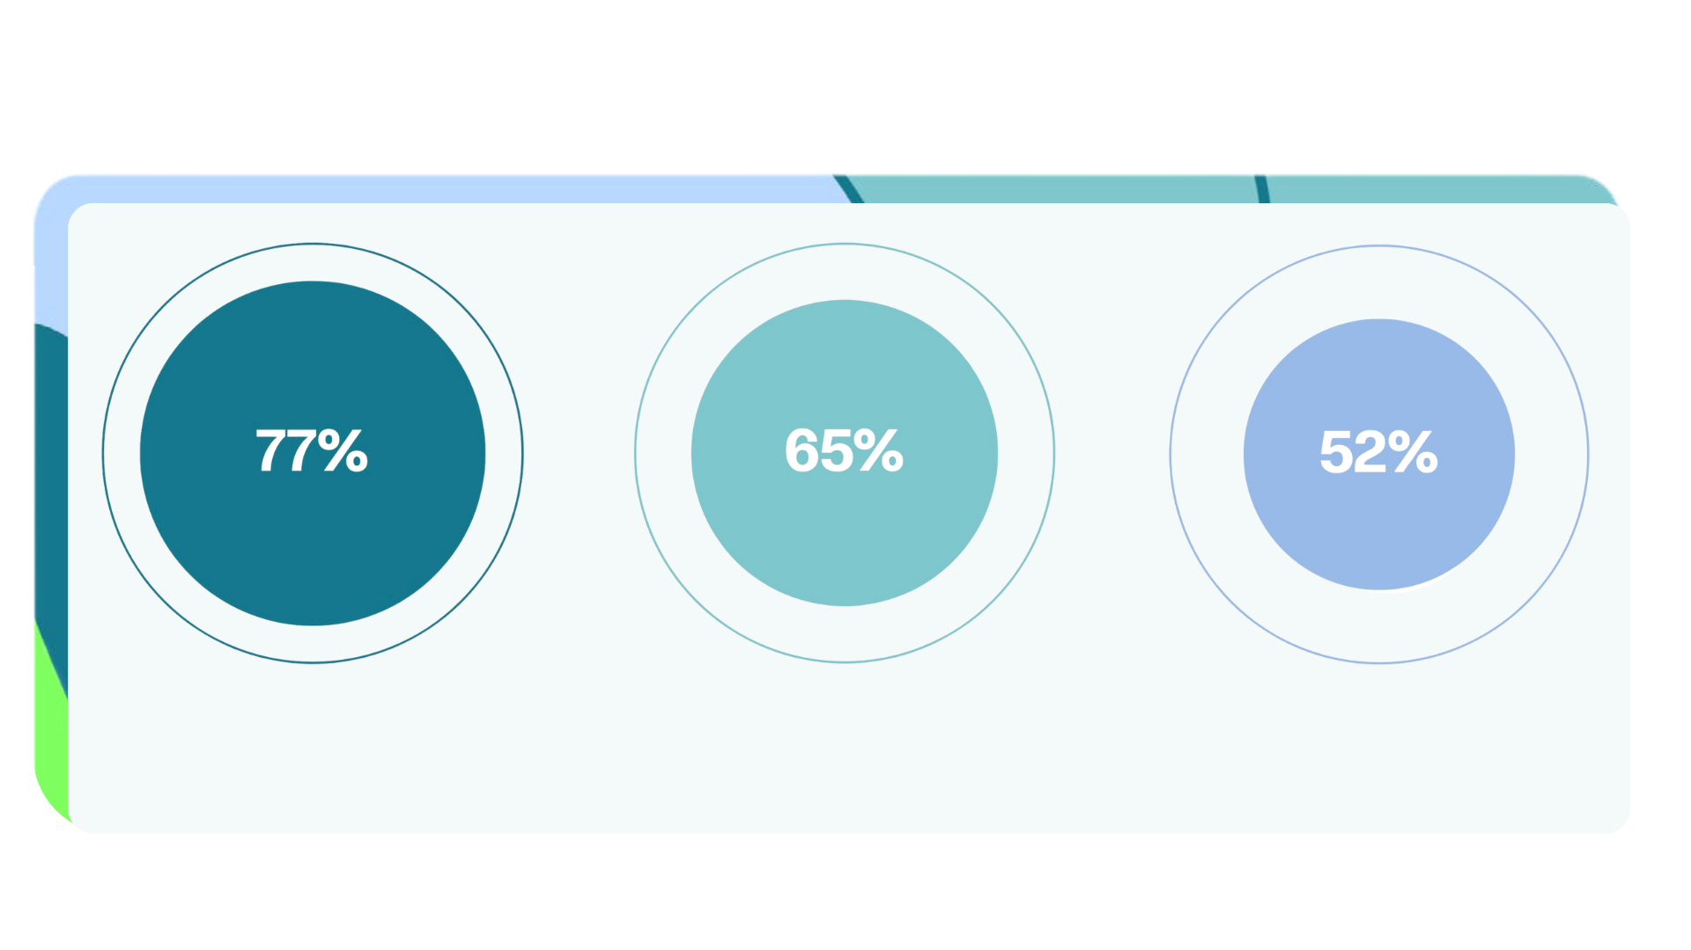
Mental health is a significant struggle for women
of women struggle with mental health related symptoms
of women struggle
with stress
of women suffer with sleeplessness/insomnia
PAGE 36
Source: Verb Biotics Consumer Health Survey, July 2024, N=2,018

Slide 37
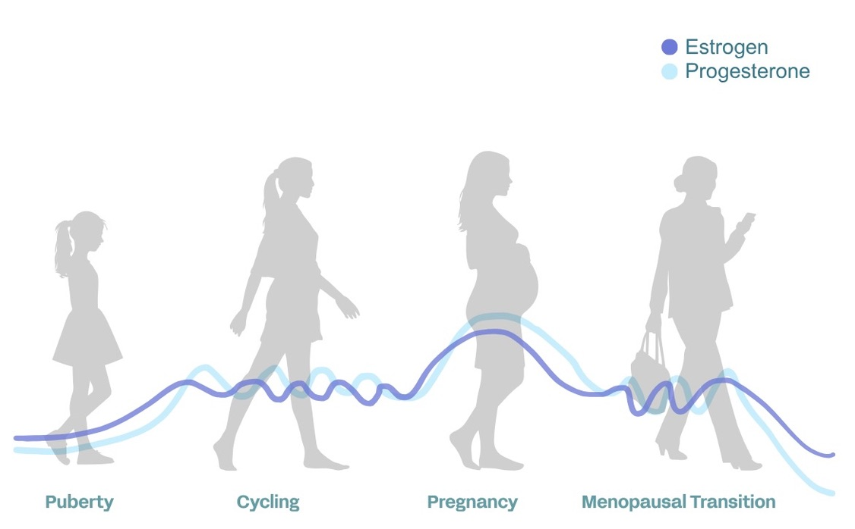
GABA levels fluctuate with women's hormones. Supporting GABA during hormonal shifts helps maintain balance—promoting better mood, stress response, and sleep.

Slide 38
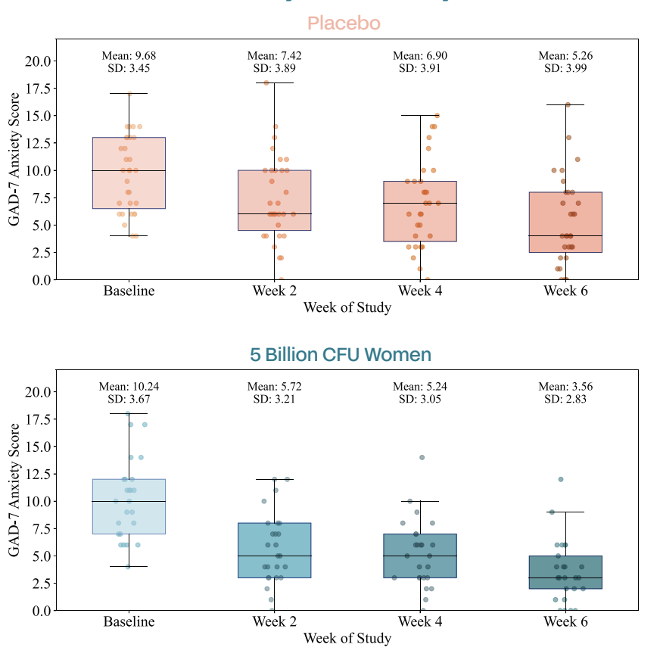
LP815 significantly reduces stress
Placebo
66.7% of women taking LP815 significantly reduced (5+ points) GAD-7 stress scores vs. 27.8% on the placebo
LP815
Women taking LP815 saw a 52.7% drop in GAD-7 scores from baseline to week 6
n=33; n=18 placebo, n=15 5 billion CFU
p<0.05 at week 6 vs. placebo

Slide 39
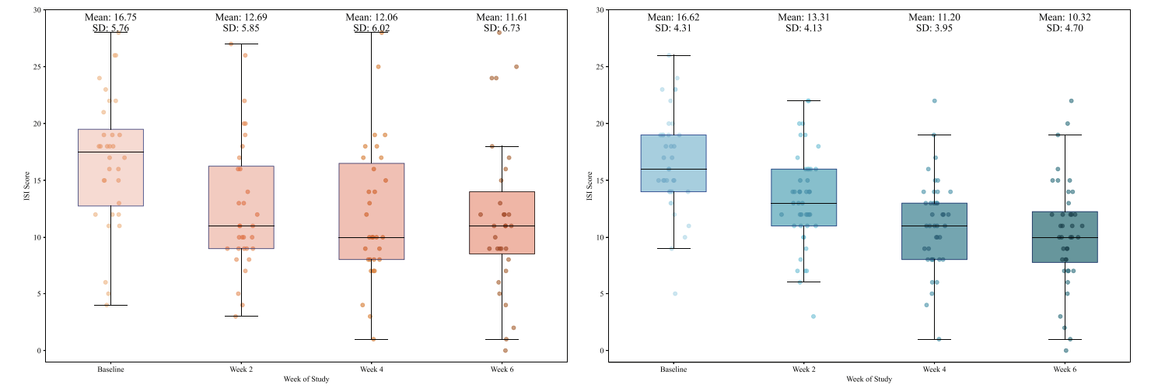
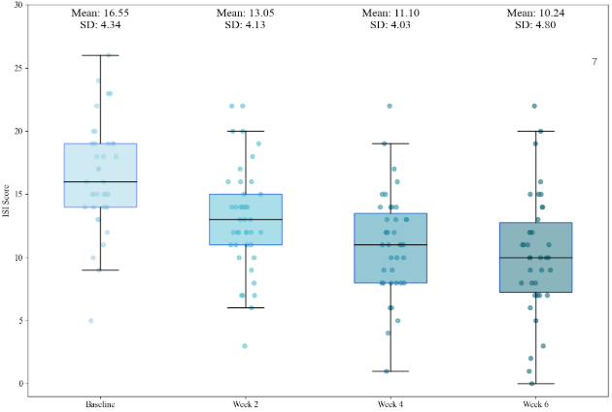
100% of women improved their sleep by week 6
n=71; p=0.07
Placebo
LP815
LP815
By week 6, all women taking LP815 improved their ISI score by 4 points, compared to just 42.9% in the placebo group
(filtered for ISI scores of at least 1+)

Slide 40
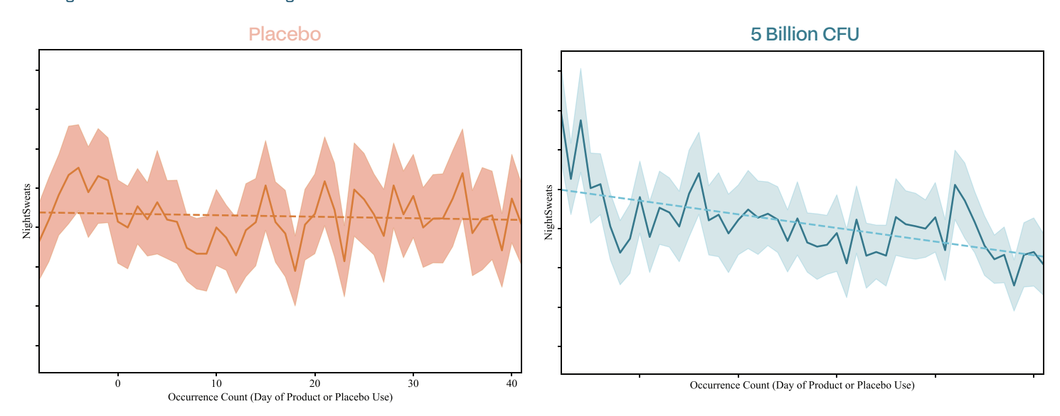
Improved nighttime temperature comfort
Regardless of age or ethnicity, LP815 had a significant decrease on elevated nighttime body heat over time
N = 71; p = 0.05
LP815
Placebo
LP815
n=71

Slide 41

LP815 for women
BENEFIT AREAS
Tension and stress support
Helps reduce irritability
Supports deep, restorative sleep
Promotes restful, temperature-balanced sleep
APPLICATIONS
PMS, perimenopause, menopause support
Hormonal support
RECOMMENDED DOSAGE
5 billion CFU (50 mg per day)
GRAS | Allergen-free | Non-GMO | Produced in USA

Slide 42
GABA LP815 for Women
Claims & Benefits
Structure/Function Claims
  Tension and stress support
  Helps reduce irritability
  Supports deep, restorative sleep
Benefits
  67% of women reduced stress by week 2
  100% of women improved sleep by week 6
  ALL women experienced significant decrease in nighttime temperature comfort
  – proven to lower elevated nighttime body heat
  Benefits felt as early as week 2
  No GI distress observed in clinical testing
PAGE 42

