Slide 1

Improving health through microbiome innovation
FOR CLIENT NAME HERE
DATE

Slide 2


“Improving health through microbiome innovation”
Function-first science that opens nature’s toolbox to bring inspired microbiome solutions to our partners.
“I feel the effect”

Slide 3







Platforms build upon foundation of science
Supporting specific needs states of the target population
GUT-BRAIN HEALTH
SPORTS RECOVERY
HEALTHLY AGING
stress
mood
sleep
gut permeability
soreness
energy/stamina
joint health
Inflammation
muscle maintenance
WOMENS HEALTH
HEALTHY METABOLISM
COMPANION ANIMAL
menopausal support
stress/mood
hormone support
healthy weight
blood glucose
satiety
anxiety
aggression
sleep
VERB’S VISION
Create a metabolite leaderboard targeting key health conditions
Technologies are modular. Standalone, stacked with other Verb technologies, or integrated with customer ingredients
North Star: Efficacy. Consumer need to "feel the effect"
PAGE 4

Slide 4


Completed human clinical trials
Keystone Postbiotic®
GABA Probiotic, LP815®
GI Symptoms (pilot)
Bacterial Composition
Stress/Mood
Sleep/Urinary
Design: DB-R
Duration: 4 weeks
Subjects: 10 Healthy M/F
Main Endpoint: GI Symptoms Rating Scale (GSRS)
Outcome: Statistically significant decrease in GSRS
Design: DB-RPC
Duration: 4 weeks
Subjects: 80 Healthy M/F
Main Endpoint: Microbiome modulation
Outcome:
≥ 800% increase in 33 beneficial endogenous bacterial species
68% improvement in emotional wellbeing
Design: DB-RPC
Duration: 6 weeks
Subjects: 102 Healthy M/F
Main Endpoint: Stress
Outcome: 68% of participants experienced reduced stress
*Manuscript published in
Beneficial Microbes
Design: DB-RPC
Duration: 6 weeks
Subjects: 150 Healthy M/F
Main Endpoint: Sleep
Outcome:
77% of participants exhibited improved sleep
Increased and sustained levels of urinary GABA through week 6
*Manuscript published in Nature's Scientific Reports
Page 4

Slide 5
Keystone Postbiotic®
for foundational gut microbiome health

Slide 6
Why we are excited …
Strains and grains work together to revitalize one's existing beneficial keystone gut microflora
Postbiotic for precision microbiome health
No major shift in diversity, endogenous “good” microbes go up and the “bad” go down, able to modulate Akkermansia
No GI distress/side effects
Consistent MOA from in vitro data to pilot to clinical trials results
MOA defined: Microbiome to butyrate to stress biomarkers to inflammatory to “feel the effect”
Notes:
Precision Microbiome modulation
Good bacteria up/bad bacteria down -> not broad increase in both good and bad
Decrease in gas/bloating
Low dose
Trending changes in fecal SCFA concentrations
Acetate (p=0.08)
Butyrate (p=0.28)

Slide 7





Keystone Postbiotic®
MULTI BENEFIT
LOW DAILY DOSE
SUPPLY CHAIN
Manufactured in USA
Scaled to meet demand
Non-GMO Project Verified
Allergen-free
Kosher
Self-affirmed GRAS
Supports microbiome balance
Supports emotional wellbeing & mood
Supports GI health and immune performance
Gas & Bloat relief
Suggested dose:
300 mg daily
=
Notes:
Refer to Purity IQ NMR and PCR data to show traceable metric and reproduceablity of Keystone Postbiotic

Slide 8

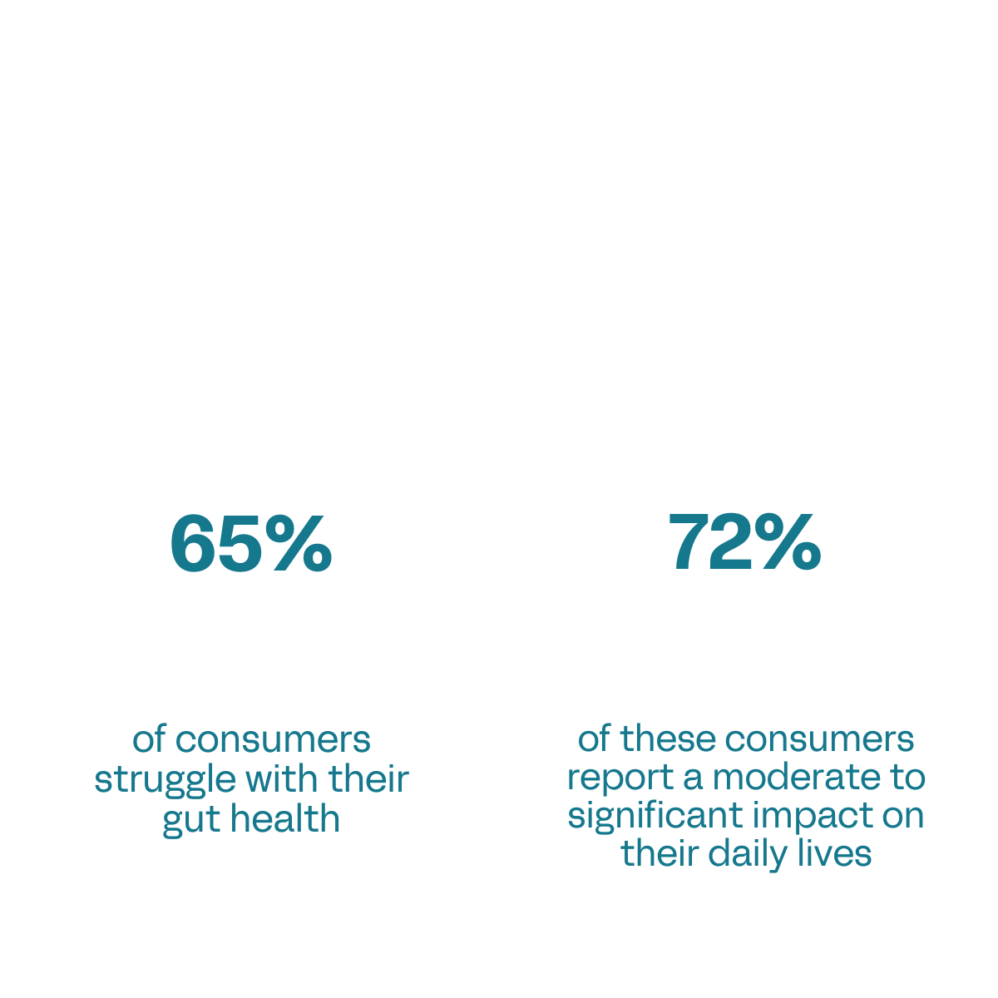
Gut health concerns are a daily struggle for many consumers
Source: Verb Biotics 2024 Consumer Health Survey

Slide 9
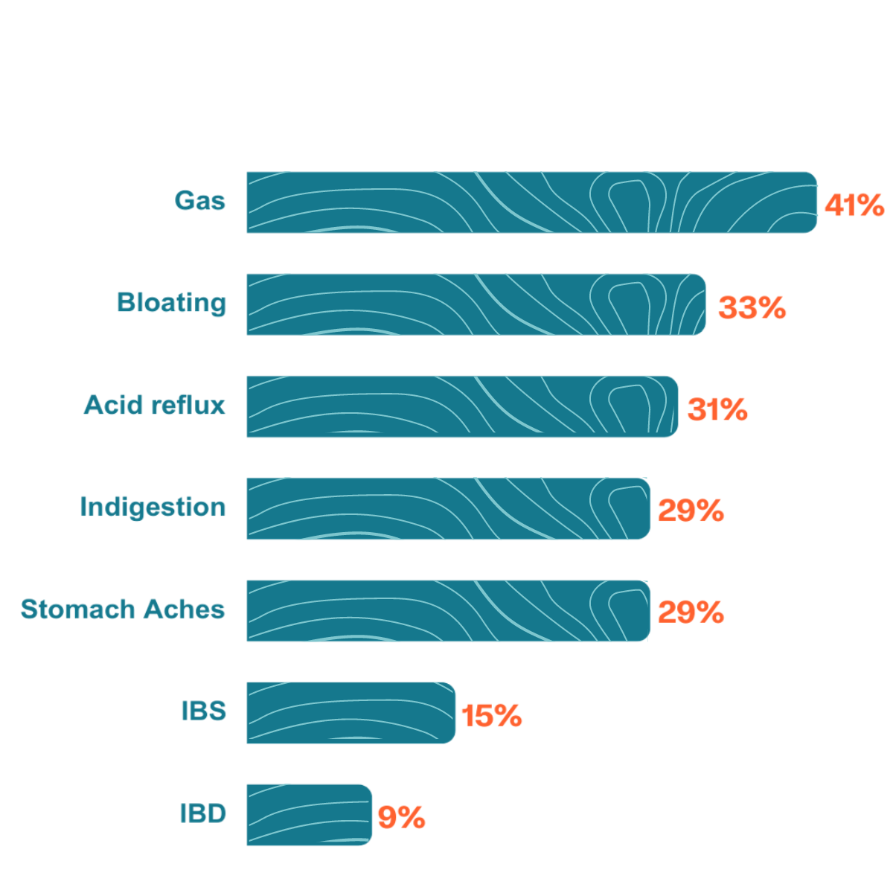
Percent of consumers who experience the following symptoms
Source: Verb Biotics 2024 Consumer Health Survey

Slide 10





Function first, intentional design
STRAIN & SUBSTRATE SELECTION
HEALTH
INDICATION
MECHANISMS
OF ACTION
Regulatory
Clinicals
Scale
GI Distress
3 synergistic MOAs
Lactobacillus probiotic strains fermented on oats
Shelf-stable
postbiotic for food, beverage & supplement brands
Notes:
keep

Slide 11
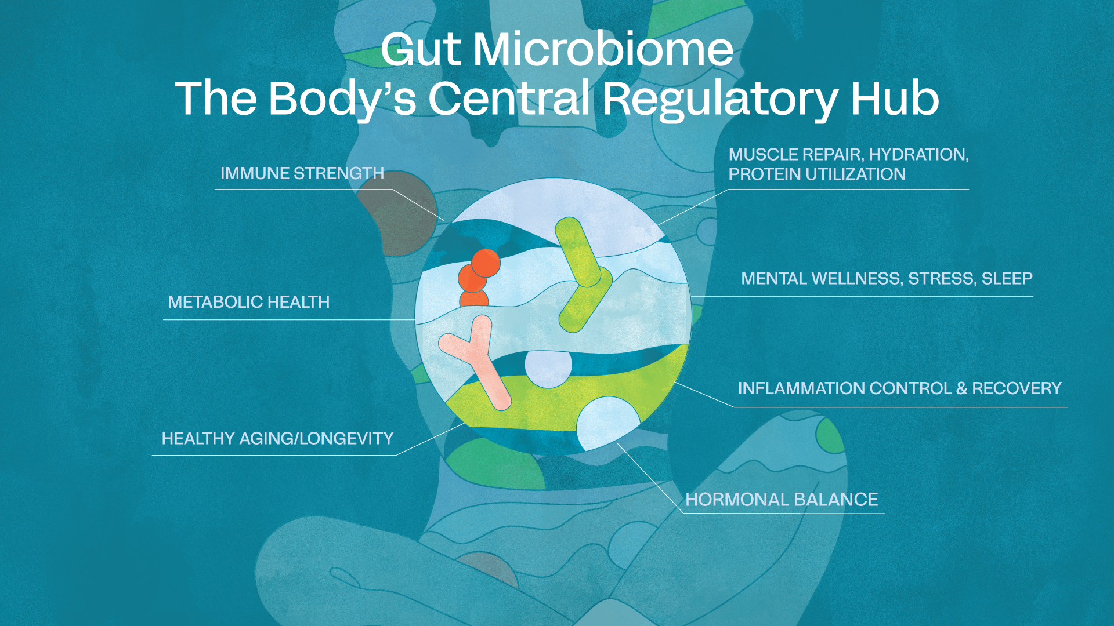

Slide 12

Keystone microbes have a big role in our health...
Central role and outsized influence in maintaining the stability, integrity (tight junctions), and function of the gut environment
Suppress the overgrowth of pathogens
Deliver metabolites (acetate, butyrate and propionate)
Often anaerobic -> difficult to isolate/manufacture/formulate

Slide 13
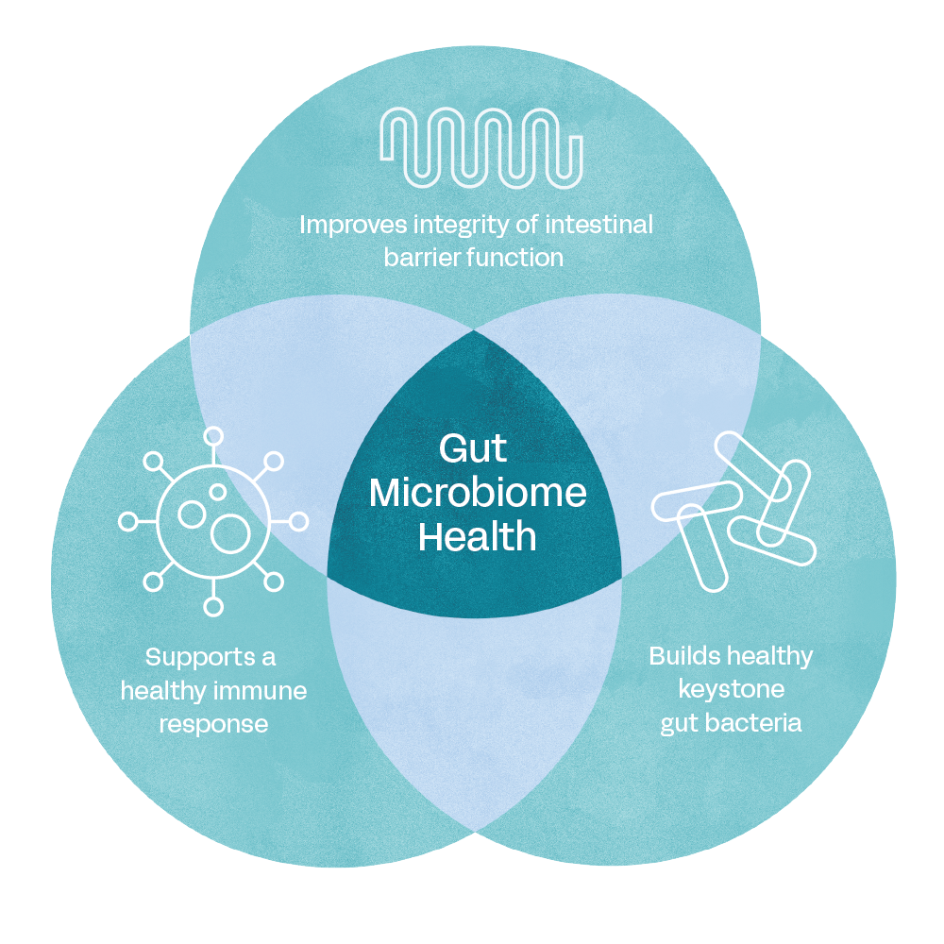
Three synergistic mechanisms of action
Notes:
Gas and bloating is the end result, these are the MOA’s that we want the product to do.

Slide 14

Why oats for the substrate?
Oats have a unique composition of beta-glucans, polyphenols, and other phytochemicals
  Beta-glucans > function as a prebiotic to boost gut health
  Polyphenols (Avenanthramides) > act as signaling molecules to modulate inflammation
Oat compounds induce gene expression in the bacteria to help regulate gut barrier function, modulate inflammation and cross feed members of the microbiome.
Notes:
Oats stimulate certain genes during the fermentation of Keystone

Slide 15


A NEW APPROACH
A new type
of postbiotic utilizing fermentation
MICROBES
Improve immune health
& gut barrier integrity
OATS
Improve immune health &
aids keystone bacteria linked
to a healthy gut.
FERMENTATION
Stimulates biotransformation of botanicals & production of metabolites
DELIVERS FUNCTION-SPECIFIC METABOLITES
Notes:
Fermented foods are products made through microbial action and the enzymatic conversion of food components.
Replace with Brooke’s version

Slide 16
In vitro Data
Keystone Postbiotic

Slide 17
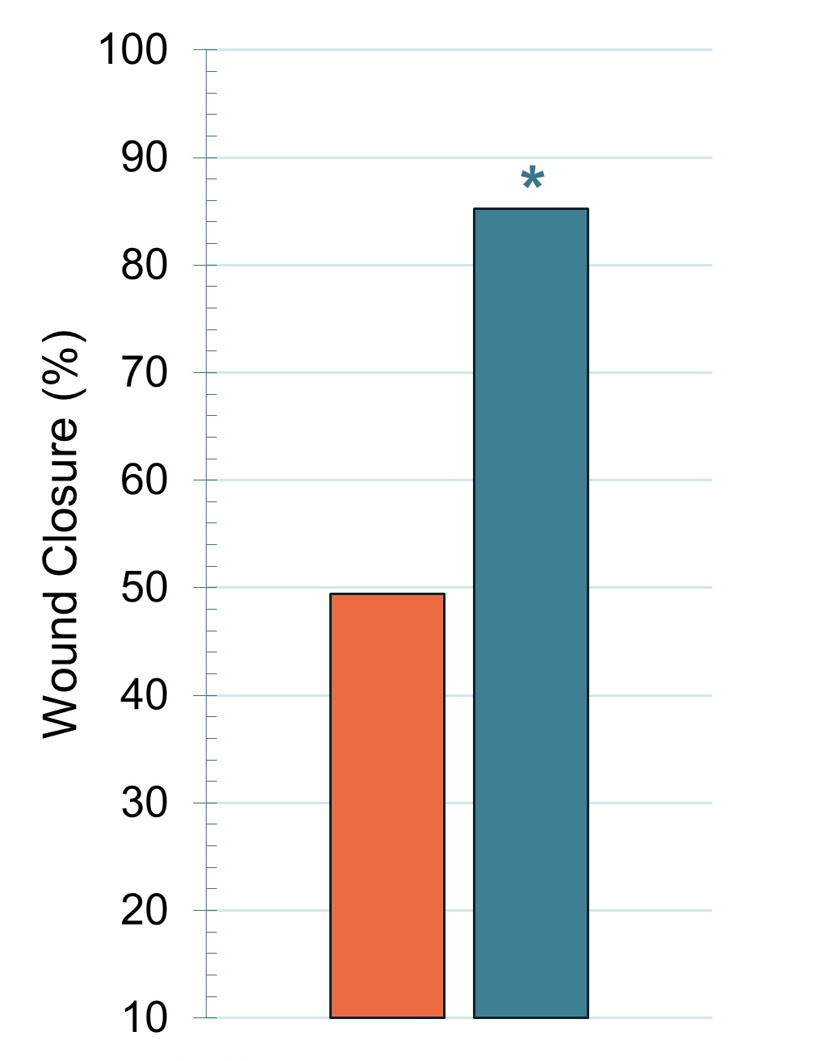
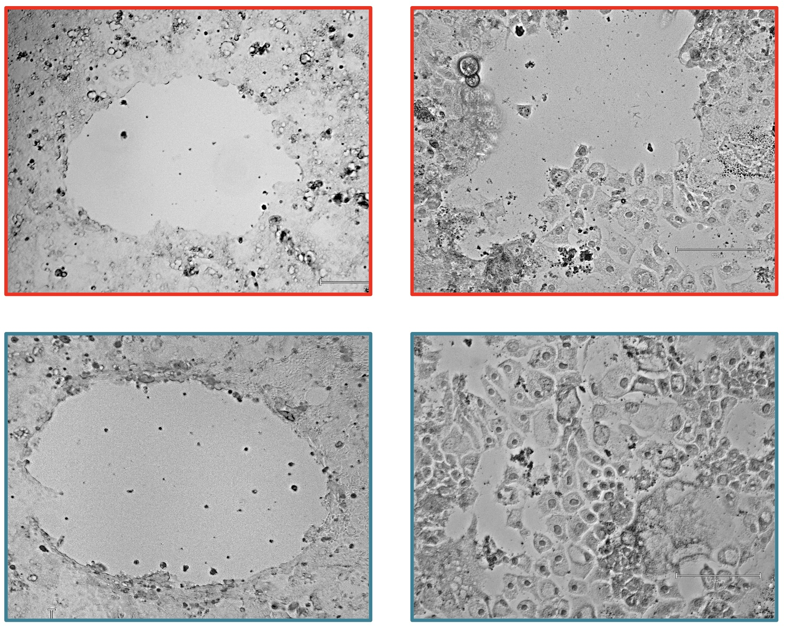
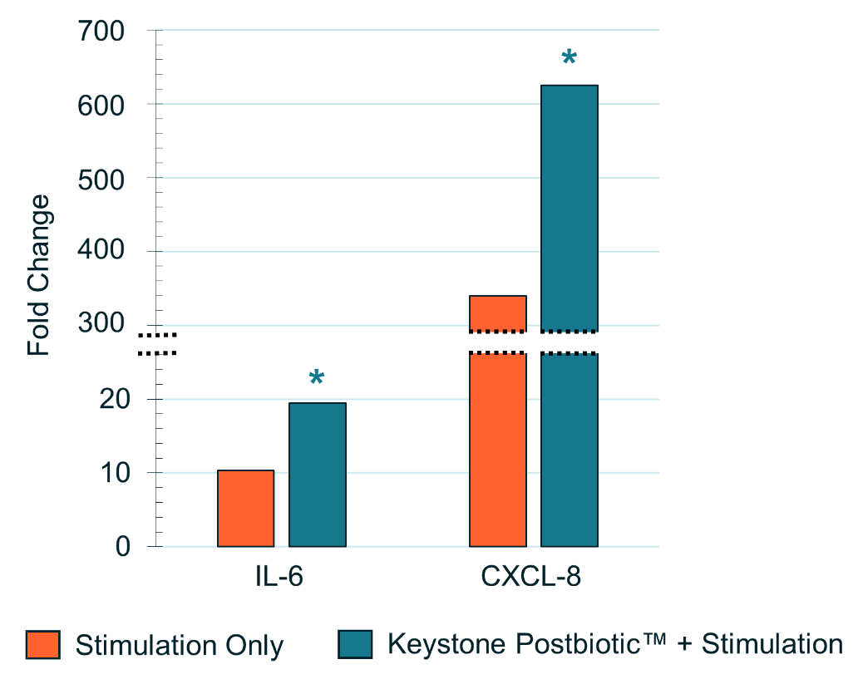
Supports foundational intestinal barrier function
0 h
24 h
Control
Keystone
Keystone Postbiotic increased chemokine production
Control
Keystone Postbiotic®
Notes:
These two strains have been shown to regulate the immune system. Took intestinal epithelial cells and added Keystone. We saw an increase in two chemotaxic cytokines or chemokines, IL-6 and CXCL-8. Initially it sounds like these markers are inflammatory, but we know from the literature and work done on these bacterial strains that we will see an increase in these cytokines. They aren’t involved in inflammation at all, but rather they are involved in maintaining a healthy intestinal epithelium. We see an increase in these signal molecules, so the next step was to look at wound healing assays.

Slide 18

Intestinal Epithelium
TEER 24h
*
*
Supports foundational intestinal barrier function
No Stimulation
Stimulation Only
Keystone + Stimulation

Slide 19
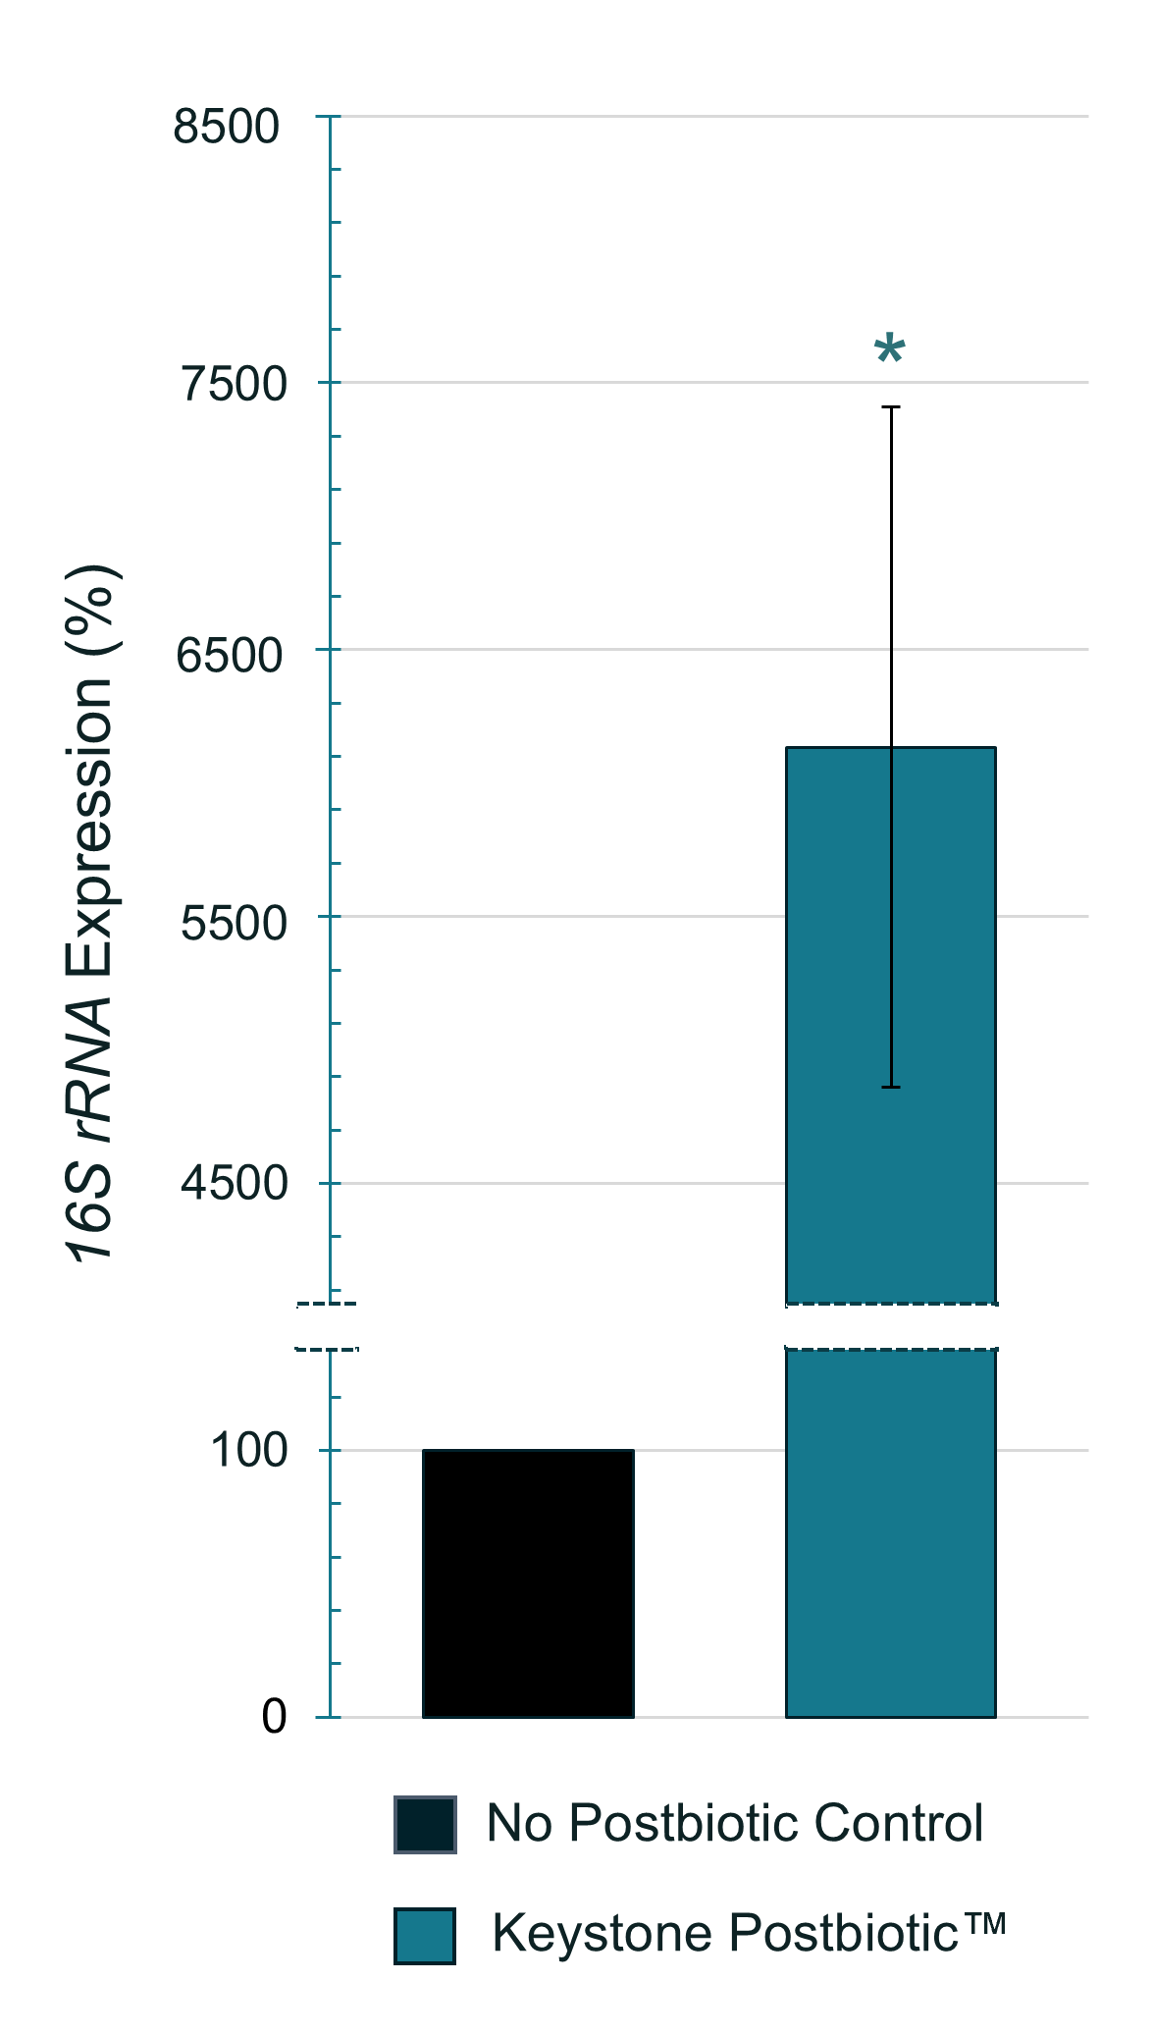
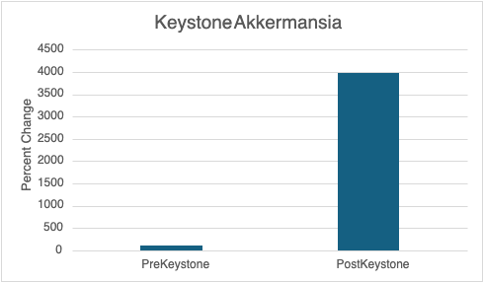
Supports keystone gut bacteria
Initial data supports human clinical #2
[
In the human pilot study, Keystone significantly
increased endogenous Akkermansia levels.
[
Supplementation with Keystone Postbiotic increased the endogenous Bifidobacterium population of human fecal flora 54 times
PAGE 19
Based on a gene-based analysis targeting a conserved DNA sequence unique to Bifidobacterium.
Notes:
To better understand how Keystone Postbiotic™ can affect the proliferation of Bifidobacterium in the human intestine, we developed a human fecal-based media seeded with human stool (n=3 donors) to quantify the Bifidobacterium population after 48 hour anaerobic incubation. Measurements of Bifidobacterium were done by quantitative polymerase chain reaction (qPCR) to determine the amount of Bifidobacterium DNA present before and after stimulation with Keystone Postbiotic™. The original Bifidobacterium population was stimulated 54-fold by Keystone Postbiotic™. The inclusion of grapeseed extract with Keystone Postbiotic™ was more supportive toward the fecal Bifidobacterium population which had a 369-fold increase. In vitro studies demonstrated that Keystone Postbiotic™ promotes the proliferation of Bifidobacterium spp., creating the foundation of numerous health-improving effects.

Slide 20
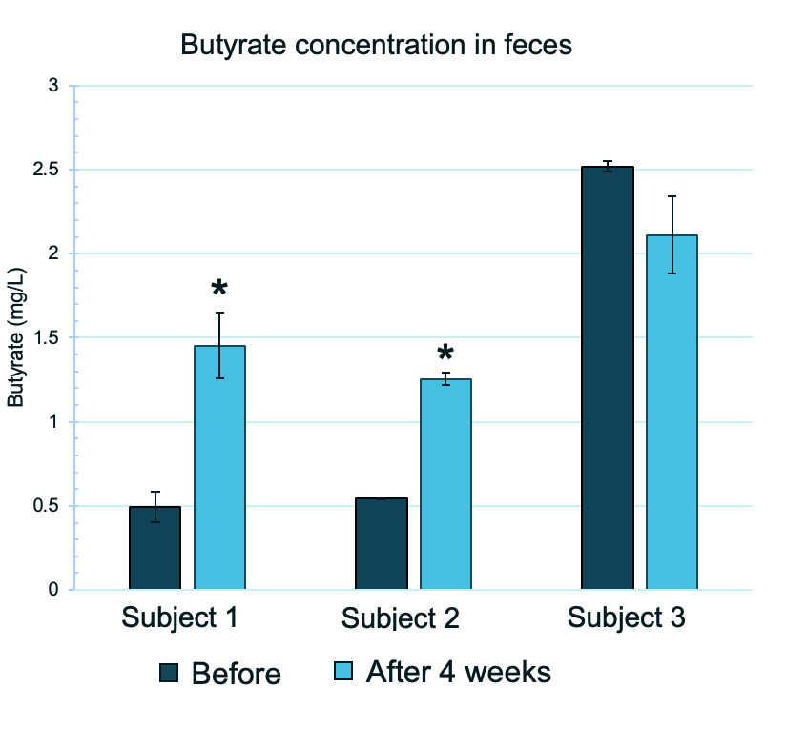
Increases butyrate levels
[
Keystone increased fecal butyrate in subjects on a Western Diet
PAGE 20
Notes:
To better understand how Keystone Postbiotic™ can affect the proliferation of Bifidobacterium in the human intestine, we developed a human fecal-based media seeded with human stool (n=3 donors) to quantify the Bifidobacterium population after 48 hour anaerobic incubation. Measurements of Bifidobacterium were done by quantitative polymerase chain reaction (qPCR) to determine the amount of Bifidobacterium DNA present before and after stimulation with Keystone Postbiotic™. The original Bifidobacterium population was stimulated 54-fold by Keystone Postbiotic™. The inclusion of grapeseed extract with Keystone Postbiotic™ was more supportive toward the fecal Bifidobacterium population which had a 369-fold increase. In vitro studies demonstrated that Keystone Postbiotic™ promotes the proliferation of Bifidobacterium spp., creating the foundation of numerous health-improving effects.

Slide 21
Human Clinical Data
Keystone Postbiotic

Slide 22
Keystone Postbiotic® human pilot study design
DESIGN
DURATION
SUBJECTS
ARMS
SITE
Randomized, double-blind
4 weeks
Healthy
Male & Female
Age 18-65
300 mg Postbiotic (n = 10)
USA
Endpoints:
  Fecal SCFAs | Changes in microbiome | GI Symptoms Rating Scale (GSRS) | Quality of Life Questionnaire (SF-36) | Physical Activity Questionnaire

Slide 23
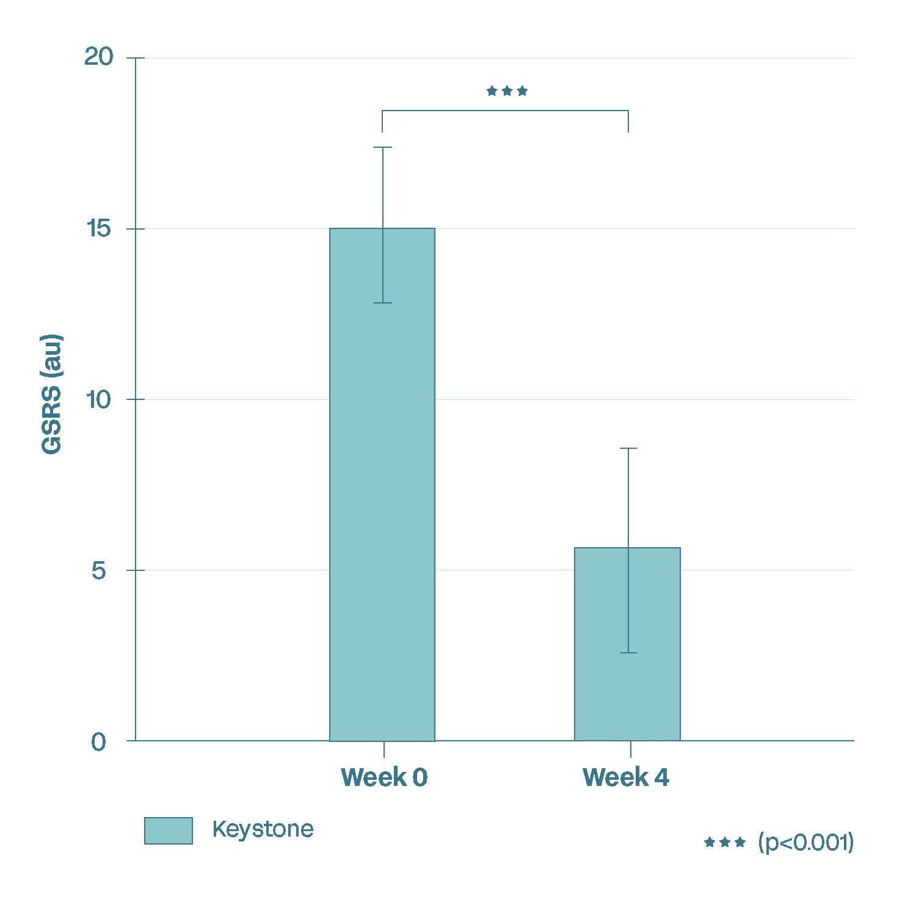
Keystone Postbiotic Decreases GSRS
(Gastrointestinal Symptom Rating Scale)
Clinical Results: GSRS
GSRS values significantly decreased after 4 weeks
Notes:
The GSRS is an instrument based on reviews of gastrointestinal symptoms and clinical experience, to evaluate common symptoms of gastrointestinal disorders including:
Abdominal pain
Reflux syndrome
Diarrhea
Indigestion
Constipation
62.7% decrease
65.9% decrease

Slide 24

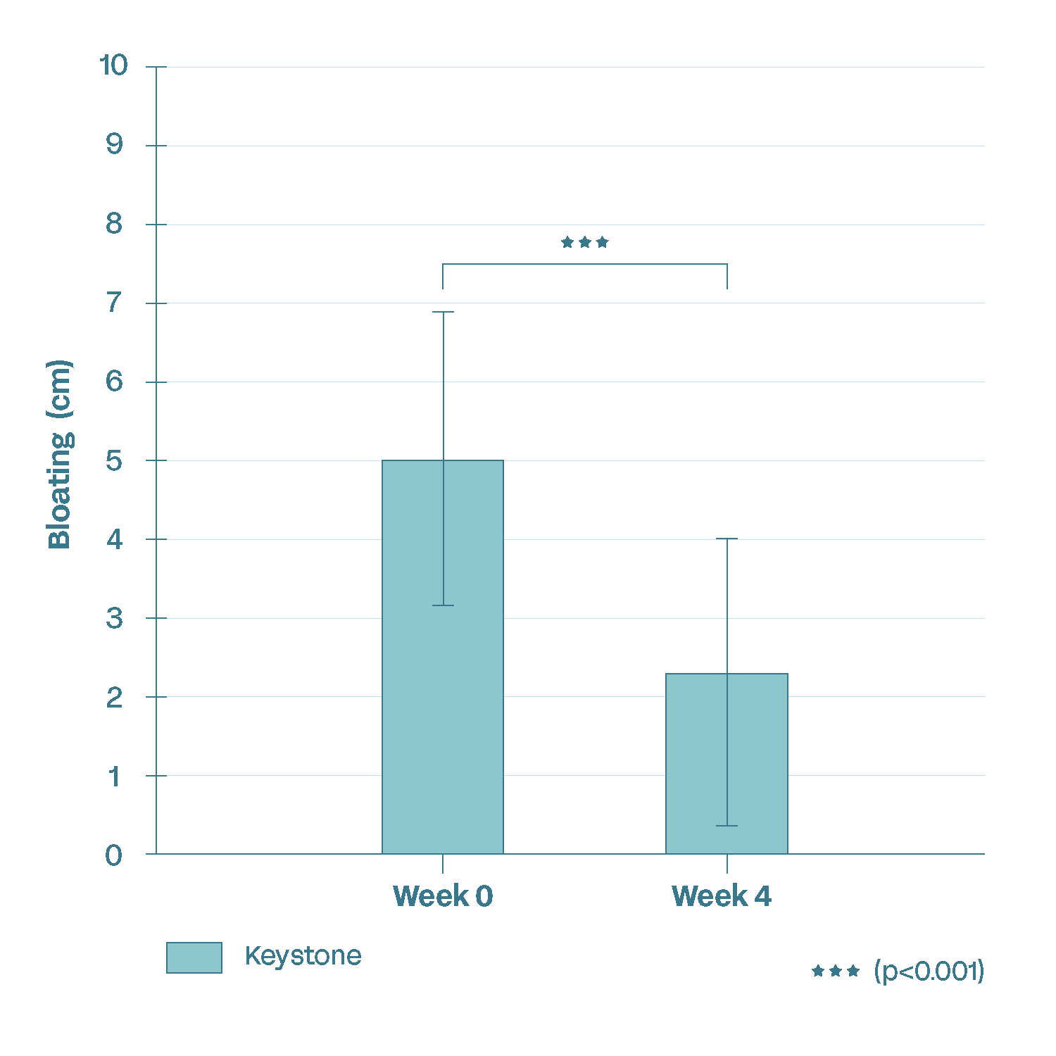
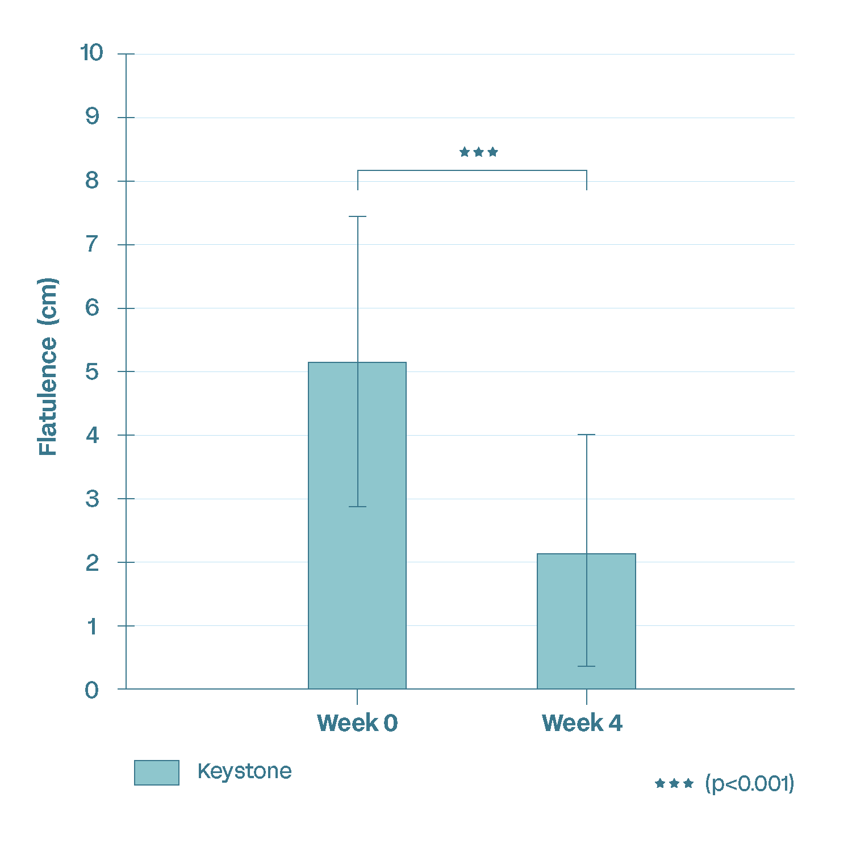
Keystone Postbiotic decreases bloating and flatulence
Clinical Results: Flatulence
Clinical Results: Bloating

Slide 25
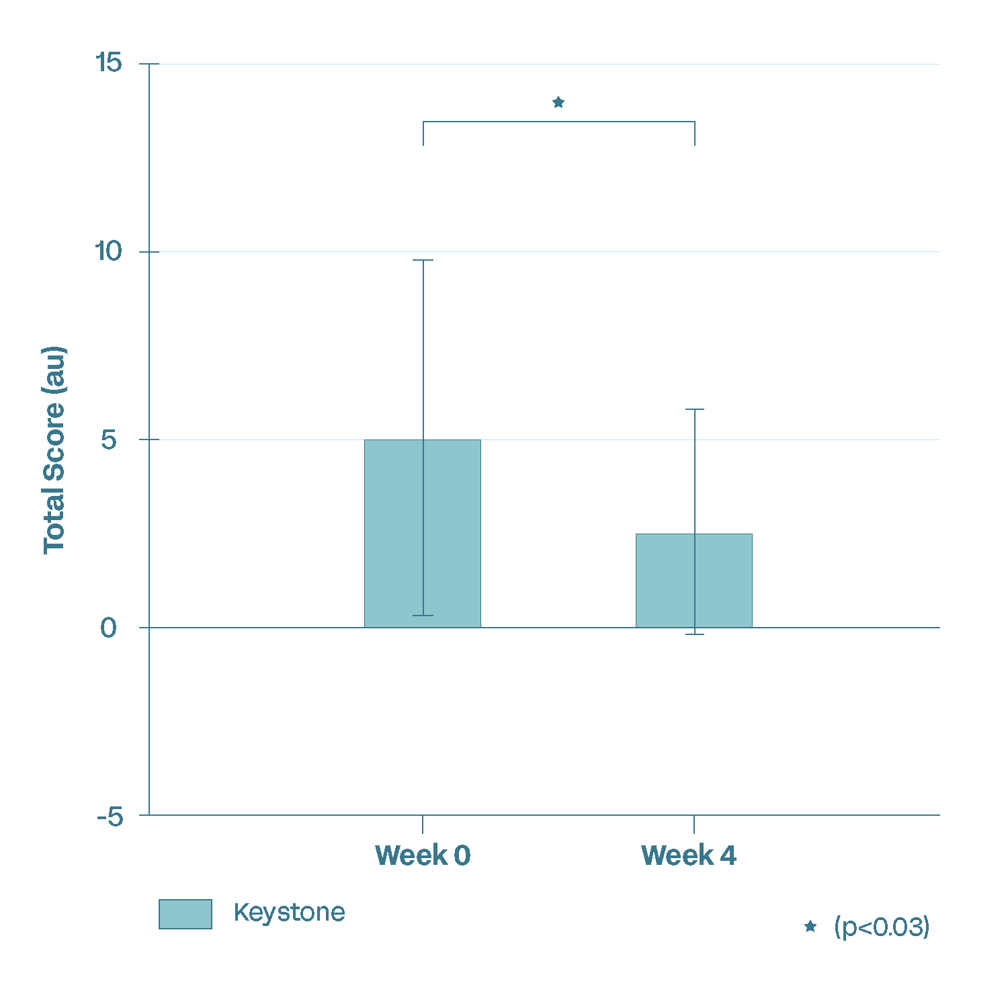
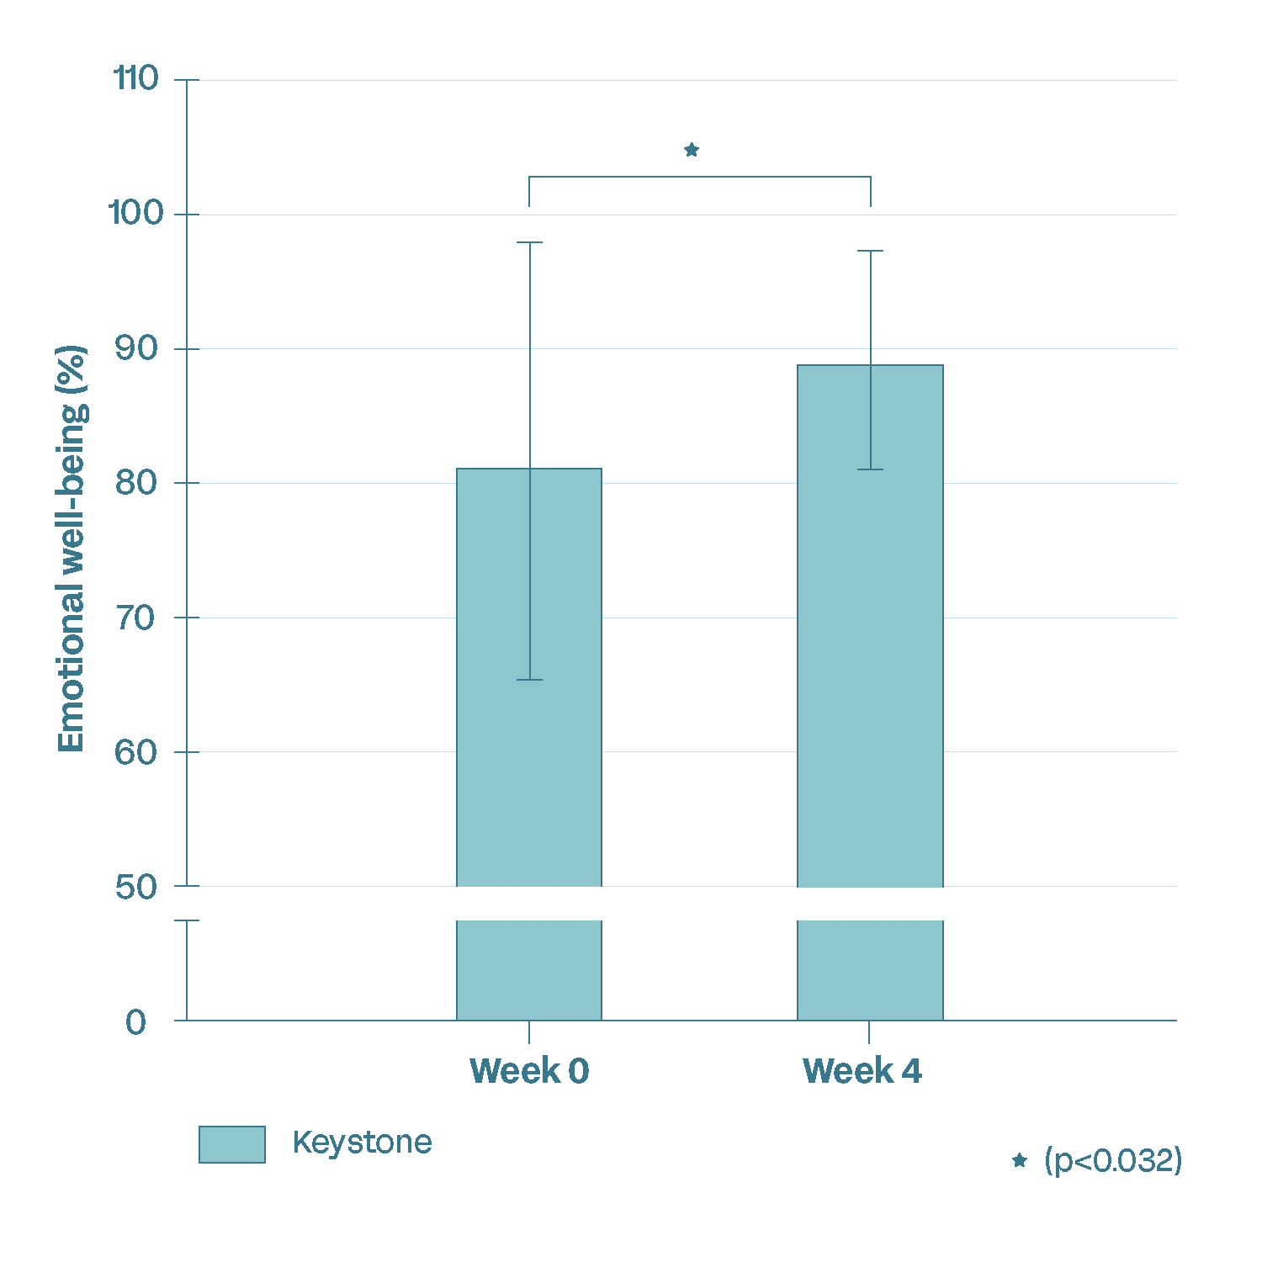
Emotional Wellbeing
Clinical Results: Mood/Stress
Clinical Results: Emotional well-being
Participants reported a significant reduction in anxiety symptoms (GAD-7 questionnaire) after 4 weeks of Keystone supplementation.
Participants reported a significant improvement in emotional well-being (SF-36 questionnaire) after 4 weeks of Keystone supplementation.
Notes:
The SF-36 questionnaire is a 36-item Short Form Health Survey to measure overall health and quality of life. The SF-36 measures emotional well-being through its Mental Health domain which includes questions related to happiness, calmness and peacefulness, depression and sadness, and nervousness.
8.8% increase

Slide 26
Keystone Postbiotic Human Study #2
DESIGN
DURATION
SUBJECTS
ARMS
SITE
Double-blind
Randomized
Placebo-controlled
4 weeks
Healthy
Male & Female
Age 18-65
300 mg Postbiotic
(n = 40)
Placebo (n = 40)
USA
Endpoints:
SCFAs | Inflammatory & Immune markers | Intestinal permeability
  Fecal microbiome diversity | Cortisol levels | GI health | GLP-1 | QoL
Notes:
Break down the endpoints to be more digestible – have everything in the notes

Slide 27
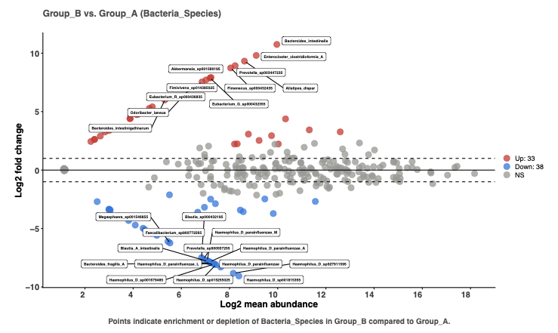
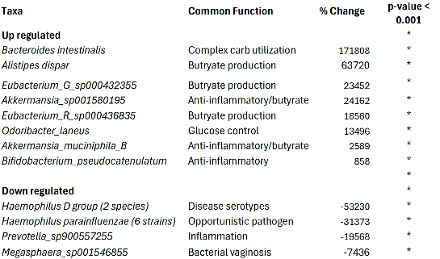
Keystone Clinical Data: Targeted microbiome modulation with Keystone
Increases endogenous Akkermansia and other beneficial bacteria already living in your gut, no colonization by foreign probiotic strains
DESIGN
DURATION
SUBJECTS
SITE
Takeaway: Significant rise in 33 beneficial species and drop in 38 potentially harmful species vs placebo
Notes:
Keystone promoted the growth of endogenous beneficial bacteria within the gut microbiome.
Clinical findings demonstrate not only an increase in health-promoting microbial species but also a corresponding decrease in non-beneficial species highlighting its role in restoring microbial balance and strengthening gut microbiome resilience.

Slide 28
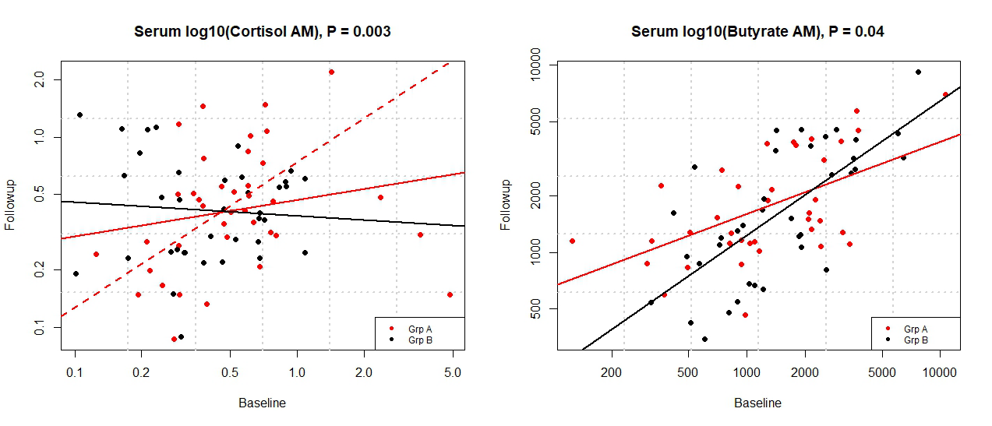
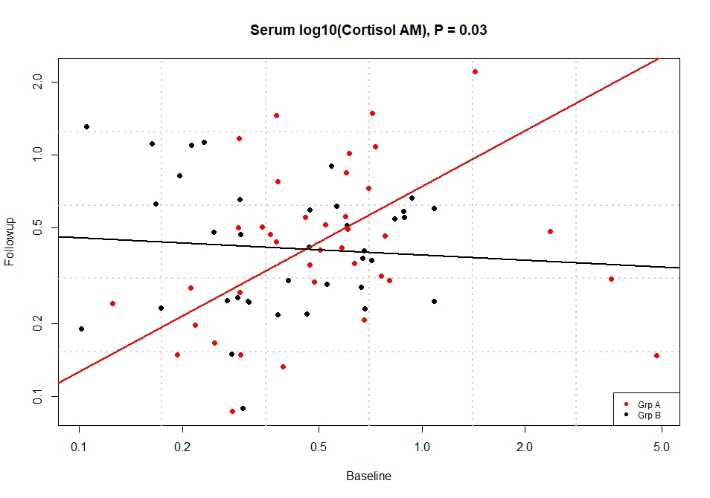
Keystone Clinical Data: Biomarkers Measured
Serum Butyrate p=0.053
Salivary Morning Cortisol p=0.03
KEY:
Red = Placebo
Black = Keystone
Takeaway: Participants on Keystone had more butyrate in blood and significantly lower rates of the stress hormone cortisol production after 4 weeks

Slide 29
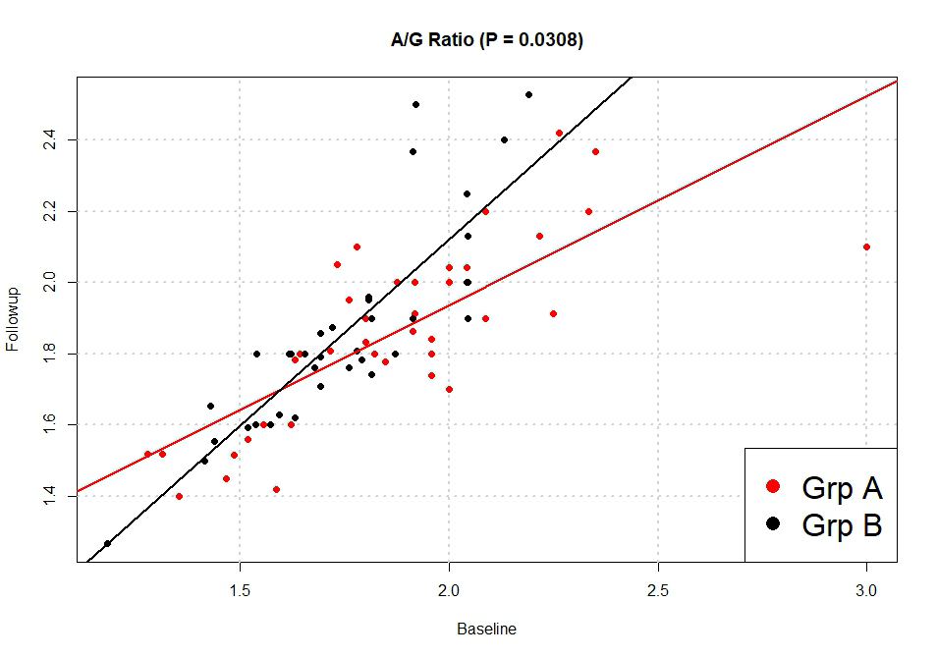
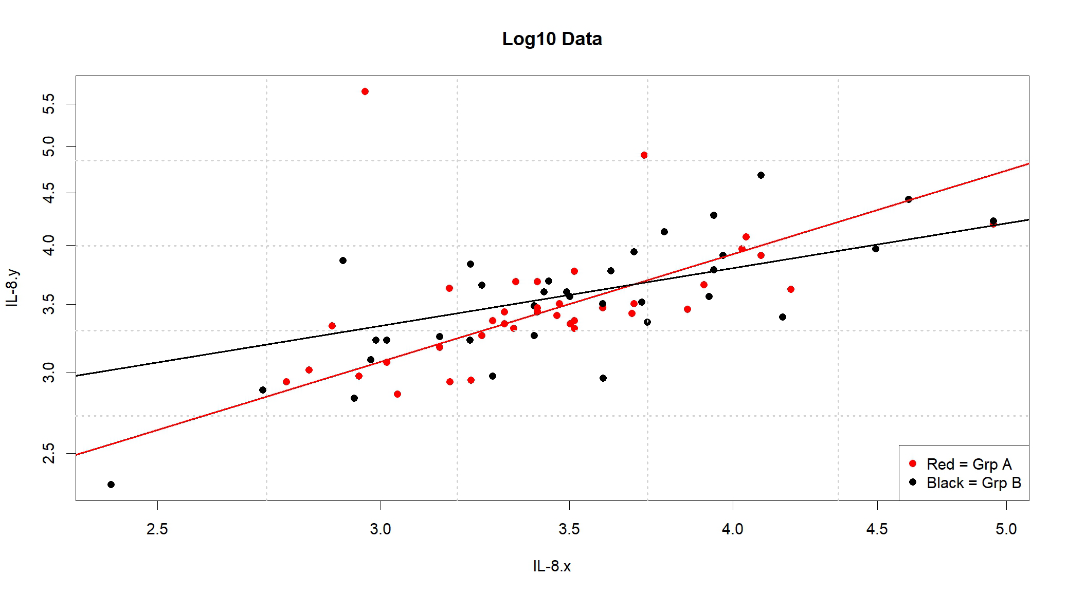
Keystone Clinical Data: Biomarkers
IL-8 Rate p=0.040
Albumin/Globulin Ratio p=0.0308
KEY:
Red = Placebo
Black = Keystone
IL-8 increases at a significantly lower rate than placebo when on Keystone, while
A/G ratio demonstrates a significantly faster rate of increase when on Keystone (liver health).

Slide 30
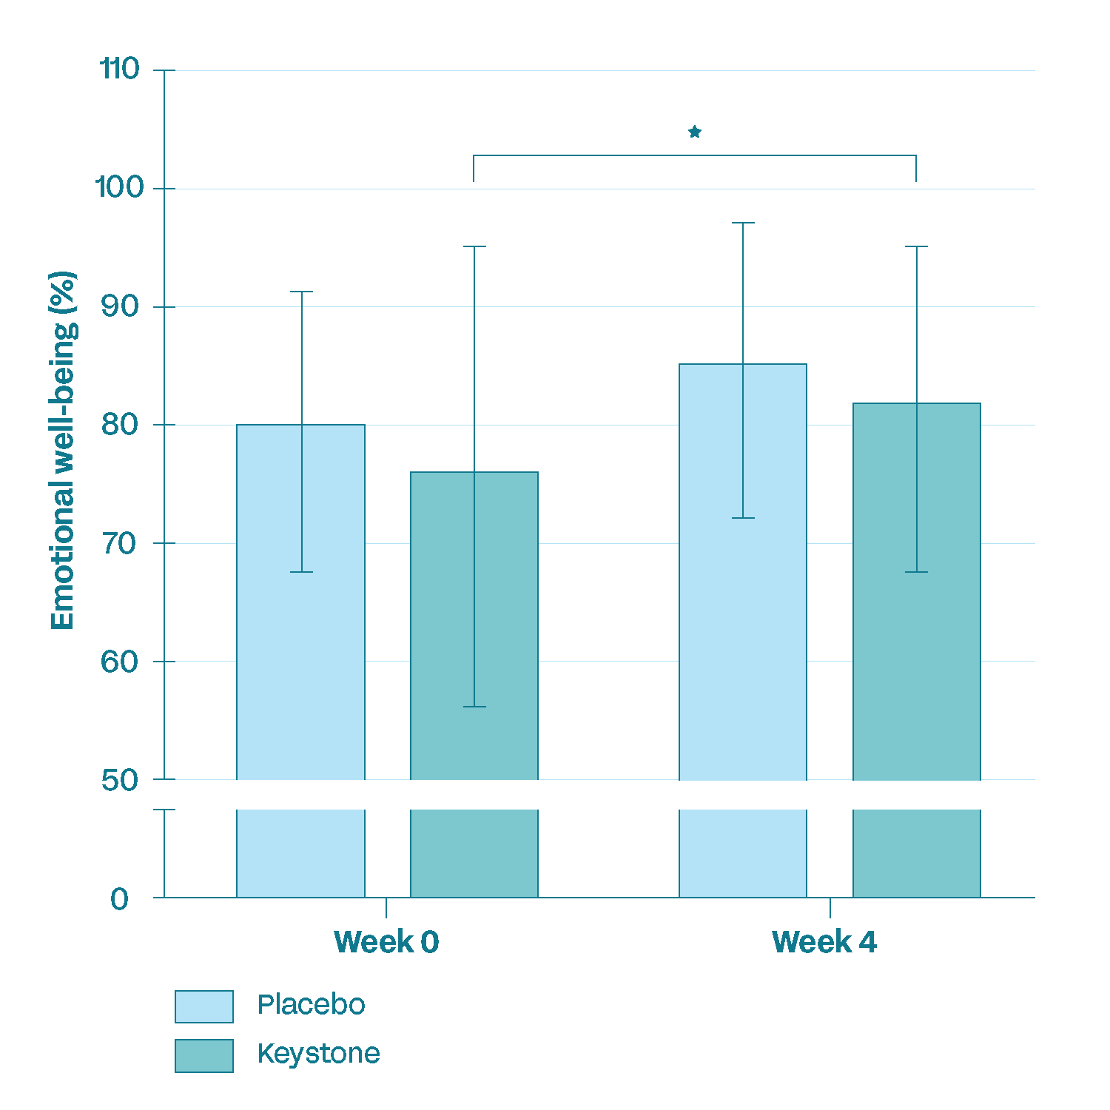
Keystone Clinical Data: Emotional Health
DASS21 Low Mood Change over 4 weeks
 | Decreased | No Change | Increased
Placebo | 34% | 47% | 18%
Keystone | 68% | 24% | 8%
*p=0.011
DASS21 Stress Change over 4 weeks
 | Decreased | No Change | Increased
Placebo | 55% | 21% | 24%
Keystone | 71% | 8% | 21%
p < 0.05
Takeaway: Participants on Keystone demonstrated a significant decrease in feeling depressed, statistically improved emotional well-being and a higher percentage of them reported a decrease in stress after 4 weeks.
Notes:
The Depression, Anxiety and Stress Scale - 21 Items (DASS-21) - is a set of three self-report scales designed to measure the emotional states of depression, anxiety and stress. Each of the three scales contain 7 questions (ranked from 0 to 4)
The SF-36 includes a component for evaluating emotional well-being and another for role limitations due to emotional problems, which are assessed through questions about feelings such as "full of pep," "nervousness," "down in the dumps," "calm and peaceful," "downhearted and blue," and "happy". It also includes a general question on how emotional health impacts daily activities like social interactions.

Slide 31
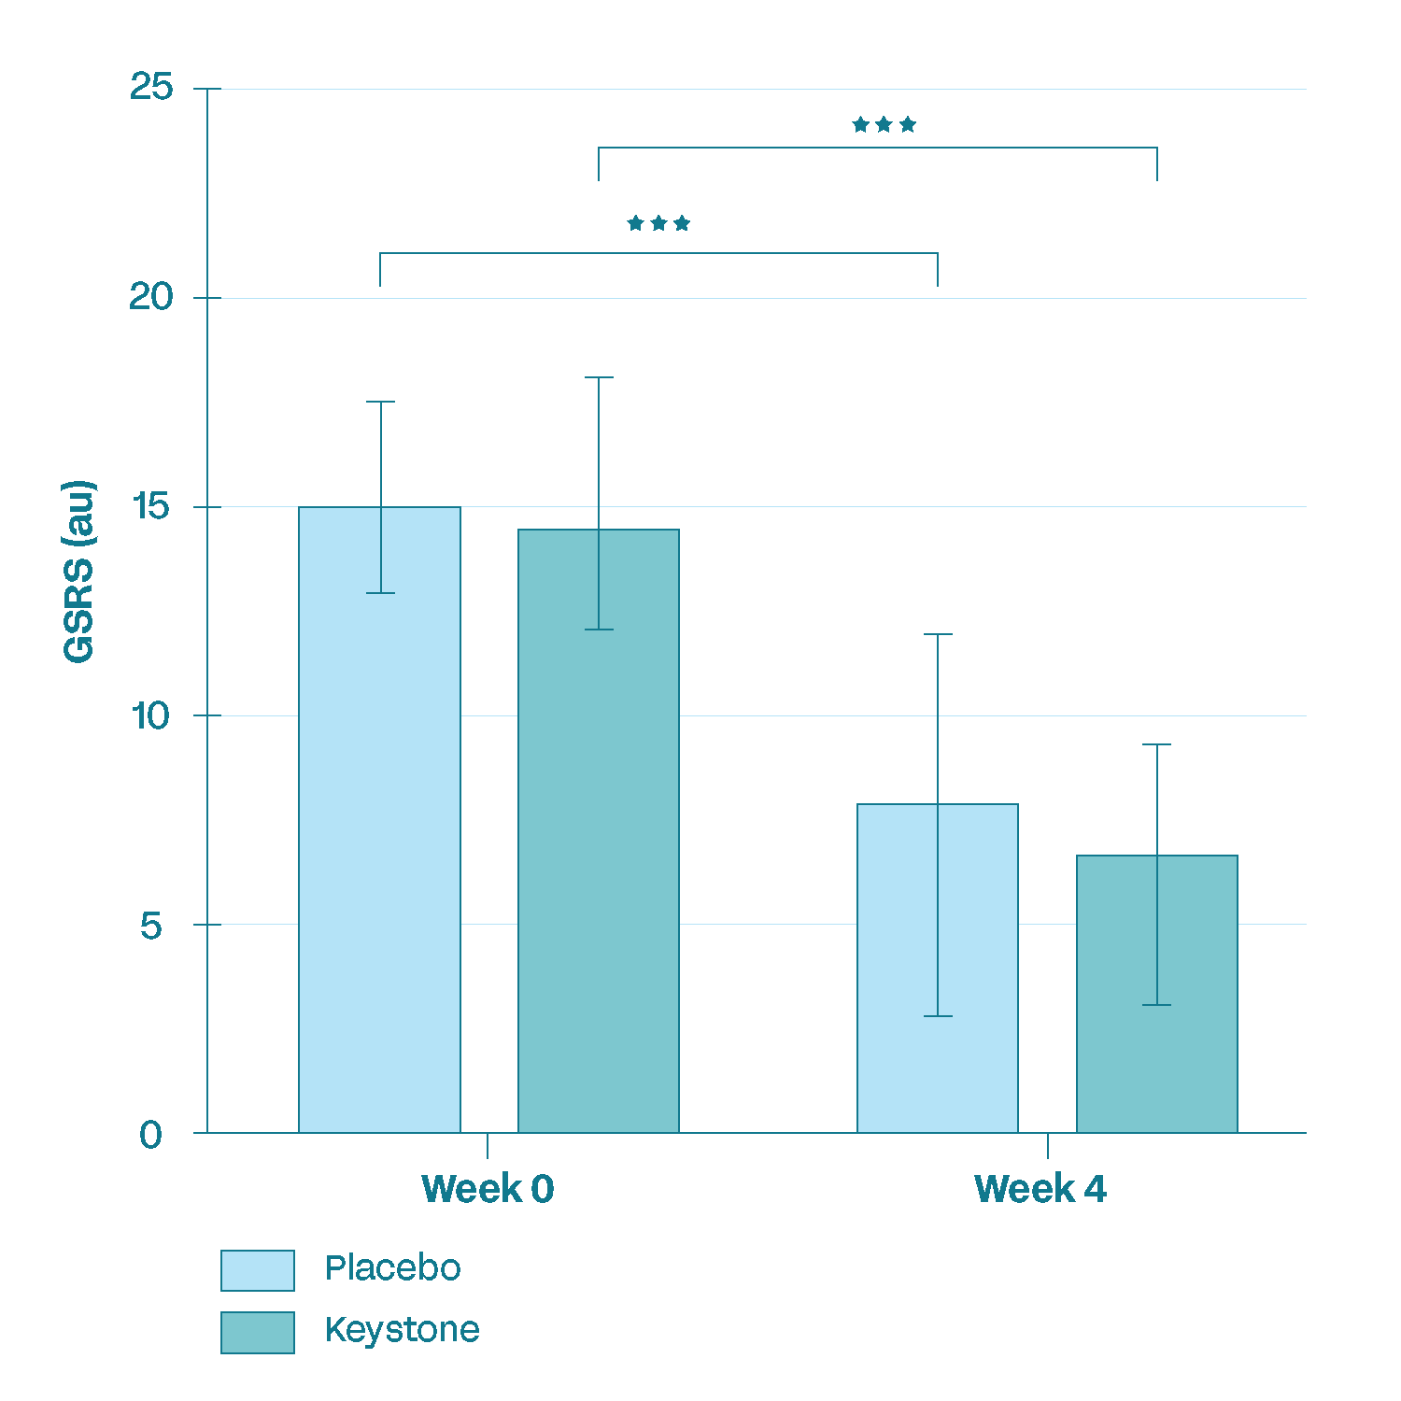
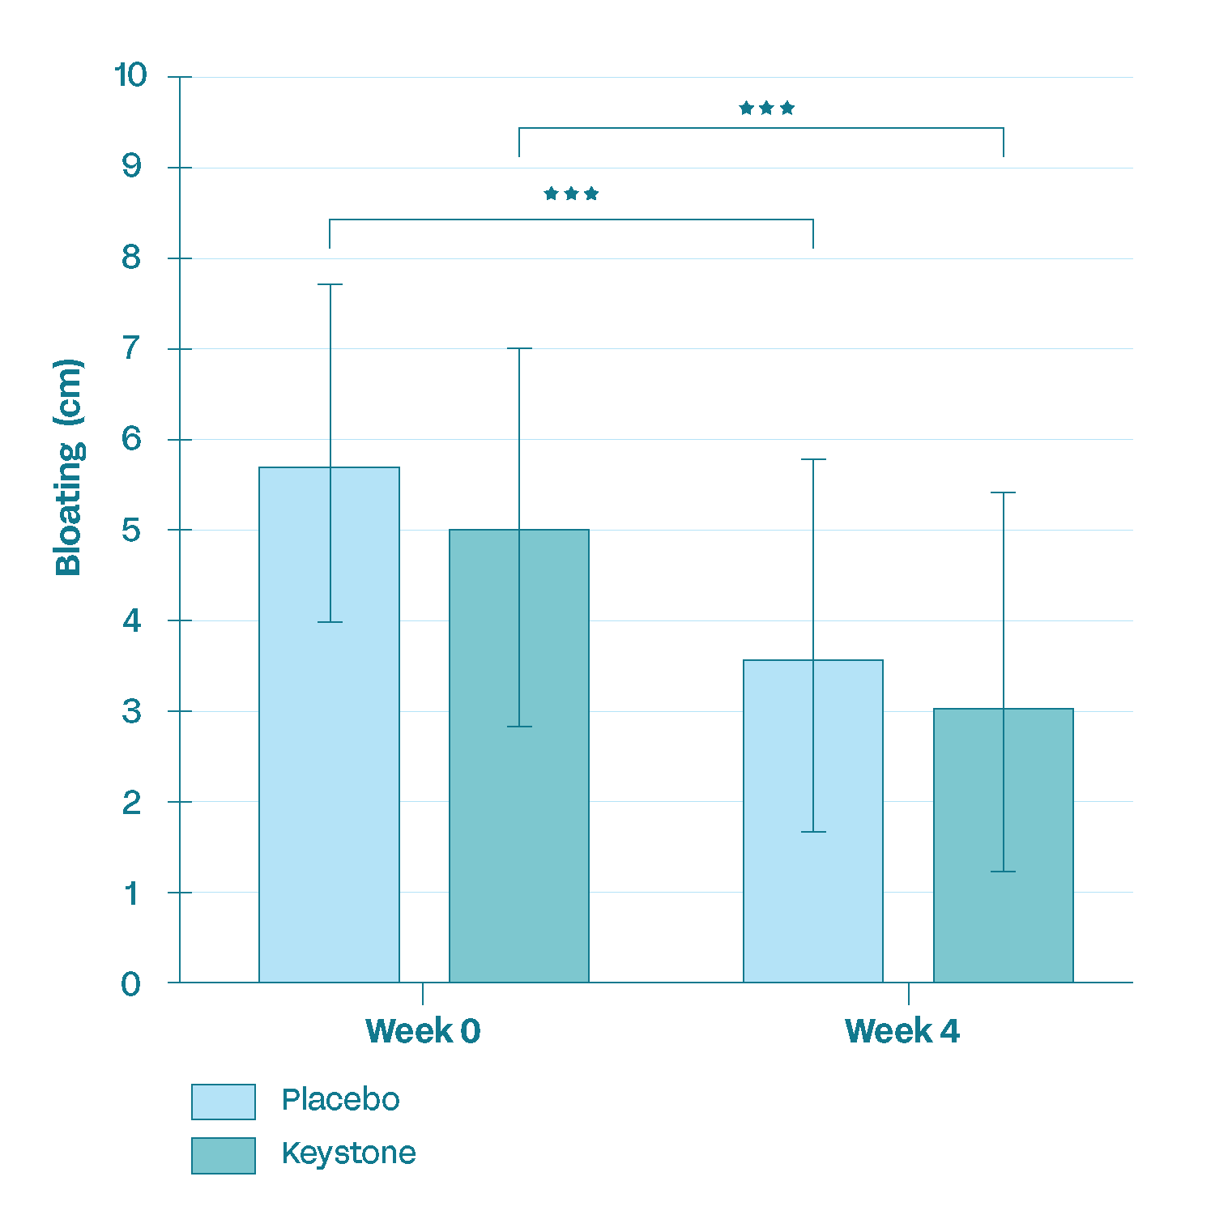
Improved GI health and bloating
These data confirms what we observed in the pilot study; Decrease in GI symptoms
and bloating from baseline p ≤ 0.001

Slide 32
Clinical Summary
Precision Microbiome Modulation
  Increase in butyrate producers, immune modulating,
  and metabolic health strains
  Decrease in non-beneficial strains
Subjects felt better over 4 weeks
  Increased mood/stress/energy
  Reduced gas and bloating
Body of evidence supports improvements in:
  Microbiome composition
  Intestinal barrier function
  Emotional wellbeing: reduces periodic stress
Notes:
Precision Microbiome modulation
Good bacteria up/bad bacteria down -> not broad increase in both good and bad
Decrease in gas/bloating
Low dose
Trending changes in fecal SCFA concentrations
Acetate (p=0.08)
Butyrate (p=0.28)

Slide 33
Keystone Postbiotic®
Foundational Gut Microbiome Health: Promotes the growth of native keystone bacteria to support a healthy gut microbiome, balanced immune response, and emotional wellbeing.
Synergistic Formulation: Combines clinically relevant Lactobacillus probiotic strains with fermented oats to revitalize one's existing beneficial gut microflora.
Shelf-Stable and Ready-to-Use: No refrigeration needed; stable across a wide range of product formats.
Precision over Prebiotics: Unlike prebiotics that merely feed bacteria, Keystone delivers ready-to-act postbiotic metabolites that interact with one's existing gut microbes.
Clean-Label and Non-GMO: Powered by whole-food oats and microbial fermentation — as well as certified non-GMO — it’s designed for health-conscious consumers.
“Keystone Postbiotic combines probiotic strains and fermented oats to deliver
shelf-stable, ready-to-act postbiotics for daily gut support, no refrigeration needed."
PAGE 33

Slide 34
Keystone Postbiotic Claims
Structure/Function Claims
Gut Health
  Promotes microbiome health
  Supports production of beneficial keystone bacteria
  Supports an increase in health-promoting microbial species
Immune & Barrier Function
  Strengthens immune performance
Mental Wellbeing
  Supports emotional wellbeing/mood
PAGE 34

Slide 35
Keystone Postbiotic Benefit Areas
Microbiome Modulation
  ≥ 800% increase in 33 beneficial endogenous bacterial species
  ≥ 7000% reduction in 38 potentially harmful bacterial species
  Up regulates endogenous Akkermansia up to 24000%
  Up regulates butyrate producing bacteria by 63000%
Whole-Body Benefits
  ≥ 50% improvement in gas and bloating
  68% of participants improved their emotional wellbeing
  Lowers IL-8 production, suggesting improved immune regulation
  Increases butyrate production, supporting anti-inflammatory pathways
  Reduces cortisol by week 4
  Improves albumin/globulin ratio, reflecting immune balance,
  resilience and healthy live function
  No GI distress observed in clinical testing
PAGE 35

Slide 36


Keystone Postbiotic applications
GREEN JUICE
SODAS
ENERGY DRINKS
FUNCTIONAL FOOD
NON-DAIRY
PROTEIN DRINKS/POWDERS
SPORTS
NUTRITION
CHOCOLATE

Slide 37

LP815®
For dual action stress and sleep support

Slide 38
Why we are excited …
LP815 acts as a GABA factory in the gut, signaling microbial production that increases GABA production
Sustained and stable GABA release for long-lasting, dual action stress, sleep, and mood support
Proven to increase GABA levels by day 7 and keep them sustained through week 6
Quality of life solution compared to acute, short-term release stress & sleep supplements
No GI distress/side effects/no next-day drowsiness
Notes:
Precision Microbiome modulation
Good bacteria up/bad bacteria down -> not broad increase in both good and bad
Decrease in gas/bloating
Low dose
Trending changes in fecal SCFA concentrations
Acetate (p=0.08)
Butyrate (p=0.28)

Slide 39
LP815®
MULTI BENEFIT
Helps reduce feelings of irritability
Promotes a calm mood
Supports a healthy stress management
Supports deep restorative sleep
Helps relieve night sweats
LOW DAILY DOSE
L. plantarum 815 (LP815TM) 50mg*
*5 Billion CFU
SUPPLY CHAIN
Manufactured in USA
Scaled to meet demand
Non-GMO Project Verified
Allergen-free
Kosher
Self-affirmed GRAS

Slide 40
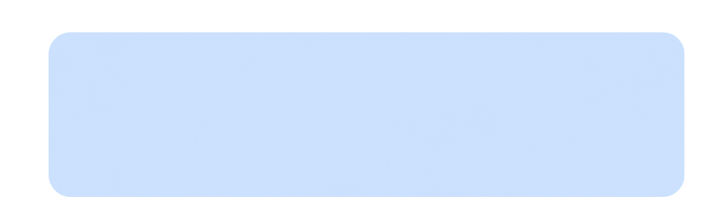
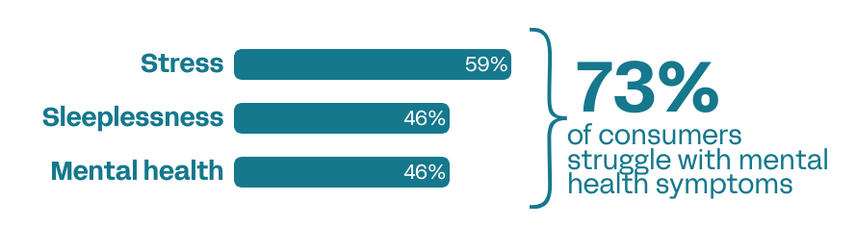
Mental well-being is a significant struggle for your consumers.
We’re here to help.
Source: Verb Biotics 2024 Consumer Health Survey

Slide 41
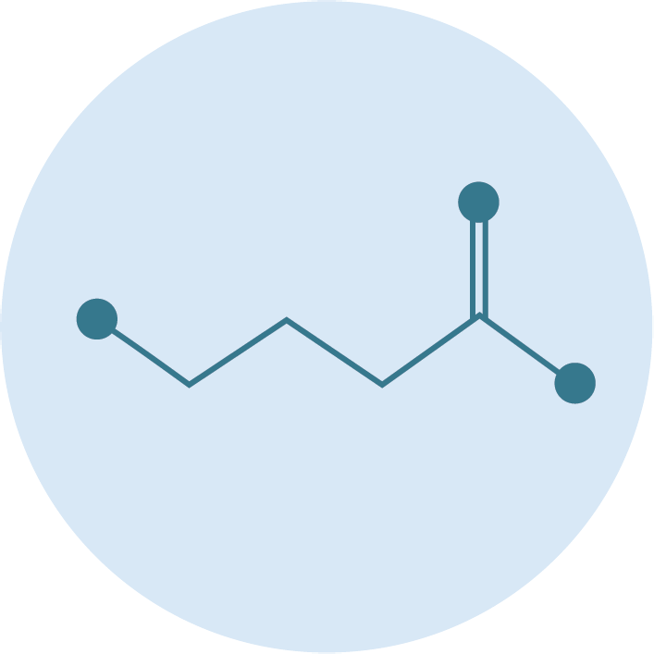
Why GABA?
A major inhibitory neurotransmitter: Gamma-Aminobutyric Acid (GABA) is a metabolite with a fundamental role in signaling the nervous system.
Main mechanism = slow the stimulation of certain nerve signals in the brain.
Provides a calming effect by preventing neurons from firing and regulating how quickly they react.
Notes:
Camille
KEEP

Slide 42



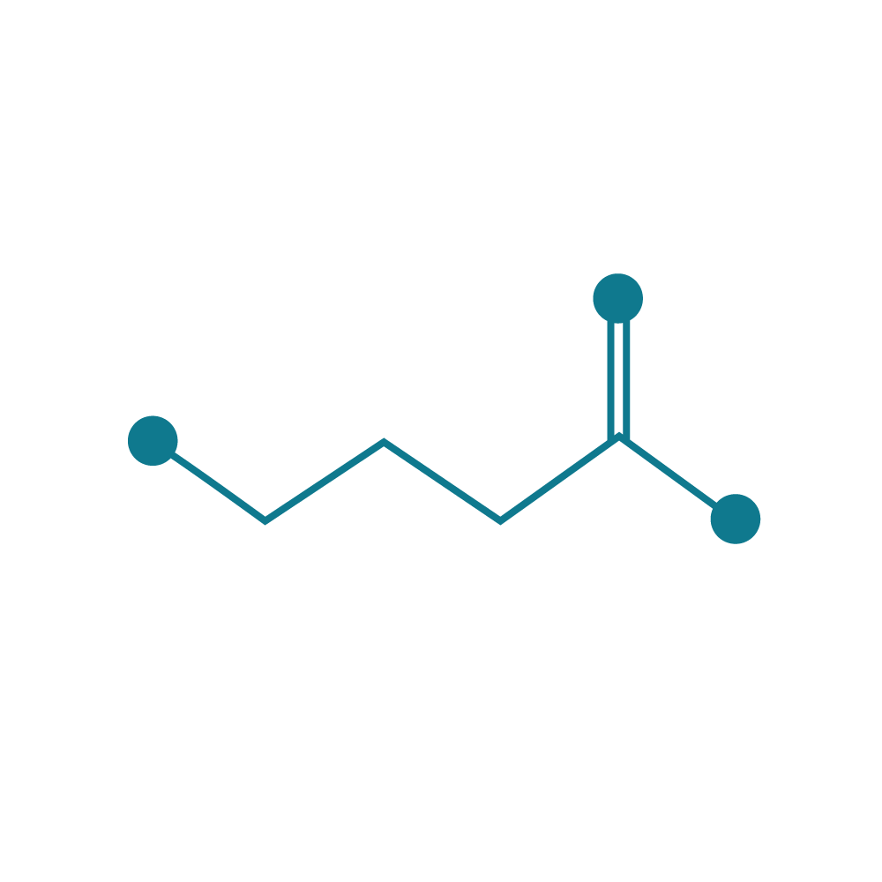
Function first, intentional design
STRAIN IDENTIFICATION/
OPTIMIZATION
HEALTH
INDICATION
MECHANISMS
OF ACTION
Regulatory
Clinicals
Scale
LP815
Stress/Mood/Sleep
Enables sustained GABA production
Lactiplantibacillus plantarum, LP815™, a proprietary strain of lactic acid bacteria
Add in mood,
stress, and relaxation dietary supplements
Non-GMO, Kosher, Allergen-Free, Self-affirmed GRAS
PAGE 42

Slide 43
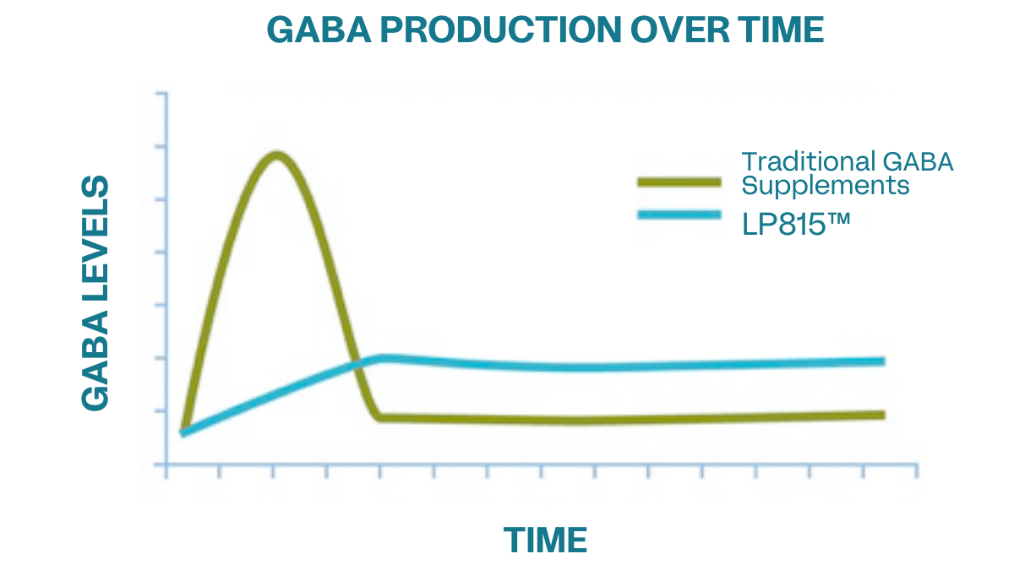
The LP815 Difference
A novel probiotic with sustained and consistent GABA production within the GI tract.
  Unlike traditional GABA supplements, LP815 consistent release provides calming and stress modulation for consumers.
Adapted from: Li J, et. al. Front Pharmacol. 2015 Nov 10;6:260. doi: 10.3389/fphar.2015.00260.
Notes:
Diane - The advantage of taking a probiotic that produces GABA versus just taking a GABA supplement is that GABA produced by bacteria will provide a consistent, prolonged release of GABA over time as long as you're taking the probiotic. This is very different then what happens when you take a GABA supplement which delivers a bolus of of GABA at once. In this case, GABA levels increase and within 4-5 hours according to the data go back down to baseline levels. While GABA production from a probiotic would be more consistent, and we believe provide a sustained release product compared to the other options that are on the market.
Remove the text, LP815™ difference

Slide 44
Unprecedented large-scale screen
Comparative GABA Production
3
We searched over 250 million isolates to identify LP815
Screen done leveraging latest biotech tools and under gut-like conditions
LP815 is a sustained and consistent producer of clinically relevant GABA
GABA Normalized per Pos. Con.
2
1
Benchmark
Lactiplantibacillus plantarum
LP815®
Notes:
We really wanted to understand what the landscape was overall, so we identified the top strains that produce GABA that were commercially available, and we benchmarked against those. From there we leveraged our relationship with Ginkgo Bioworks to be able to force some strains to produce more GABA through directed evolution. Through this effort, we screened over 250 million different isolates to to identify those that produce the most. When you look at this graph, what are you are looking at is a small subset of those isolates.
Note: strains not all L.Plantarum
L. plantarum 815 produces three times the amount of GABA compared to benchmark. This high production stems in part from its ability to uncouple the production of GABA from pH which is the main driver of what allows different strains within the gut to produce GABA. It can produce GABA at more of a neutral pH which you'll find in the gut as opposed to highly acidic pH, so at physiological concentrations of pH it produced higher amounts of GABA.

Slide 45
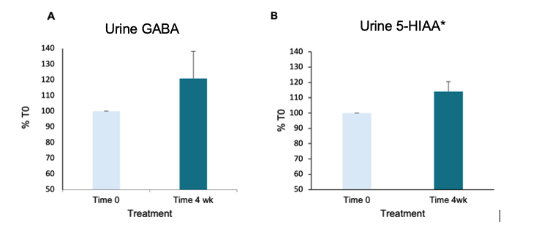
Pilot data: LP815 increases GABA & Serotonin in humans
75% of participants demonstrated an increase in GABA levels in urine, averaging 20% above baseline
90% of participants demonstrated an increase in urinary 5-HIAA, which is a metabolite of serotonin
n=8 (5 F, 3 M)
*5-hydroxyindoleacetic acid (5-HIAA), a metabolite of serotonin
Notes:
Diane - Eight healthy adults (5F, 3M) provided a urine sample at the beginning of the study (T0) and after 4 weeks of supplementation. Urine collection was performed according to the manufacturer’s instructions and measured at the manufacturer’s laboratory facility using the Neurotransmitter Basic Panel (Life Extension/National Diagnostics, Inc.). Participants that had GABA levels in the high range (<4.7mmol/g creatinine) at baseline were excluded from the study. The participants then took Lp815TM GABA Probiotic (1x10⁹ cfu/day) for 4 weeks. Participants went about their normal activities and diets during the study period; however, they did refrain from beginning any new treatments, using antibiotics, or taking probiotic products. After 4 weeks of supplementation, a second urine collection was performed according to the manufacturer’s instructions and measured at the manufacturer’s laboratory facility.
LP815TM was well tolerated by the participants. After 4 weeks of treatment with Lp815TM, 75% of participants demonstrated an increase in GABA levels in urine, averaging 20% above baseline (Figure 1A). Concomitant with GABA, 90% of participants demonstrated an increase in urinary 5-hydroxyindoleacetic acid (5-HIAA) which is a metabolite.
Urinary GABA levels were increased in a cohort of healthy adults taking 1x10⁹ CFU/day of Lp815TM, suggesting Lp815TM can increase GABA in the human body. Concomitant with the increase in urinary GABA, a corresponding increase in urinary 5-HIAA* was observed as well. LP815 is well tolerated.

Slide 46
GABA Probiotic, LP815
Gut-Based GABA Production: LP815 acts as a “GABA factory” in the gut, interacting with existing gut microbes to naturally produce the calming neurotransmitter where it can be absorbed and utilized.
Sustained GABA Delivery: Unlike traditional GABA supplements that deliver a quick, short-lived bolus and require frequent redosing, LP815 enables a sustained and consistent release aligned with the body’s physiological rhythms.
Long-Lasting Support for Stress & Sleep: Clinical findings show GABA levels significantly increase within one week, with users reporting improvements in stress response and sleep quality by week four—delivering lasting support through continued use.
Optimized for Human Physiology: LP815 is one of the few strains proven to produce GABA within the body’s natural pH range, ensuring more consistent, biologically relevant effects.
"GABA Probiotic, LP815 delivers long-lasting stress and sleep support by
turning your gut into a natural GABA factory, no redosing, just real results you can feel."

Slide 47
LP815® for better sleep
Microbiome-Based Sleep Support: LP815® is a clinically backed probiotic that stimulates natural GABA production in the gut, supporting the body’s transition into restorative sleep.
Sustained Results: Clinical findings show GABA levels rise within one week, with users reporting improved sleep and reduced stress by week four, without the risk of dependency.
Dual Action: Stress + Sleep: By targeting the gut-brain axis, LP815® provides stress relief and sleep support in one root cause solution.
Biologically Aligned, Not Forced: Unlike melatonin or sleep drugs that override the brain’s natural rhythms, LP815® may help restore circadian balance by working in sync with your internal clock.
Deep Sleep, Naturally: Encourages deeper, higher-quality sleep by calming the nervous system through GABA modulation, not by inducing drowsiness or causing next day adverse effects.
"LP815® offers non-drowsy, microbiome-based sleep and stress support
that works with your biology - not against it - for longer, deeper sleep"
PAGE 47

Slide 48
First Human DB-RPC Clinical Trial:
LP815 Stress/Mood Study
DESIGN
DURATION
SUBJECTS
ARMS
SITE
Double-blind
Randomized
Placebo-controlled
Decentralized
6 weeks
Adults, self-reported with Mild to Moderate anxiety (GAD-7 screening of 5-14)
USA
1B CFU LP815 (n = 34)
5B CFU LP815 (n = 34)
Placebo (n = 34)
ENDPOINTS:
Anxiety GAD-7 questionnaire | HRV | Sleep Metrics (latency, sleep stages)
Grant, A.D., et. al. (2025). Lactiplantibacillus plantarum Lp815 decreases anxiety in people with mild to moderate anxiety: a direct-to-consumer, randomised, double-blind, placebo-controlled study. Beneficial Microbes https://doi.org/10.1163/18762891-bja00073
Notes:
Camille
. Endpoints, don’t delineate primary and secondary, remove safety

Slide 49

Stress/Mood
Study Population
Study population: adults, self-reported with 'Mild to Moderate' anxiety (GAD-7 screening of 5-14)
83 individuals completed the trial
  63% female
  37% male
GAD-7 Questionnaire Categories:
  0–4: minimal anxiety
  5–9: mild anxiety
  10–14: moderate anxiety
  15–21: severe anxiety
Notes:
Camille – change name to study population
Adults, self-reported with Mild to Moderate anxiety (GAD-7 screening of 5-14)

Slide 50
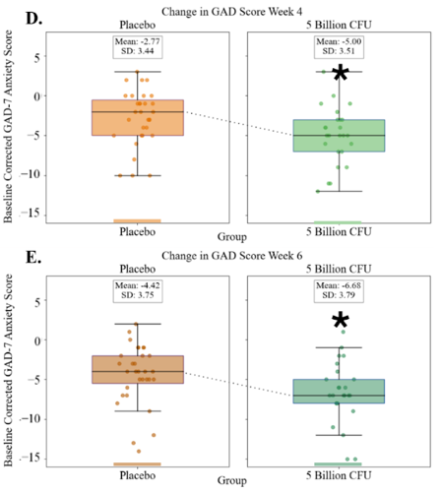
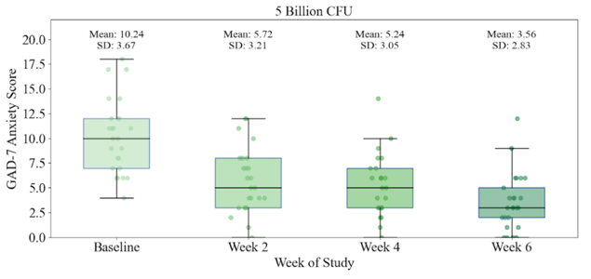
Stress reduction upon taking LP815 may begin as early as 2 weeks, and reaches significance at 4 weeks.
68% of the 5 billion CFU cohort GAD score improved at week 6 vs. 26% of the placebo cohort (p<0.05).
P = 0.02, Week 6
GAD-7 Score is reduced at 5 Billion CFU by weeks 4 and 6 compared to placebo.
Notes:
Camille-
IRRITABILITY – of the GAD-7, all of the questions showed an improvement, but the one question that stood out was the question around “Becoming easily annoyed or irritable”. That is where we saw a large statistically significant impact. We saw a full point improvement at the 5B dose and a ¾ point improvement at the 1B dose.

Slide 51
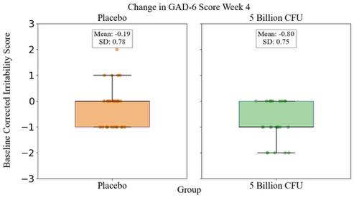
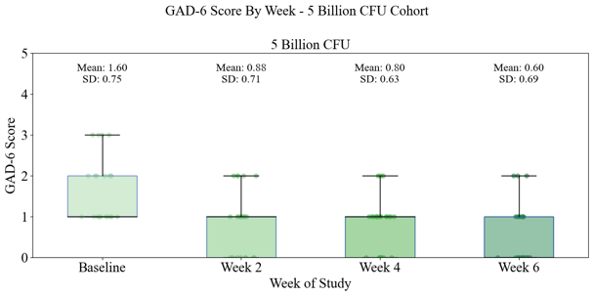
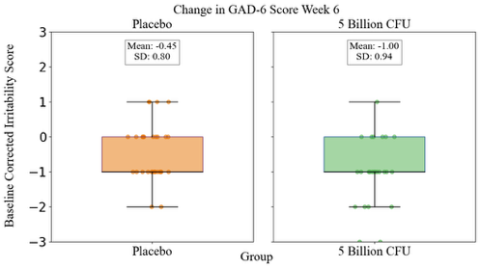
LP815 significantly reduced irritability and annoyance in the GAD-7 screening (p=0.04 at week 4 and p=0.1 at week 6).
*
Notes:
IRRITABILITY – of the GAD-7, all of the questions showed an improvement, but the one question that stood out was the question around “Becoming easily annoyed or irritable”. That is where we saw a large statistically significant impact. We saw a full point improvement at the 5B dose and a ¾ point improvement at the 1B dose.
For Irritability, within the 5B group, all time points are statistically different from baseline (p<0.02).
For 5B group versus placebo:
p=0.04 for week 4
p=0.12 for week 6

Slide 52
Second Human DB-RPC Clinical Trial:
LP815 Sleep Study
DESIGN
DURATION
SUBJECTS
ARMS
SITE
Double-blind
Randomized
Placebo-controlled
Decentralized
6 weeks
Adults, self-reported with moderate to severe sleep disturbance
(ISI score ≥ 15)
5B CFU LP815 (n = 75)
Placebo (n = 75)
USA
ENDPOINTS:
Sleep disturbance symptoms – Insomnia Severity Index (ISI) | Anxiety | GI symptoms | Sleep quality | Daytime alertness | Mood | Night sweats | Quality of life | Sleep duration | Sleep latency | Sleep efficiency | HR | HRV
Notes:
The ISI is comprised of seven items assessing the perceived severity of difficulties initiating sleep, staying asleep, and early morning awakenings, satisfaction with current sleep pattern, interference with daily functioning, noticeability of impairment attributed to the sleep problem, and degree of distress or concern caused by the sleep problem. Total score from 0-28.
Anxiety - Generalized Anxiety Disorder-7 (GAD-7)
GI symptoms - Gastrointestinal Symptom Rating Scale (GSRS)
Sleep quality - daily 10-point visual analogue rating scale (VAS)
Daytime alertness - daily 10-point VAS scale
Mood - daily 10-point VAS scale.
Severity of night sweats - daily 10-point VAS scale.
quality of life score - daily 10-point VAS scale.
Evaluation of GABA levels in the urine at days 0, 2, 4, 7, 14, 28, and 42.

Slide 53

Sleep Study Population
138 individuals completed the trial
51.1% female (n=71)
48.9% male (n=68)
Mean age = 44.1 ± 12.8 yrs
Trial took place over the ‘24 holiday season
Traditionally inconsistent sleep patterns, diets, and routines
Notes:
Camille – change name to study population
Adults, self-reported with Mild to Moderate anxiety (GAD-7 screening of 5-14)

Slide 54
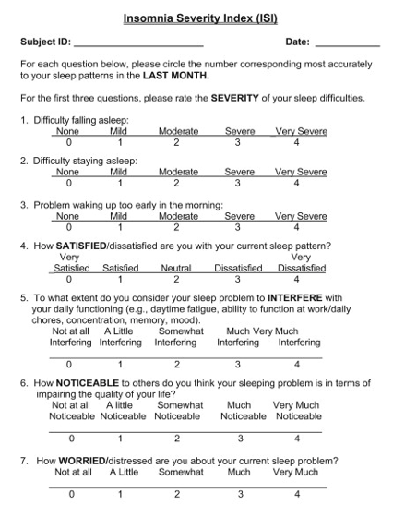
What is the
Insomnia Severity Index?
Screening tool to evaluate severity of sleep issues
ISI Questionnaire Categories:
  0–7: No insomnia
  8–14: Minimal insomnia
  15–21: Moderate insomnia
  22–28: Severe insomnia
Notes:
If you get the question: “Is this a diseased population?” or “Can we translate these data to a healthy population?”
The IRB did not consider our enrollment to be “disease” and no one was diagnosed with a sleep disease.
ISI is a screening tool, not a diagnosis. It's used as a triage tool, and also of course as one of the gold standard in sleep research to assess the efficacy of interventions
As such criteria from formal clinical diagnostic tools (such as DSM‑5 or ICSD‑3) were not met/verified such as frequency (needs to be more than 3x/week) and how long it has been perduring (more than 3 months)
General pop cohort that besides their concerns about sleep quality was in "general good health"
Also, the protocol explicitly excluded untreated sleep apnea, narcolepsy, major depression, etc

Slide 55
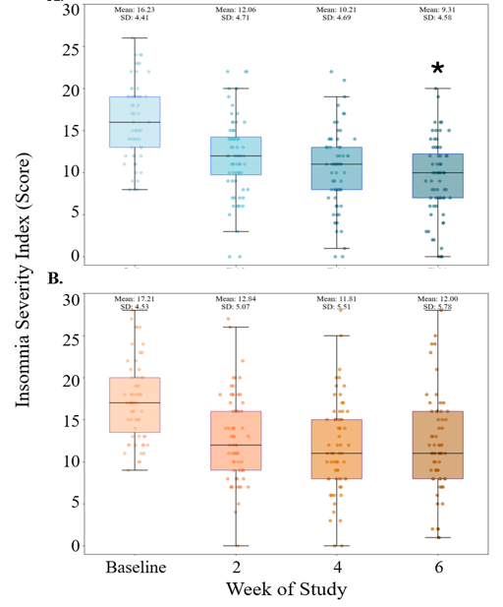
LP815 delivers clinically meaningful sleep relief in 6 weeks
LP815
Statistically significant reductions exceed the 4‑point Minimal Clinically Important Difference (MCID).
LP815 provides a significant improvement that participants can feel.
Outcome at Week 6 | 5 B CFU | Placebo | P value
Mean ISI score | 9.31 ± 4.58 | 12.00 ± 5.78 | 0.01
Reached ≥4‑point MCID | 77 % | 58 % | 0.02
ISI sub‑questions | 5 out of 7↓, p ≤ 0.05 | - | -
Placebo
*p=0.01
Notes:
Additionally, those with severe baseline insomnia exhibited a statistically significant drop by week 4 (p=0.04), (-11.1 ± 5.7 vs -6.9 ± 4.8).
What is a clinically meaningful reduction in ISI? Consensus among the CRO and other sleep experts was a 4-point reduction. Ultimately, the result was that it is meaningful if the participant feels it is meaningful. In the end, there is no definition of clinically meaningful and the argument becomes a blackhole.

Slide 56
ISI sub-questions show improvements across most metrics
ISI Questions | p-values | Key findings
1. Difficulty Falling Asleep | 0.01 | ▲ Improved sleep onset latency
2. Difficulty Staying Asleep | 0.04 | ▲ Improved sleep maintenance
3. Problem Waking Up Too Early | 0.03 | ▲ Improved sleep maintenance
4. Satisfaction With Current Sleep Pattern | 0.05 | ▲ Greater satisfaction with sleep
5. Extent of Interference With Daily Function | 0.42¹ | — No added daytime drowsiness
6. How Noticeable is the Sleep Problem in Terms of Impairing Quality of Life? | 0.11¹ | ▼ Trend towards less visible impairment
7. Worry or Distress About the Current Sleep Problem | 0.05 | ▼ Reduced sleep-related emotional burden
¹ NS=nonsignificant ; Nominal p-values

Slide 57
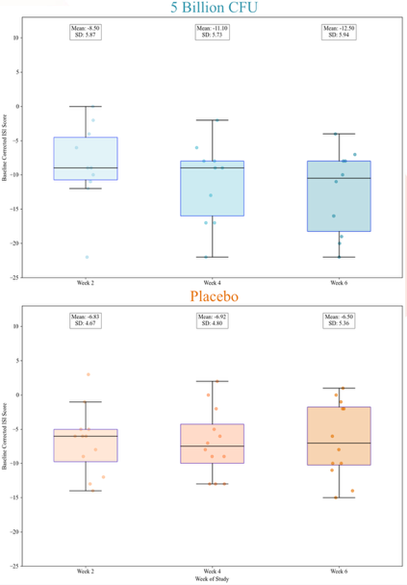
ISI Reduction for Severe Baseline Insomnia
LP815 Delivers Larger Benefits as Baseline Sleep Quality Worsens
LP815
Week 6: the severe-insomnia group cut ISI by 12.5 ± 5.9, triple the MCID, dropping two categories to mild insomnia and doubling the full-cohort response.
ISI reduction at Week 6 | 5 B CFU | Placebo | P value
At least minimal starting insomnia (n=127) | -6.97± 5.48 | -5.26 ± 4.71 | 0.01
At least moderate starting insomnia (n=96) | -8.67 ± 5.09 | -5.67 ± 4.86 | 0.01
Severe starting insomnia (n=21) | -12.50 ± 5.94 | -6.5 ± 5.36 | 0.01
Placebo
Notes:
Additionally, those with severe baseline insomnia exhibited a statistically significant drop by week 4 (p=0.04), (-11.1 ± 5.7 vs -6.9 ± 4.8).
What is a clinically meaningful reduction in ISI? Consensus among the CRO and other sleep experts was a 4-point reduction. Ultimately, the result was that it is meaningful if the participant feels it is meaningful. In the end, there is no definition of clinically meaningful, and the argument becomes a blackhole.
At time 0:
No insomnia n=11
Minimal n=31 (127-96)
Moderate n=75
Severe n=21

Slide 58
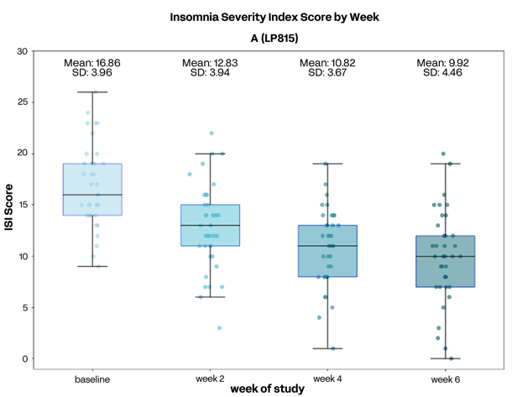
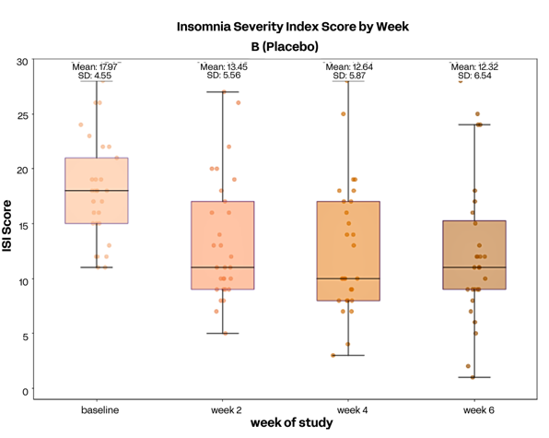
LP815 Improves Women’s Sleep
Women outperform men and placebo in 6-week ISI reduction
Sources
Ask ChatGPT
n=37 5B CFU, n=29 Placebo​; Filtered for scores of at least 8 (Mild Insomnia); * p = 0.003 vs placebo at Week 6
Mixed-effects model, Sex × Treatment: ΔISI −1.7, p = 0.006

Slide 59
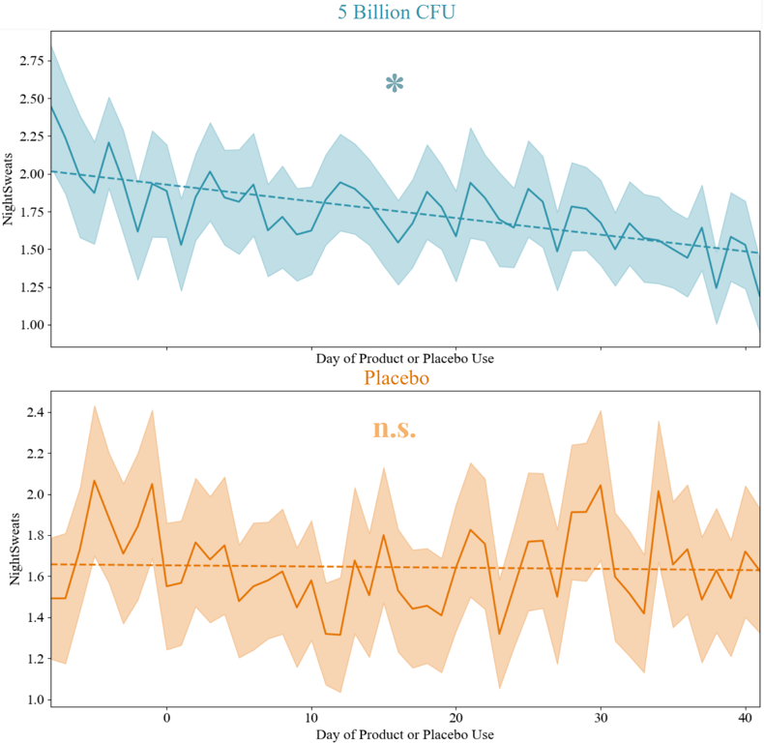
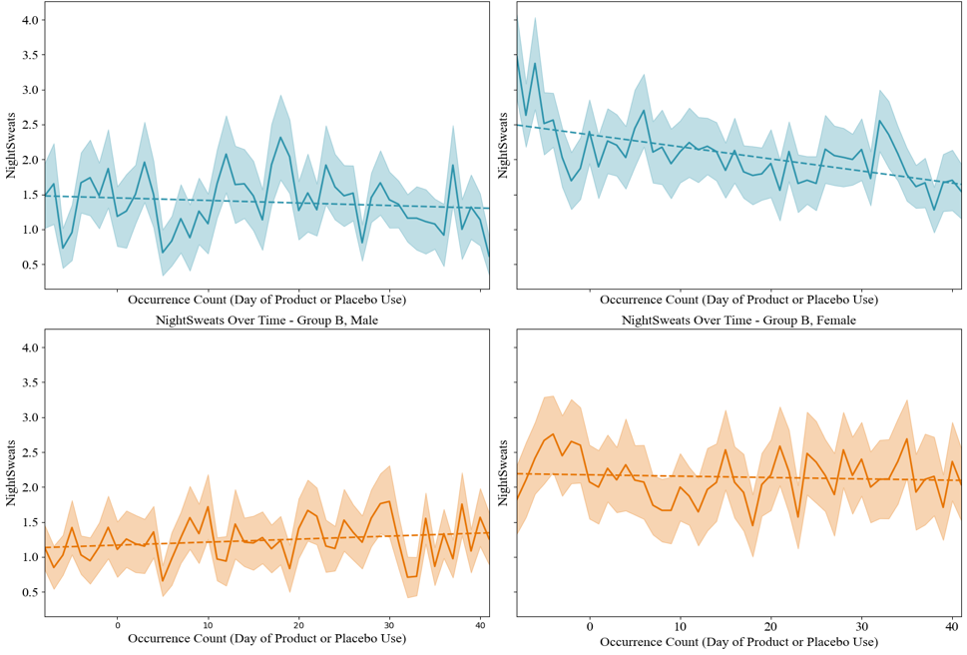
LP815 Decreases Night Sweat Severity
MALE
FEMALE
5 Billion CFU
*
*
Day of Product or Placebo Use
n.s.
n.s.
Placebo
Women have a higher baseline for night sweats and a steeper slope of improvement.
*p<0.05 across study period

Slide 60
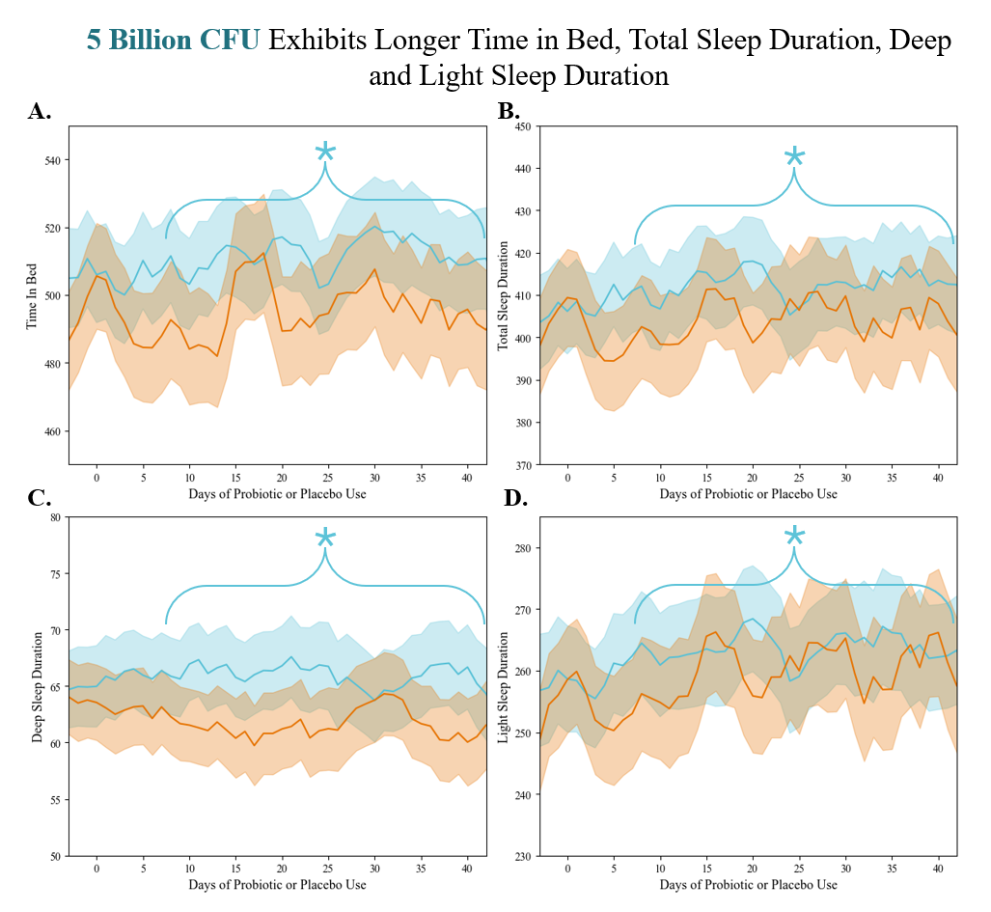
Placebo
LP815
Wearable data also show objective sleep gains:
Longer Time in Bed
Total Sleep Duration
Deep Sleep Duration
...without next-day drowsiness!
* indicates significant difference between groups over the bracketed time window.
*p<0.05 across study period

Slide 61
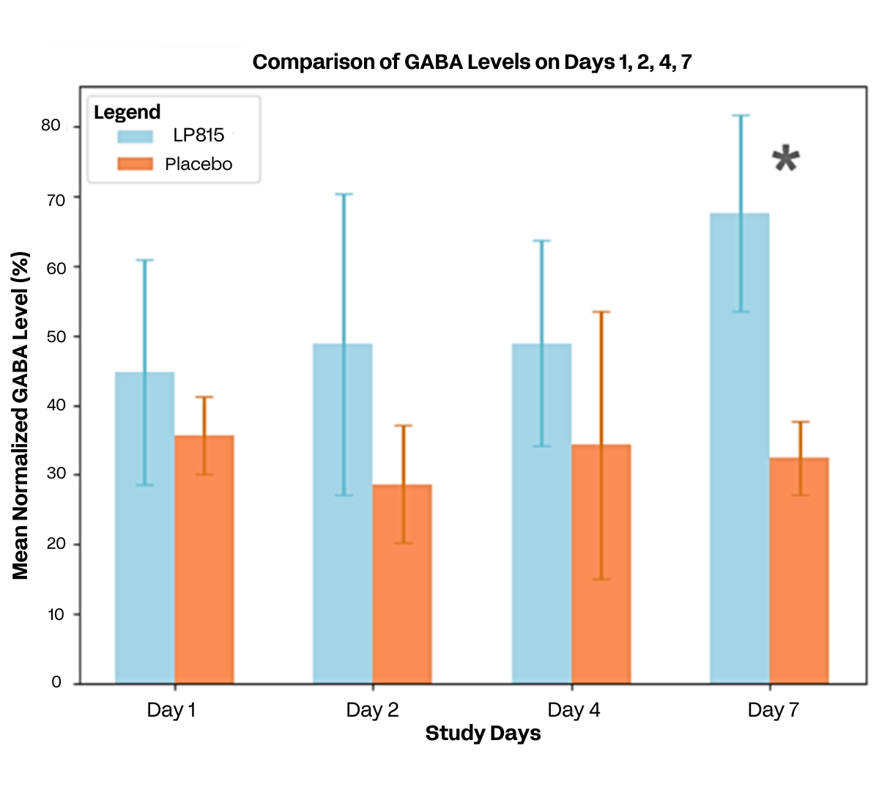
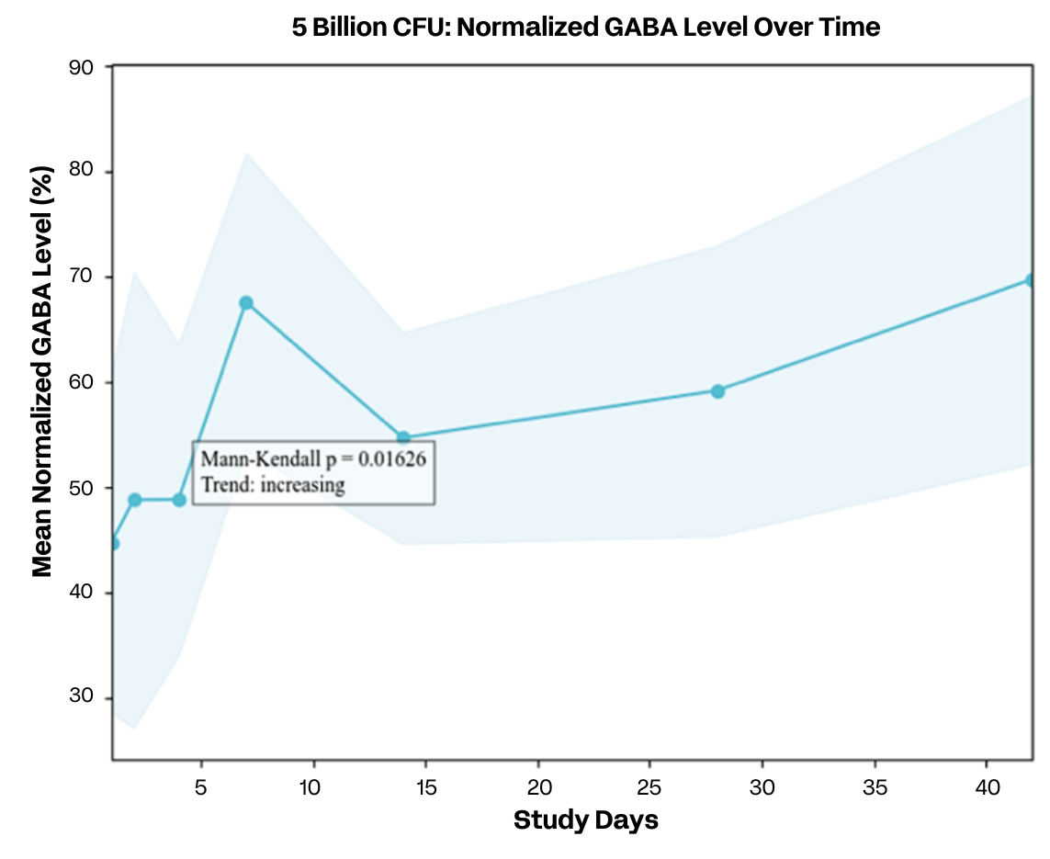
Mechanistic Evidence: LP815 Elevates Urinary GABA
*
*p=0.04
LP815: n=9
Placebo: n=8
Notes:
Placebo had only two participants per time point after day 14, so only 5 Billion CFU data is shown

Slide 62
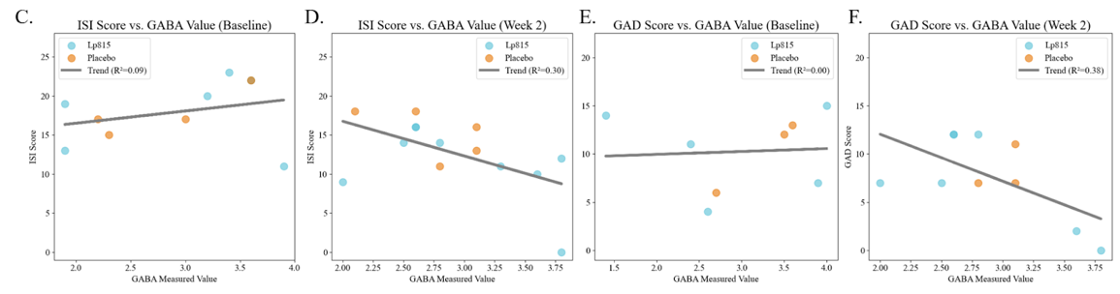
Mechanistic evidence: LP815-driven rise in urinary GABA correlates with lower insomnia and anxiety
Baseline: Urinary GABA shows no link to ISI or GAD-7 (r² ≈ 0)
Week 2: Higher GABA following LP815 supplementation predicts lower ISI and GAD-7 (r² = 0.30, 0.38)
Placebo participation falls to two after Day 14, so Week 2 is the strongest cross-group comparison
Notes:
Mechanistic understanding of LP815

Slide 63
GABA LP815 Claims & Benefits
Structure/Function Claims
  Helps reduce feelings of irritability
  Promotes a calm mood
  Supports healthy stress management
  Supports deep restorative sleep
  Helps relieve night sweats
  Improved total sleep duration and deep sleep duration
Benefits
  68% of participants reduced stress by week 4
  77% of participants improved sleep by week 6
  Stress improved by 151%
  Benefits felt as early as week 2
  No GI distress observed in clinical testing
PAGE 63

Slide 64

LP815® Compatibility
LP815 has been tested to be stable and compatible with the following sleep supplements in powder format when combined and stored at room temperature for 1 week.
L-Theanine – 200mg
Magnesium L-Threonate – 144mg
Ashwagandha – 600mg
Melatonin – 10mg
*Sleep supplements were tested in capsule concentration amounts
PAGE 64

Slide 65
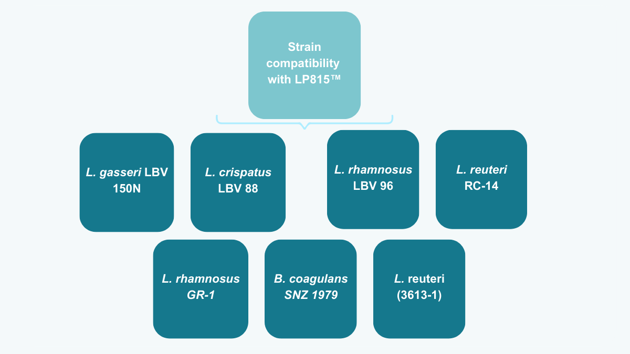
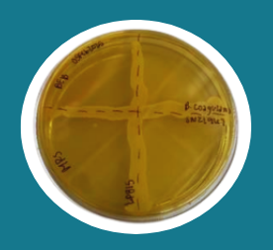
16S rRNA sequencing positively identified each strain
Cross streaking of LP815 against each of the commercially available probiotic strain did not result in a growth inhibition of either the commercially available probiotics or of LP815.
LP815® is viable and compatible with commercially available vaginal health strains.
SNZ 1969

Slide 66








LP815™ Applications
CAPSULES
TABLETS
POWDERS
ICE CREAM
Ask us about this unique format!
YOGURT | KEFIR
KOMBUCHA
non-pasteurized
CHOCOLATE
FREEZE-DRIED FRUIT BITES
Melt & Jet x Verb Biotics

Slide 67
Companion Animal, LP815®
For calming, anxiety and sleep support

Slide 68
Why GABA?
A major inhibitory neurotransmitter: Gamma-Aminobutyric Acid (GABA) is a metabolite with a fundamental role in signaling the nervous system.
Main mechanism = slow the stimulation of certain nerve signals in the brain.
Provides a calming effect by preventing neurons from firing and regulating how quickly they react.
Notes:
Camille
KEEP

Slide 69
Function first, intentional design
STRAIN IDENTIFICATION/
OPTIMIZATION
HEALTH
INDICATION
MECHANISMS
OF ACTION
Regulatory
Clinicals
Scale
LP815
for Pets
Anxiety/Aggression
Enables sustained GABA production
Lactiplantibacillus plantarum, LP815™, a proprietary strain of lactic acid bacteria
Add in supplements, hard chews,
or toppers
Non-GMO, Kosher, Allergen-Free, Self-affirmed GRAS
PAGE 69

Slide 70
Companion Animal: GABA Probiotic study design
Start: Q3 2024 End: Q4 2025
DESIGN
DURATION
SUBJECTS
ARMS
SITE
Randomized
Placebo-controlled
5 weeks
Adult (1-12 y.o) home-owned dogs. All breeds and sizes with existing anxiety and/or aggression conditions
1B CFU/25 pounds GABA Probiotic
(n = 35)
Placebo (n = 15)
USA
ENDPOINTS:
Primary: User-reported questionnaire (Q-BARK framework for Behavioral Changes)
Secondary: Activity monitor via FitBark activity tracker (daily activity, separation anxiety and sleep changes)
Safety: tolerance
Notes:
Q-Bark Questionnaire:
Owner directed aggression
Stranger directed aggression
Stranger directed fear
Dog-directed aggression
Trainability
Chasing
Non social fear
Dog-directed fear
Separation related behavior
Attachment or attention seeking behavior
Touch sensitivity
Excitability
Energy

Slide 71
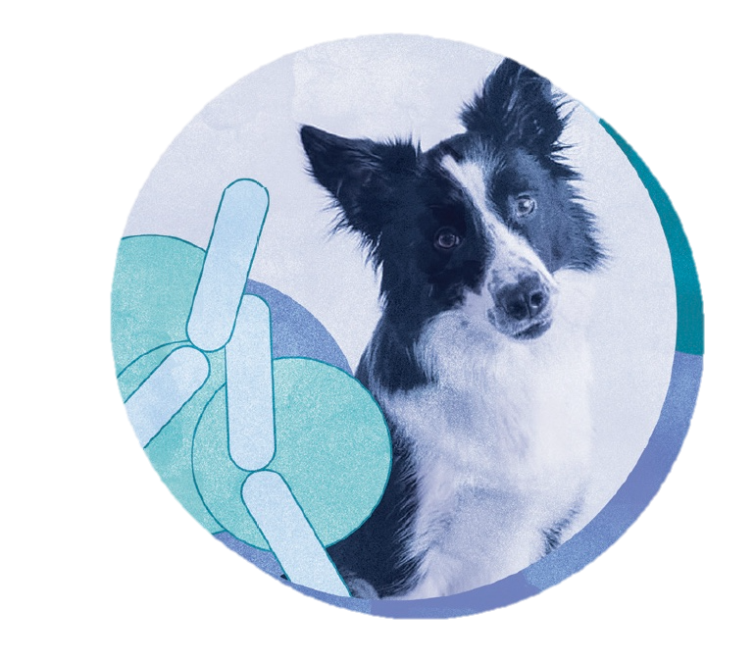
GABA Probiotic – Data in Dogs
The GABA Pet, LP815® supplement:
✔ Decreased anxiety & aggression markers
✔ Decreased activity levels without lethargy
✔ Increased sleep consistency
✔ Increased morning energy levels
✔ Decreased settling down time when left alone
In dogs with existing behavioral concerns.

Slide 72
GABA Pet, LP815
MULTI BENEFIT
LOW DAILY DOSE
1 Billion CFU (10mg) per 25 lbs body weight
APPLICATIONS
Food topping powders
Hard chews
Capsules
Supports decreased anxiety
Supports decreased aggression
Supports restorative sleep

Slide 73
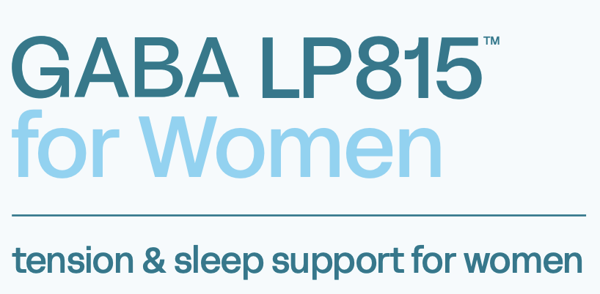

Slide 74

Mental health is a significant struggle for women
of women struggle with mental health related symptoms
of women struggle
with stress
of women suffer with sleeplessness/insomnia
PAGE 74
Source: Verb Biotics Consumer Health Survey, July 2024, N=2,018

Slide 75

GABA levels fluctuate with women's hormones. Supporting GABA during hormonal shifts helps maintain balance—promoting better mood, stress response, and sleep.

Slide 76

LP815 significantly reduces stress
Placebo
66.7% of women taking LP815 significantly reduced (5+ points) GAD-7 stress scores vs. 27.8% on the placebo
LP815
Women taking LP815 saw a 52.7% drop in GAD-7 scores from baseline to week 6
n=33; n=18 placebo, n=15 5 billion CFU
p<0.05 at week 6 vs. placebo

Slide 77


100% of women improved their sleep by week 6
n=71; p=0.07
Placebo
LP815
LP815
By week 6, all women taking LP815 improved their ISI score by 4 points, compared to just 42.9% in the placebo group
(filtered for ISI scores of at least 1+)

Slide 78

Improved nighttime temperature comfort
Regardless of age or ethnicity, LP815 had a significant decrease on elevated nighttime body heat over time
N = 71; p = 0.05
LP815
Placebo
LP815
n=71

Slide 79

LP815 for women
BENEFIT AREAS
Tension and stress support
Helps reduce irritability
Supports deep, restorative sleep
Promotes restful, temperature-balanced sleep
APPLICATIONS
PMS, perimenopause, menopause support
Hormonal support
RECOMMENDED DOSAGE
5 billion CFU (50 mg per day)
GRAS | Allergen-free | Non-GMO | Produced in USA

Slide 80
GABA LP815 for Women
Claims & Benefits
Structure/Function Claims
  Tension and stress support
  Helps reduce irritability
  Supports deep, restorative sleep
Benefits
  67% of women reduced stress by week 2
  100% of women improved sleep by week 6
  ALL women experienced significant decrease in nighttime temperature comfort
  – proven to lower elevated nighttime body heat
  Benefits felt as early as week 2
  No GI distress observed in clinical testing
PAGE 80

Slide 82
Appendix

Slide 83

^{Services}
Development & Marketing

Slide 84
Development Services
We collaborate with your R&D and PD teams to develop differentiated, outcome-driven formulation concepts
FORMULATION COMPATIBILITY
NEW PRODUCT CONCEPTS
Compatibility Assessment
MOA development
Ingredient assessments
Near term stability
Potential process development
Product Ideation
Health outcome
MOA
Clinical Biomarkers
Claims
Structure/function claims + lifestyle claims
Page 84

Slide 85
Marketing Services
We collaborate with your marketing team to identify gaps & product fit for a successful launch
CONSUMER MESSAGING
NEW PRODUCT CONCEPTS
Ingredient Storytelling Kit
Science-backed narratives
Messaging/positioning
Visuals
Educational content
Consumer and Category Insights
Retailer data | category opportunity | food/beverage
Amazon data | benchmarks for velocity
Price point data
Formulations
New product concepts + combinations
Claims
Structure/function claims + lifestyle claims
Labels
Design + nutrition facts panel (NFP)
Page 85

Slide 86


Marketing Services Team
Meet the team with B2C dietary supplement and food experience
Celestia Howe
Sr. Director of Marketing
Brooke Burditt
Marketing Manager
Celestia brings deep expertise in brand strategy and consumer marketing, with a proven track record of building awareness and driving growth for innovative health, wellness, and tech companies. Celestia founded Cofo Provisions, a marine collagen brand sold at Whole Foods, Erewhon, and Amazon.
Brooke is a data-driven, creative marketer with a diverse CPG background, from baby food to chocolate to better-for-you snacking. At Verb Biotics, she draws on this cross-industry experience to turn complex science into clear, compelling marketing that resonates with consumers and fuels brand growth.
Page 86

