Slide 1
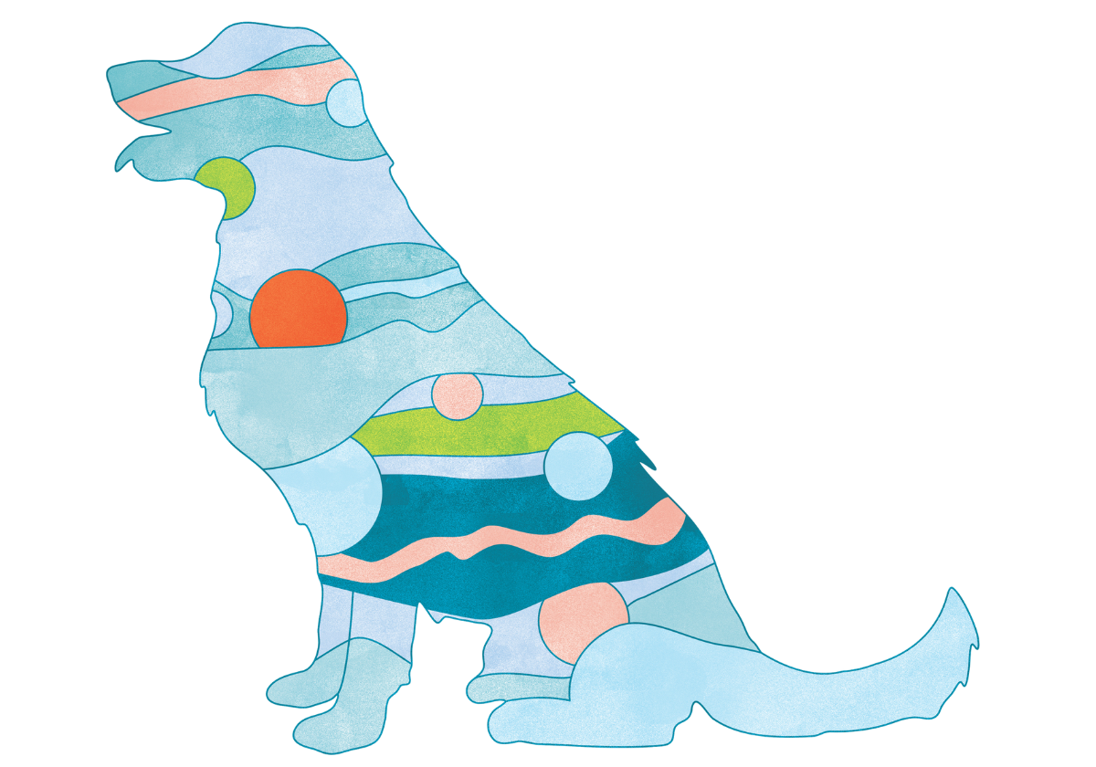
GABA Pet, LP815®
Improving health ​
through microbiome ​
innovation​
​
​

Slide 2


Improving health through microbiome innovation
Function-first science that opens nature’s toolbox to bring inspired microbiome solutions to our partners
B2B PARTNERS:
• Human Supplements
• Animal Supplements
• Functional Food
• Functional Beverage

Slide 3
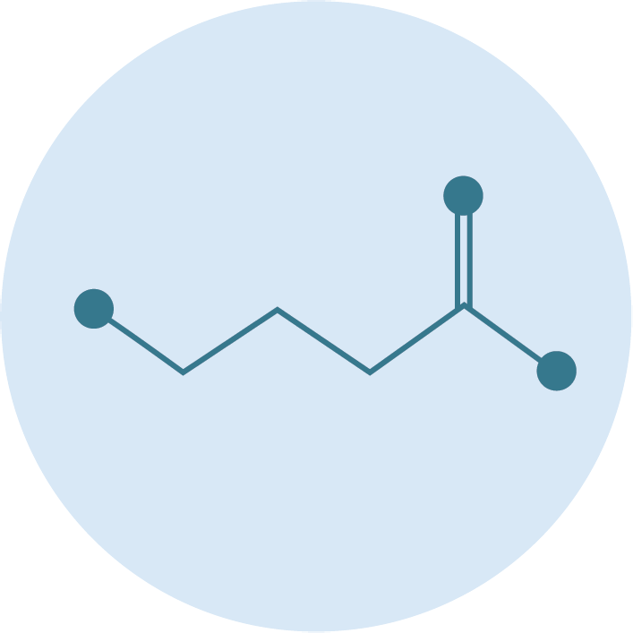
What is GABA?
A major inhibitory neurotransmitter: Gamma-Aminobutyric Acid (GABA) is a metabolite with a fundamental role in signaling the nervous system.
Main mechanism = slow the stimulation of certain nerve signals in the brain.
Provides a calming effect by preventing neurons from firing and regulating how quickly they react.
Notes:
Camille
KEEP

Slide 4




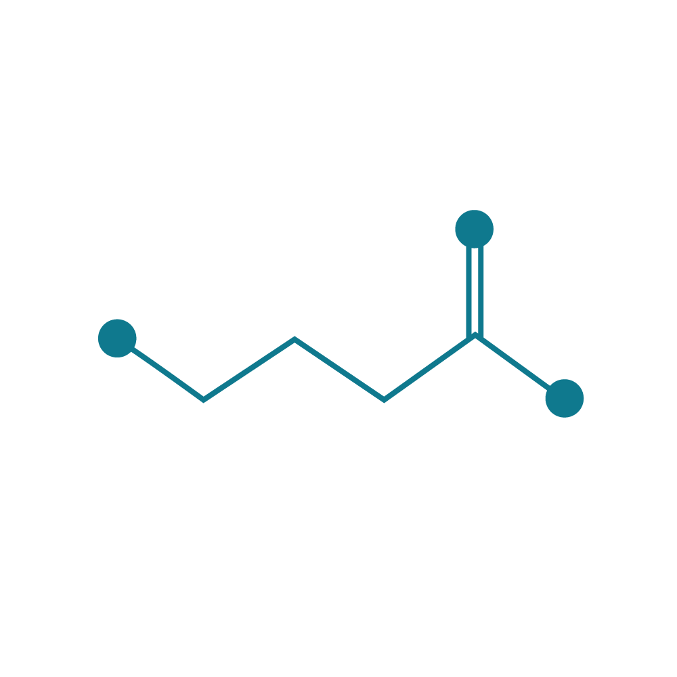

Function first, intentional design
STRAIN IDENTIFICATION/
OPTIMIZATION
HEALTH
INDICATION
MECHANISMS
OF ACTION
Regulatory
Clinicals
Scale
Stress/Mood/Irritability
Enables sustained GABA production
Lactiplantibacillus plantarum, LP815®, a proprietary strain of lactic acid bacteria
Add in canine mood, stress, anxiety, and sleep supporting formulas
Non-GMO, Kosher, Allergen-Free, Self-affirmed GRAS, Produced in USA

Slide 5

Comparative GABA Production
3
With advanced biotechnology, we searched over 250 million isolates to identify strains for GABA Probiotic within several months.
GABA Normalized per Pos. Con.
2
1
Benchmark
Lactiplantibacillus plantarum
LP815®
Notes:
We really wanted to understand what the landscape was overall, so we identified the top strains that produce GABA that were commercially available, and we benchmarked against those. From there we leveraged our relationship with Ginkgo Bioworks to be able to force some strains to produce more GABA through directed evolution. Through this effort, we screened over 250 million different isolates to to identify those that produce the most. When you look at this graph, what are you are looking at is a small subset of those isolates.
Note: strains not all L.Plantarum
L. plantarum 815 produces three times the amount of GABA compared to benchmark. This high production stems in part from its ability to uncouple the production of GABA from pH which is the main driver of what allows different strains within the gut to produce GABA. It can produce GABA at more of a neutral pH which you'll find in the gut as opposed to highly acidic pH, so at physiological concentrations of pH it produced higher amounts of GABA.

Slide 6

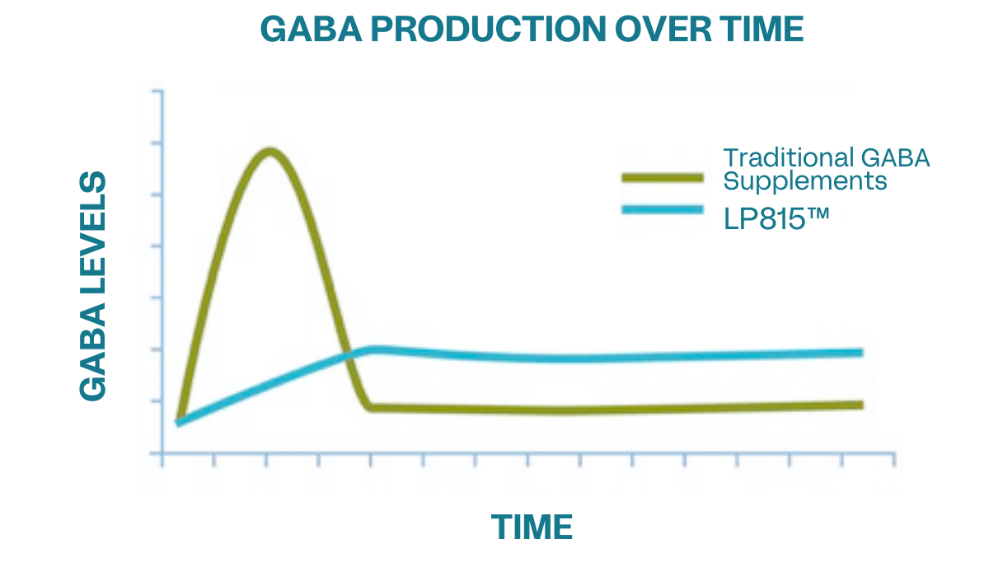
The LP815® Difference
A novel probiotic with robust, consistent GABA production within the GI tract.
  Unlike traditional GABA supplements, LP815® consistent release provides calming and stress modulation for canines.
Notes:
Diane - The advantage of taking a probiotic that produces GABA versus just taking a GABA supplement is that GABA produced by bacteria will provide a consistent, prolonged release of GABA over time as long as you're taking the probiotic. This is very different then what happens when you take a GABA supplement which delivers a bolus of of GABA at once. In this case, GABA levels increase and within 4-5 hours according to the data go back down to baseline levels. While GABA production from a probiotic would be more consistent, and we believe provide a sustained release product compared to the other options that are on the market.
Remove the text, LP815™ difference

Slide 7
Canine Trial Results
Notes:
To start out the presentation, I wanted to highlight a few high level insights when it comes to consumers and their awareness and interest in food and beverages containing ingredients that impact the microbiome. There is going to be a fantastic presentation and workshop by SPINs to discuss the beverage market in more detail this afternoon.

Slide 8

Verb Biotics x Treat Therapeutics: Caring for your Canines
A Better Approach to Pet Wellness: At Verb Biotics, we prioritize advancing pet health without disrupting the lives of the animals we aim to support
Real-World Research: Instead of traditional animal testing, we conducted an at-home clinical trial in partnership with Treat Therapeutics
Natural Environments, Meaningful Insights: By allowing dogs to stay in their everyday settings, we gathered authentic data on behavior, anxiety levels, and sleep patterns
Notes:
Remove the text, LP815™ difference

Slide 9
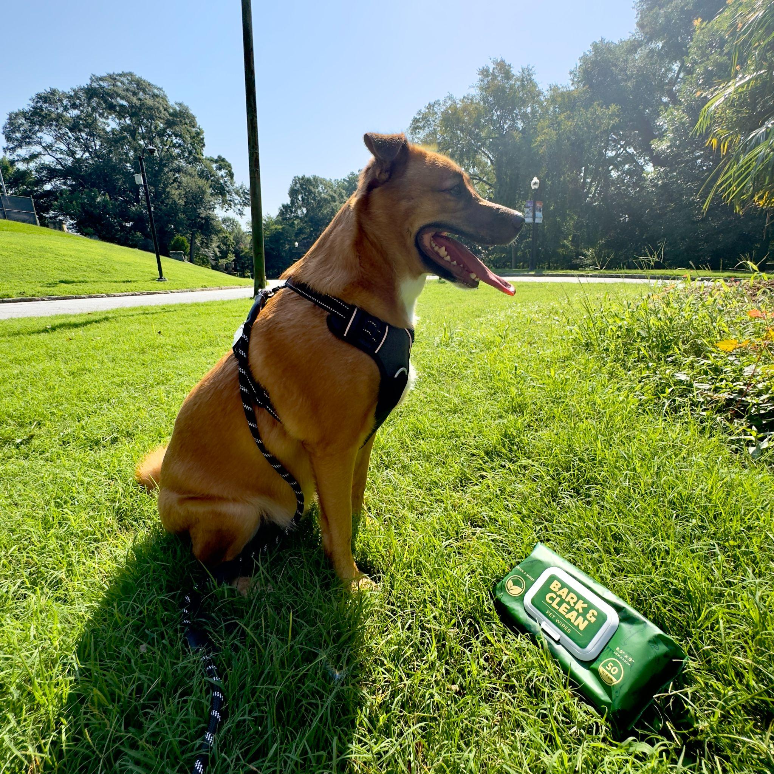
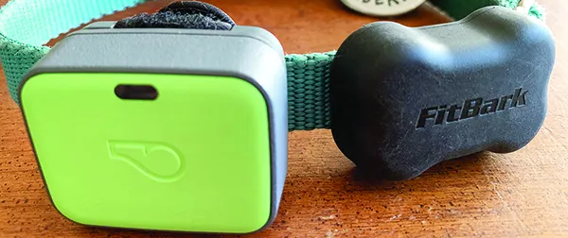
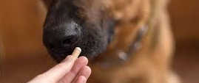



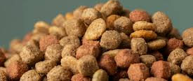

A demographically diverse, placebo controlled trial
40 enrolled dogs
2 Data sources (tracker & survey)
1120 Total doses
28 Days of intervention
1:3 Placebo:Treatment
23 Different breeds (large & small)
6 Diet types
0 Adverse events*
*assessed as dogs dropping out of the study due to owner reported adverse events

Slide 10
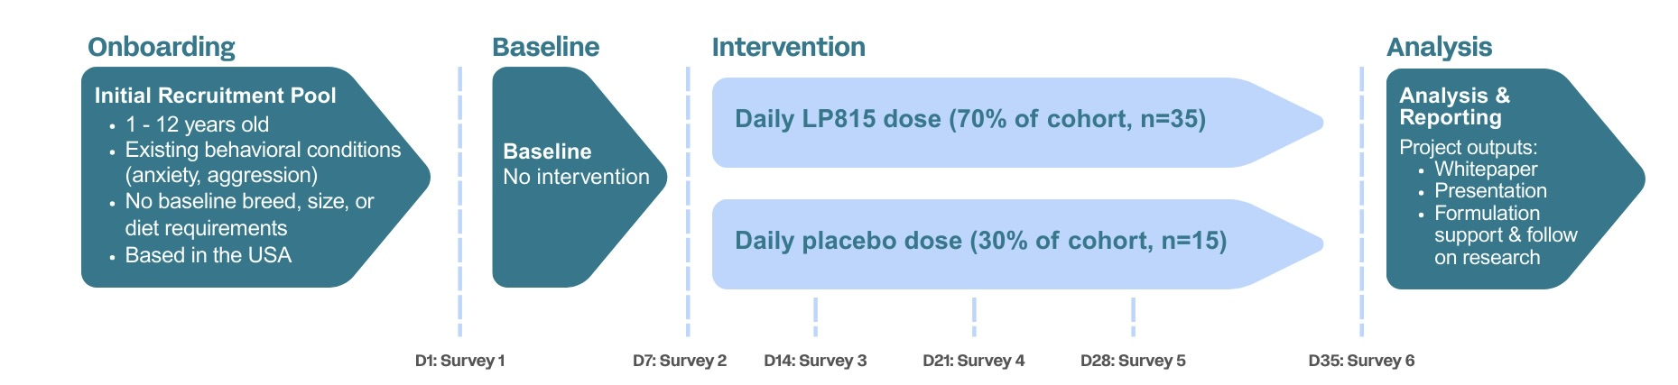
LP815™: Scientifically Proven Results for Calmer, Happier Dogs
All dogs recruited had baseline behavioral concerns (46% anxiety, 26% aggression)
Data points included C-BARQ surveys and a wearable canine activity tracker
Dose: 1B CFU (10mg) per 25lb body weight

Slide 11
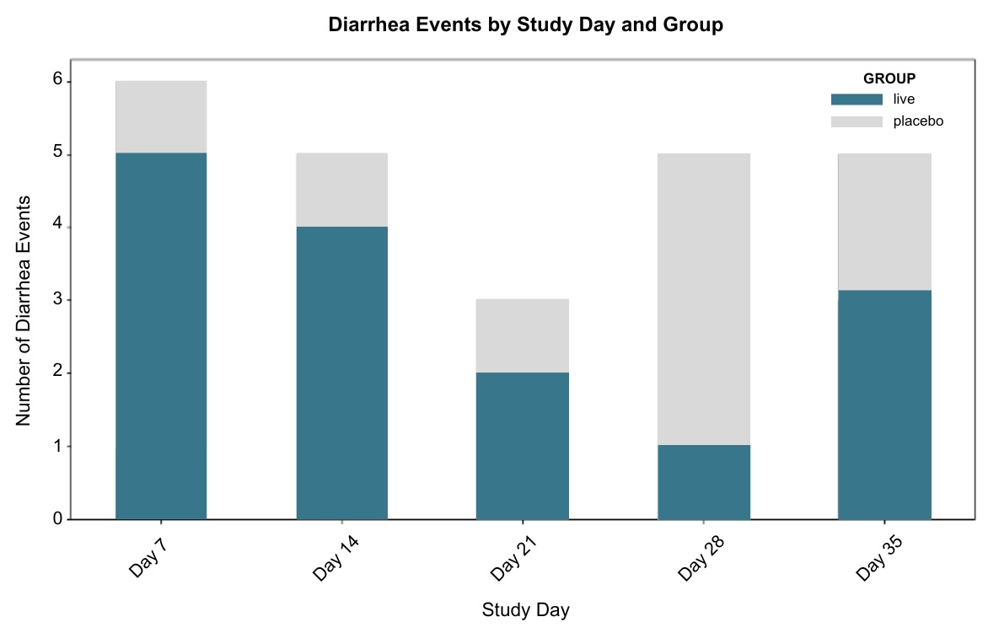

Gut Health Events
No significant differences were observed between treatment and placebo groups for adverse event reporting.
Notes:
Live group less than placebo

Slide 12
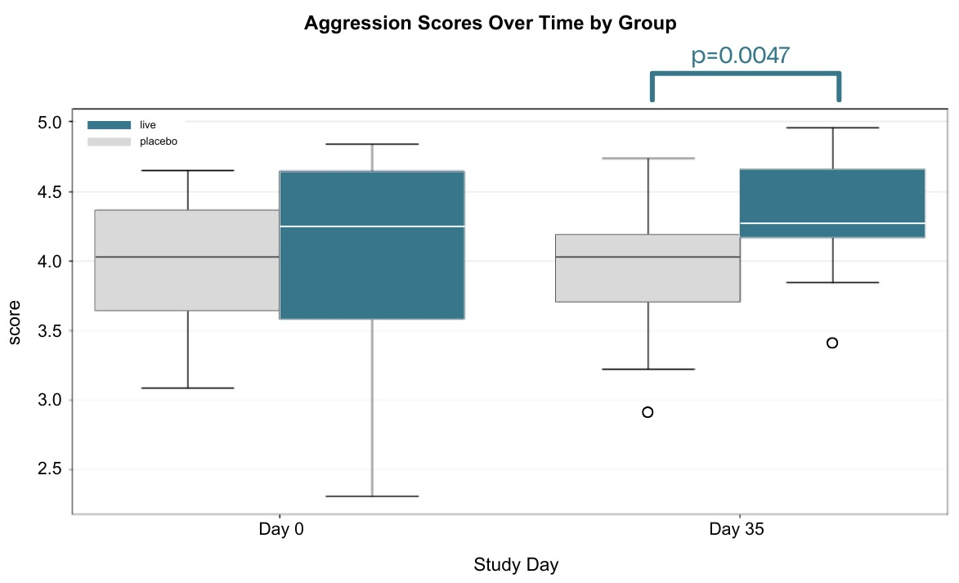
Aggression
Using the 100-question C-BARQ¹ veterinary assessment framework, pet-parents feeding the LP815® supplement reported statistically significant increases in scores for benefits of aggression markers.
Increased score = reduced aggression

Slide 13
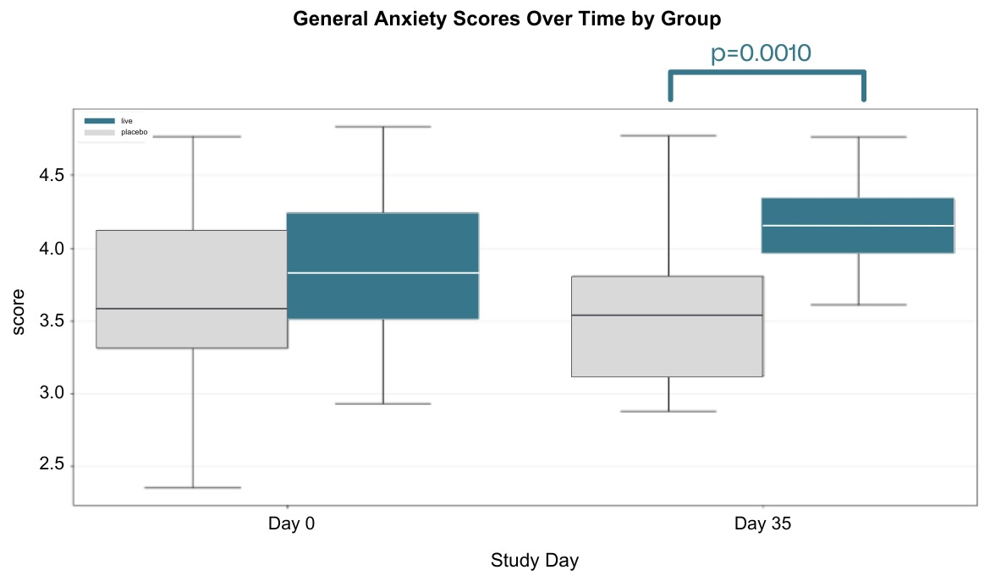
Anxiety
Using the 100-question C-BARQ¹ veterinary assessment framework, pet-parents feeding the LP815® supplement reported statistically significant increases in scores for benefits of anxiety markers.
Increased score = reduced anxiety

Slide 14
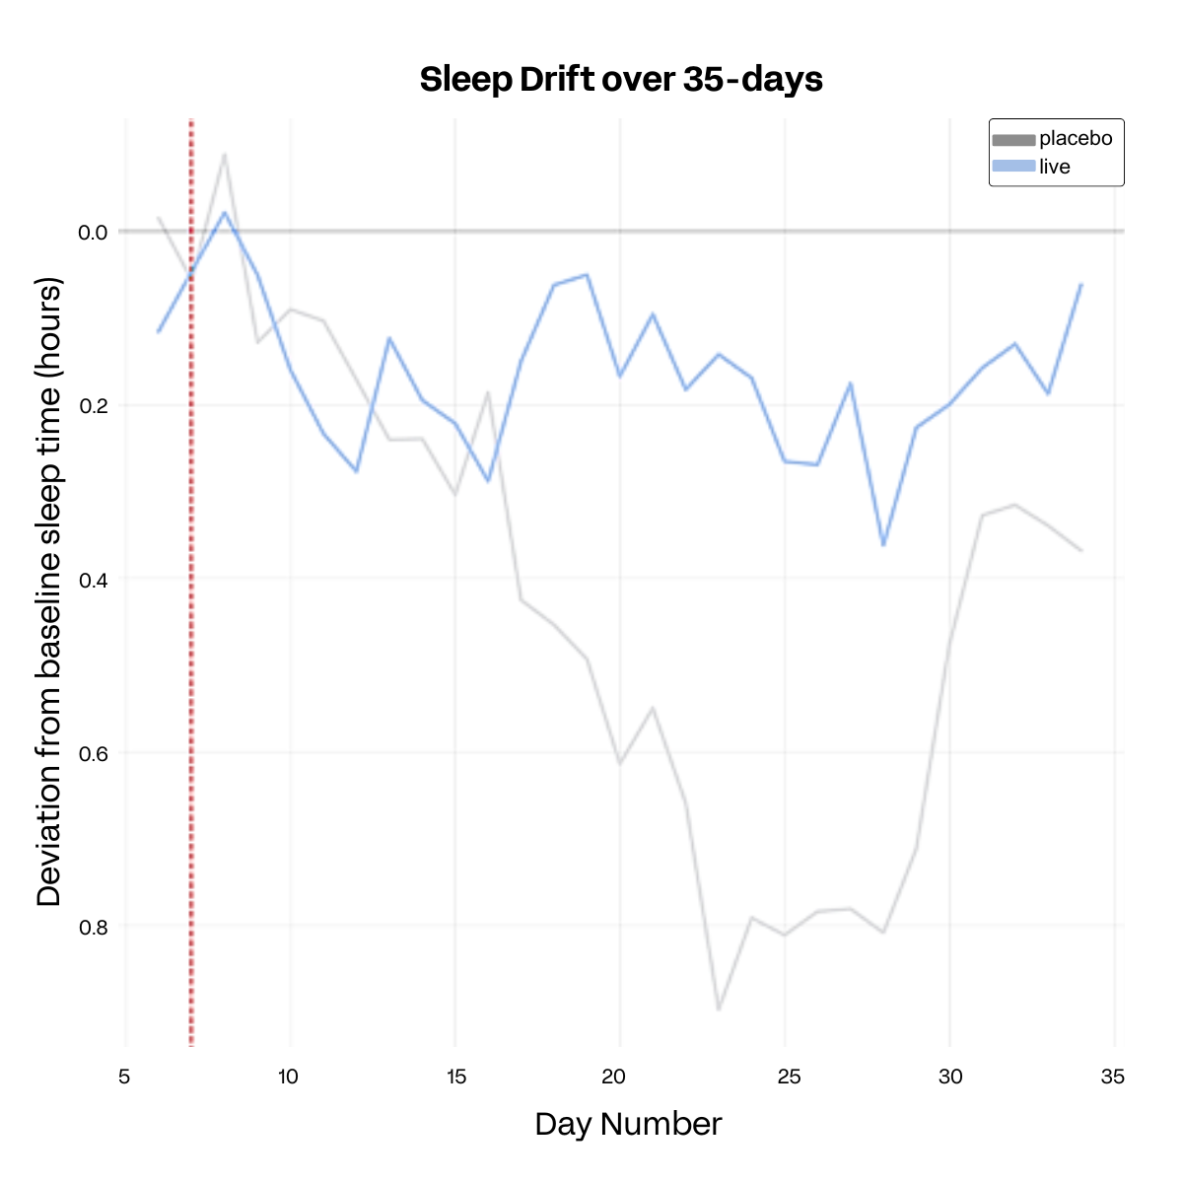
Sleep
Dogs on the LP815® supplement demonstrated more consistent and efficient sleep patterns compared to those on placebo. Their sleep schedules remained stable, with slightly earlier wake times, indicating improved sleep quality.
Notes:
Dogs were napping less, but their sleep quality at night was higher. Consistency (change chart to LP815 vs live)

Slide 15
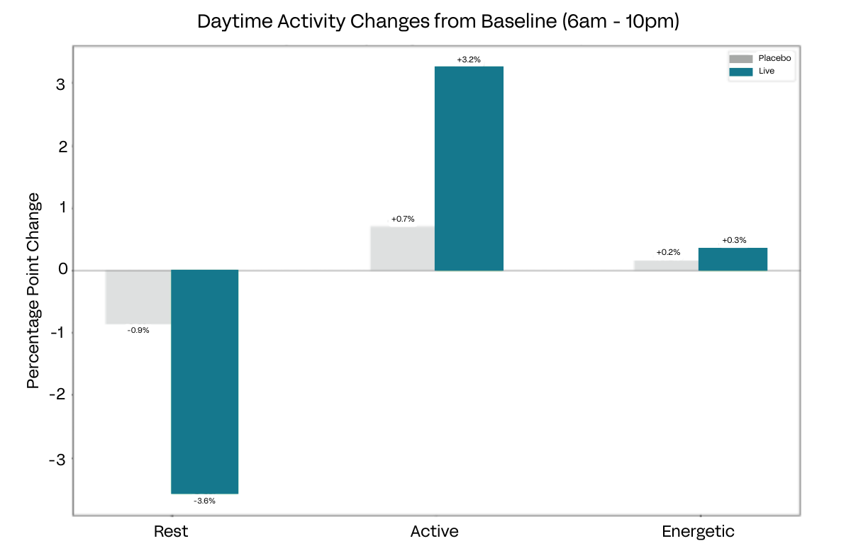
Activity
Daytime Activity Changed from Baseline (6am – 10pm)
Dogs on LP815® showed a more balanced activity pattern, with less daytime sleep replaced by increased moderate activity. High-energy periods remained stable, indicating improved behavior without lethargy—less so than placebo.
Notes:
3 activities – sleep, moderate activity and play/excitable (change energetic to play?)

Slide 16
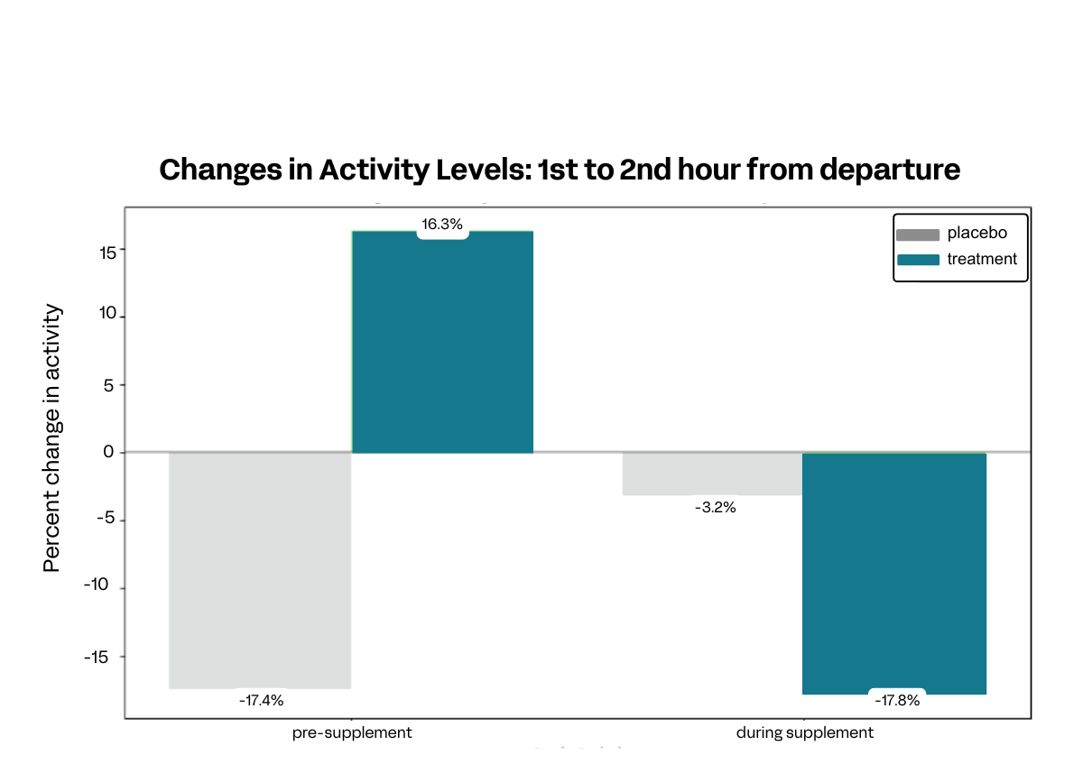
Settling Behavior
Dogs on LP815® demonstrated increased settling behavior, with a significant reduction in second-hour activity levels during the supplement phase. This suggests potentially reduced anxiety traits following owner departure compared to placebo.

Slide 17
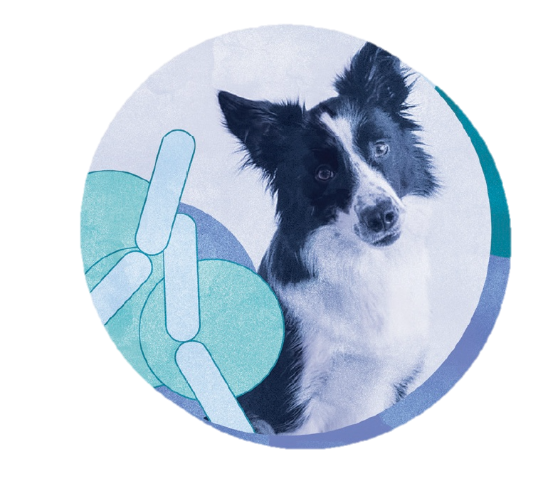
Conclusions
The GABA Pet, LP815® supplement:
✔ Decreased anxiety & aggression markers
✔ Decreased activity levels without lethargy
✔ Increased sleep consistency
✔ Increased morning energy levels
✔ Decreased settling down time when left alone
In dogs with existing behavioral concerns.

Slide 18




GABA Pet, LP815
MULTI BENEFIT
LOW DAILY DOSE
1 Billion CFU (10mg) per 25 lbs body weight
APPLICATIONS
Food topping powders
Hard chews
Capsules
Supports decreased anxiety
Supports decreased aggression
Supports restorative sleep

Slide 19
Applications

Slide 20

GABA Pet, LP815 Applications
With a low dosage of 1 Billion CFU* per day, LP815 can easily be incorporated into:
Food-topping powders
Soft chews
Hard chews / tablets
Powder supplements / capsules
*10mg per 25 lbs

Slide 21
Testimonials

Slide 22


“Bear is much less anxious, particularly around new guests & other dogs”
“Noticeable change in his mood / excitement at night, feels more playful and happy”
“Knox is less nervous and much more playful. He's acting like a puppy even in the evenings”
“Seems calmer. still jumpy and excitable but much less than when we first started.”
“Rue was the most confident I've ever seen her this week! She let a new visitor to our home pet her. That never happens!”
“Thank you so much for allowing us to join this study. Rue has been so calm throughout since giving her the supplement, and she is much more social than she's ever been.”
“He’s better with car reactivity, we’re able to walk past busy streets without him reacting as much!”

Slide 24
Appendix

Slide 25
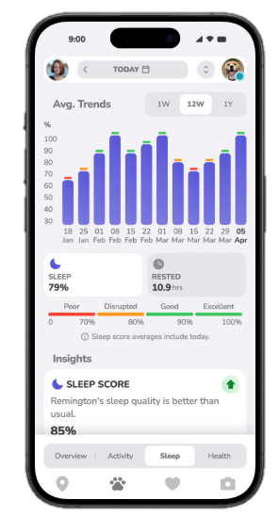

FitBark:
Wearable activity tracker
Activity levels: Categorized as "rest", "active", and "play" time
Sleep quality: Measures the quality of a dog's sleep
Calorie burn: Estimates the number of calories a dog burns based on its activity

Slide 26
What is the C-BARQ?
The C-BARQ is a survey aimed at dog owners/guardians and handlers that provides a set of numerical scores for the following fourteen different categories of dog behavior:
Stranger-directed aggression: Threatening or hostile responses to strangers approaching or invading the dog's or owner's personal space, territory, or home range.
Owner-directed aggression: Threatening or hostile responses to the owner or other members of the household when challenged, manhandled, stared at, stepped over, or when approached while in possession of food or objects.
Dog-directed aggression: Threatening or hostile responses when approached by unfamiliar dogs.
Dog rivalry: Threatening or hostile responses to other familiar dogs in the same household.
Stranger-directed fear: Fearful or wary responses when approached by strangers.
Nonsocial fear: Fearful or wary responses to sudden or loud noises, traffic, and unfamiliar objects and situations.
Dog-directed fear: Fearful or wary responses when approached by unfamiliar dogs.
Separation-related behavior: Vocalizing and/or destructiveness when separated from the owner, often accompanied or preceded by behavioral and autonomic signs of anxiety including restlessness, loss of appetite, trembling, and excessive salivation.
Attachment and attention-seeking: Maintaining close proximity to the owner or other members of the household, soliciting affection or attention, and displaying agitation when the owner gives attention to third parties.
Trainability: Willingness to attend to the owner, obey simple commands, learn quickly, fetch objects, respond positively to correction, and ignore distracting stimuli.
Chasing: Chasing cats, birds, and/or other small animals, given the opportunity.
Excitability: Displaying strong reactions to potentially exciting or arousing events, such as going for walks or car trips, doorbells, arrival of visitors, and the owner arriving home; has difficulty settling down after such events.
Touch sensitivity: Fearful or wary responses to potentially painful procedures, including bathing, grooming, nail-clipping, and veterinary examinations.
Energy level: Energetic, “always on the go”, and/or playful.

