Slide 1
Keystone Postbiotic
Revitalizes ones existing gut microflora
February 2026

Slide 2
Sales Positioning/Angles
Keystone is not just a digestive health solution, it’s an essential foundational health solution
Keystone repatterns / revitalizes one’s existing microbiome’s microbial network
Long-term resilience over short-term symptom relief
MOA: Microbiome (ecosystem) modulation through native microbial collaboration
  ~ It’s so much more than a typical digestive health postbiotic or a prebiotic ~

Slide 3
The Problem
The market lacks gut health and microbiome solutions that deliver meaningful benefits with unlimited product applications.
Why did we develop Keystone?
What we know
The gut microbiome functions as a central integrative hub connecting digestion, immunity, metabolism, mental wellness, hormones, and overall health.
Our Solution
Revitalize the functional balance of our gut microbiome by a highly compatible, versatile precision biotic.

Slide 4
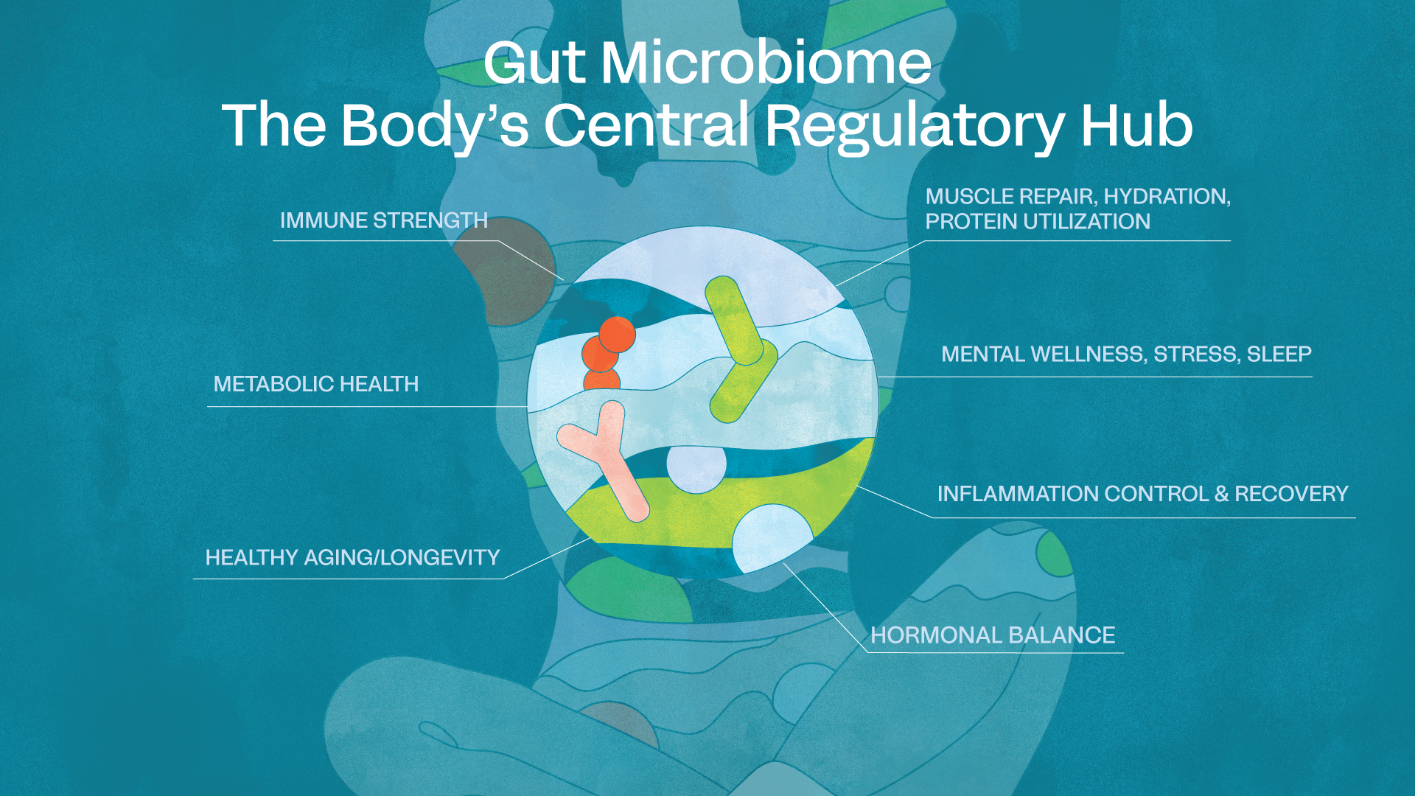

Slide 5
MOA → highly targeted microbiome modulation, strengthening the performance of specific beneficial microbes already present in the gut while reducing the rise of harmful microbes.
Foundational gut health isn’t about adding more microbes, it’s about strengthening the ecosystem that’s already there.
It’s not just gut health, its whole-body resilience, from the inside out.

Slide 6
A one-liner describing Keystone
Keystone Postbiotic interacts with native gut microbes to enhance functionally beneficial keystone species, strengthening the gut microbiome ecosystem from within.

Slide 7
Keystone MOA Flywheel Example
Precision Driven, SCFA flywheel: Compared to prebiotics like inulin or fiber, Keystone is a more directed MOA to strengthen foundational gut function.
Keystone increases Bifidobacteria
Bifido increases lactate and acetate
These metabolites fuel butyrate producers
Butyrate improves mucin turnover in the colon
Increased mucin supports Akkermansia growth
Akkermansia generates more acetate
The entire cycle repeats, creating a self-reinforcing metabolic loop

Slide 8
Formulation Positioning
Foundation & Stack Compatibility
  Foundational ingredient for microbiome, gut, and immune health
  Enhances pre, pro, and postbiotic formulations
  Enables next-generation microbiome stacks
Unlimited Formulation Opportunities
  Compatible with beverages, powders, bars, capsules, and chocolate
  Stable across processing and shelf conditions
  Low water activity; compatible with acids, botanicals, and actives
  Not suitable for kombucha fermentation environments
Superior Consumer Experience
  No fiber load or GI distress
  Acts like a prebiotic without tolerance issues
  Neutral taste and easy integration
Commercial Advantage
  Enables microbiome benefits in everyday formats
  Expands product innovation without reformulation challenges
  Supports premium positioning and differentiation

Slide 9
I Feel the Effect….
800% increase in beneficial endogenous bacteria linked to butyrate production, barrier integrity, and metabolic signaling​
68% of participants experienced an increase in emotional wellbeing & mood​
IL-8 participant rate of change lowered, suggesting improved immune function​
Salivary Cortisol significantly decreased (p-0.03) and serum butyrate increased (p=0.053)
Greater than 50% decrease in gas and bloating

