Slide 1
GABA Probiotic, LP815®
Sustained and stable GABA release for sleep & stress support
February 2026

Slide 2
Sales Positioning/Angles
Sustained and long-term GABA signaling through microbial production rather than acute dosing (a factory)
Release profile: sustained & consistent vs. fast & short
Quality of life/Wellness solution vs. acute, immediate relief
Dual action stress & sleep support
For those who want nervous system resilience
Backed by 2 successful clinical trials supporting efficacy for stress & sleep

Slide 3
The Problem
Most sleep and stress ingredients as well as current GABA supplements provide short-term relief.
Why did we develop LP815?
What we know
Certain bacteria work with existing microflora in the gut to produce endogenous GABA.
Our Solution
Deliver strains in the gut that create a ‘GABA factory’ for consistent GABA signaling.

Slide 4
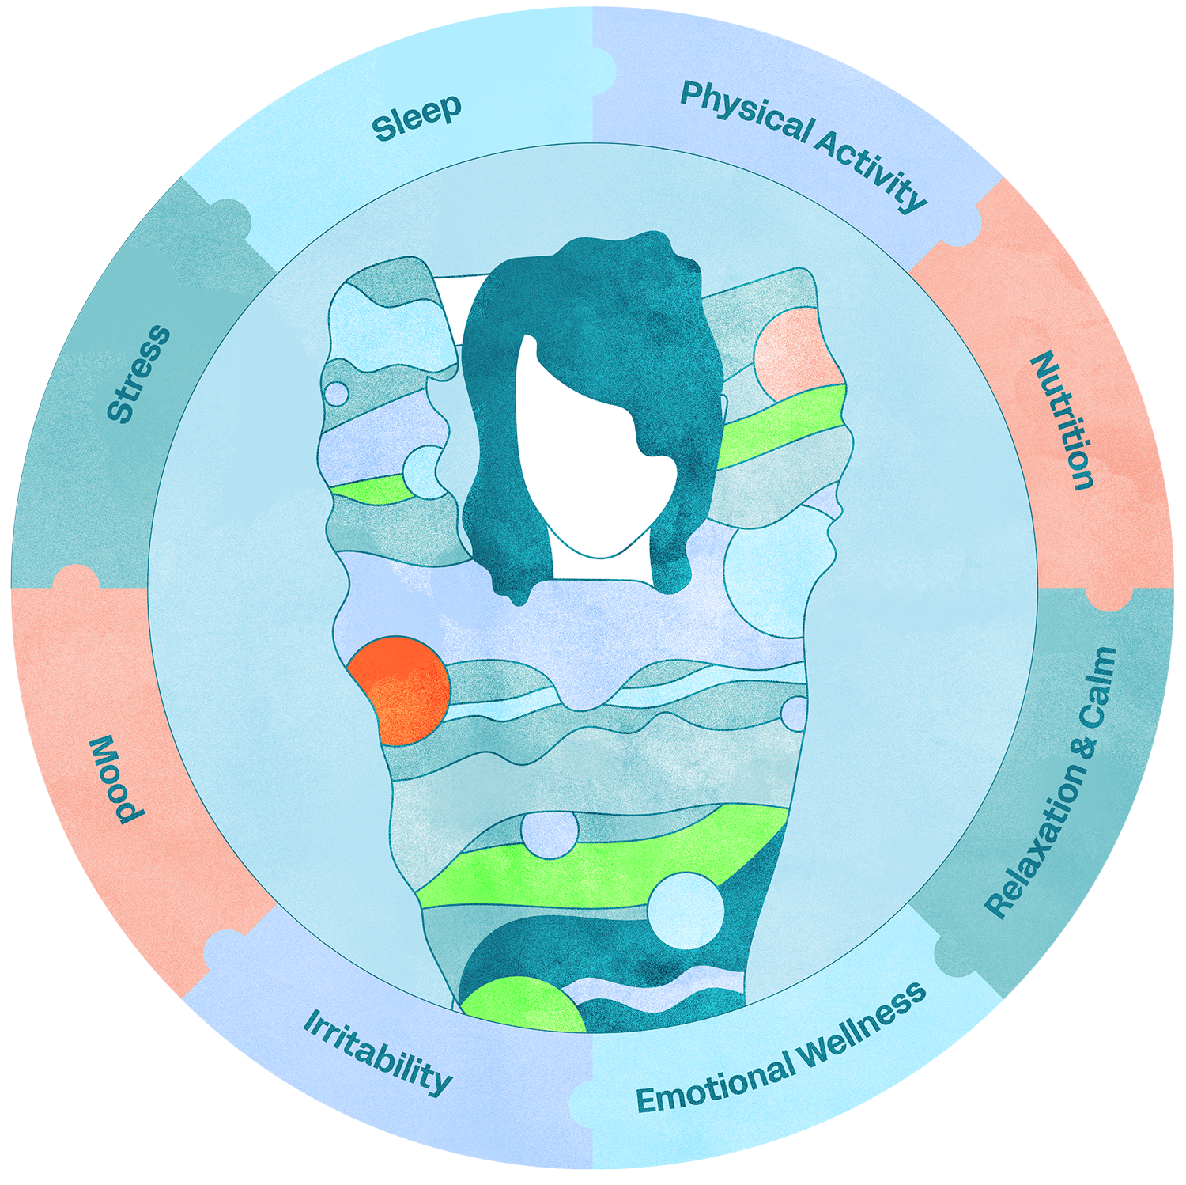
GABA, the calming neurotransmitter, impacts many aspects of our health.

Slide 5

MOA → LP815 supports sustained GABA signaling through microbial production in the gut, creating a GABA factory for consistent release.
LP815 works with the existing gut microflora to
create a consistent and long-term release of GABA.
Your body feels the benefit before you do - Elevated stable GABA levels by 7 days correlated to better sleep quality and mood.

Slide 6
A one-liner describing GABA
"LP815 acts as a GABA factory in the gut, signaling microbial production that increases GABA production for sustained and long-term GABA release."

Slide 7
Audience Profile for LP815
Consistent Sleep & Stress maintenance
Those who want long-term nervous system resilience
Fewer middle-of-the-night awakenings
More consistent sleep week-to-week
Less next-day fallout (mood, resilience, exhaustion)
Lifestyle health plan – your Mediterranean diet – Longevity – long-term wellness/health

Slide 8
Formulation Positioning
Hero ingredient for stress/sleep formulations
Complements acute/fast/short release ingredients for stress & sleep
Add to women’s health solutions – strain is compatible with vaginal health strains
Use as a non-drowsy, no next day grogginess, no GI distress
Builds effects with consistent daily use
Doesn’t compete with supplements that compete on speed

Slide 9
"I Feel the Effect"
68% reduction in stress
77% improved sleep
100% of women participants improved sleep
10% experienced an increase in deep sleep
Women experienced a 40% decrease in night sweats
Urinary GABA levels rose by day 7 and remained elevated by week 6

